Slide 1
McAfee Governance, Risk and Compliance (GRC) Portal:
Implementing a Policy, Compliance, Risk and Security
Awareness Program
Bill Dalrymple Jr.
Sr. Manager, Policy and Compliance, Global Security Services
McAfee
Harold Toomey
Sr. Compliance Engineer, Policy and Compliance, Global Security Services
McAfee
Notes:
Bill Dalrymple
Sr. Manager of Policy and Compliance for Global Security Services reporting to McAfee’s Chief Security Officer.
PMP, CISA, and CGEIT and has been in IT in various roles for over 20 years. With McAfee since 2005
Oversight of security awareness, policies, and compliance for one of the best security companies in the world, including:
SOx, PCI, ISO 27001 certification,
all the regulations and policies you can eat in one sitting, and
a world class Security Awareness and Training Program we call Security Matters.
Harold Toomey
Sr. Compliance Engineer with McAfee Global Security Services in Plano, TX.
With McAfee for 4½ years.
Over 15 years of information security experience in both private industry and in the military
Worked as a product manager for McAfee’s GRC business unit for the past four years before switching over to the operational side of security in January.
Harold is currently responsible for McAfee’s policy architecture and new policy portal which manages all of McAfee’s corporate policies.

Slide 2


Agenda
Managing GRC
GRC at McAfee
Summary
Q&A
Notes:
McAfee on McAfee: Building a GRC Portal and McAfee’s implementation of Policy, Compliance, Risk and Security Awareness
Are you responsible for your company’s IT compliance or security policies?
Do you have a mature security awareness and training program (SATP) that meets security and compliance requirements?
How are you managing risk?
We have wrestled with the same challenges you have

Slide 3
Agenda
Managing GRC
GRC at McAfee
Summary
Q&A
Notes:
Today we want to talk to you about our implementation of a Governance Risk and Compliance Portal which is helping us to:
1) Automate compliance audits for PCI and SOx
2) Manage corporate security policies, update them continuously with a real workflow, and map them to corporate business initiatives
3) Integrate tools such as ePO, Foundstone, Configuration Control to manage risk and automate compliance
4) SATP – Deliver an effective Security Awareness and Training Program

Slide 4



The McAfee Environment
The view inside our world -
across 42 countries and 81 cities
Overwhelming levels of unpredictability
Every 30 seconds a new malicious website detected
40M Active new zombies per month
104% increase, or a doubling of malware from 2008 to 2009
90%
4 billion queries to Global Threat Intelligence per day
2 billion security events per month
55,000 malware identified each day
85% malware is obfuscated
Mining the threats
requires a new level
of sophistication
Of all threats are financially motivated*
Statistics from internal McAfee sources including McAfee Labs Quarterly Threat Reports, and Global Security Services operational data.
* According to data collected from the U.S. Computer Emergency Readiness Team (US-CERT) at the Department of Homeland Security
Notes:
To underscore the significance of cyber threats,
40+ US states have laws on security breaches and notification requirements
International incidents and requirements are growing at a rapid pace, too.
There is a proliferation worldwide of Privacy regulations.
And if there was any question,
Operation Aurora taught us: that intellectual property is valuable, perhaps even more valuable than money, so it should be properly secured.

Slide 5
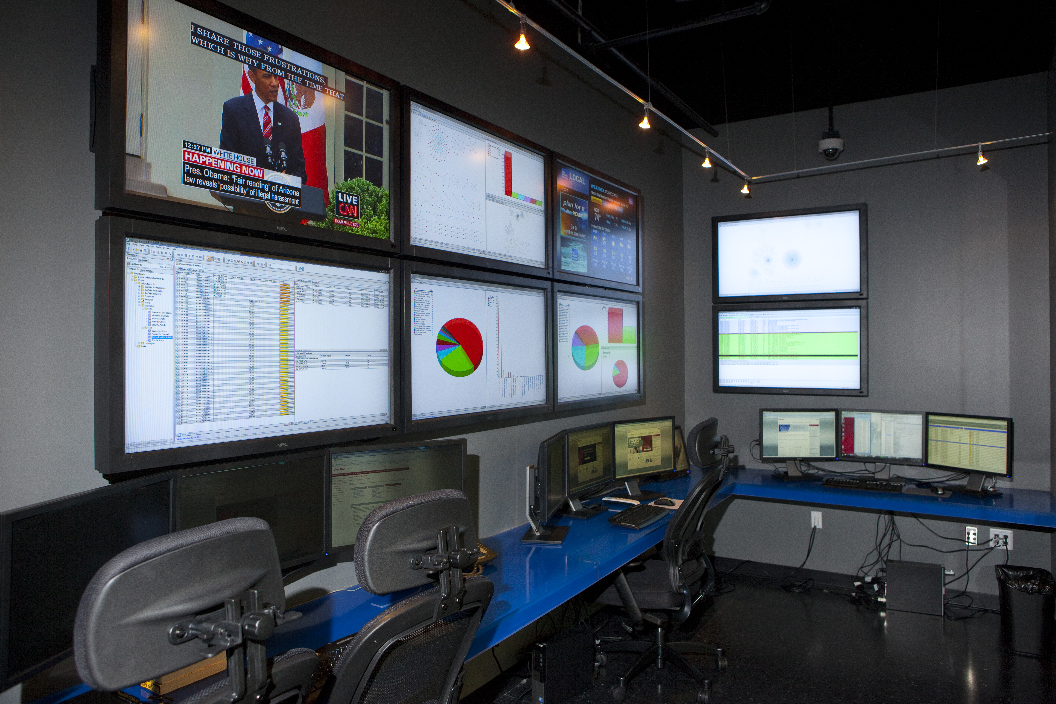
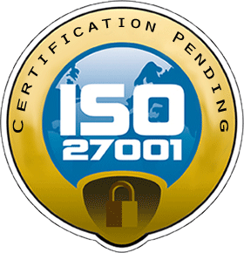





McAfee Global Security Services (GSS)
FY10 Initiatives
Security Operations Center
McAfee in Action
ISO 27001 Certification
Corporate Security Infrastructure Upgrade
Emergency Response Program/GEARS
Security Awareness Training Program
GRC Portal
GRC Portal
Policy
Compliance
Vulnerability & Risk
Awareness
Notes:
As members of Global Security Services
Our Mission
Build world-class security capabilities that protect McAfee’s assets,
accelerate business growth, and showcase McAfee products at work.
We have a number of initiatives in GSS to achieve this mission and as Sr. Manager of Policy and Compliance…
Our goal is to develop policies that manage compliance and keep McAfee secure while enabling McAfee’s business.
Security must be pervasive but not disruptive to business.

Slide 6

Impact on McAfee and Our Customers
McAfee
GSS
Data Center Management
Legal
Business Recovery Coordinators
Global Network Command Center
Global Audit Services Group
Internal Audit
GSS Policy & Compliance Team
Engineering
Sales
Policy
Compliance
Privacy
Support
Marketing
Audit Support
Training & Awareness
Help Desk
McAfee Business Sectors
IT Support
Finance
Human Resources
Supply Chain
= SLAs
Notes:
But developing policies and managing compliance that meet this goal can be challenging…
Interrelationship of departments for policies and compliance

Slide 7
Agenda
Managing GRC
GRC at McAfee
Summary
Q&A
Notes:
Now let’s talk about GRC at McAfee…

Slide 8
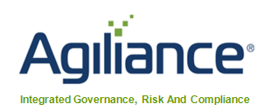
McAfee’s GRC Portal
Governance, Risk and Compliance (GRC) Portal
GRC impacts the entire organization, so cross-functional inputs were taken into consideration in its planning, design and procurement
GRC Portal
Policy
Compliance
Vuln. & Risk
Awareness
Key Considerations
Workflow
Ownership
Change tracking
Risk calculator
Common controls
Notes:
We knew we needed a tool to help us manage all the different areas of policy, governance, risk and compliance.
What is the GRC Portal?
The Governance, Risk and Compliance (GRC) Portal is a central repository for all policies, standards and guidelines on global, regional and local levels and manages ongoing compliance with the vast array of industry, regulatory and other requirements.
As GRC impacts the entire organization, cross-functional inputs were taken into consideration in its planning, design and procurement.
We wanted a GRC tool that would:
* Provide an integrated web-based solution for global risk management and compliance
* Create a system to track policies to regulations on a global scale, capable of regional and local customization
* Facilitate the determination of intelligent, risk-based levels to manage policies and take action
* Offer real-time dashboards and metrics

Slide 9

GRC Portal – Timeline
CY’10
What’s Next
Q4 ‘09
Q1 ‘10
Q2 ‘10
Q3 ‘10
Q4 ‘10
Q1 ‘11
October
GRC Vendors Researched
January
P&C Team
Trained
April
Policy Ack.
Survey
July
SOx 404
Audit
October
Vuln & Risk, Depts. Trained
January
Vendor Mgmt.
November
Vendor
Selected
February
PCI Audit
May
TVM, MVM
Connector
August
Corp. Policies
Managed
November
ePO
Connector
February
Map Policy & Vulns. to Controls
December
Tool
Installed
March
McAfee Security Policy Managed
June
IT Policies Managed
September
SOx 302
Audit, Policy Template
December
ISO
Certification
March
Risk Driven GRC
NOTE: future dates are for planning purposes only
Notes:
9
GRC Portal – Timeline
Q4’09 – Vendor selection, Proof of Concept and
Dec ‘09 – Installed at McAfee
Q1’10 – Policy & Compliance Team trained,
IT policies imported and
Feb ’10 – 1st assessment launched – PCI Audit
Q2’10 – Completed workflows for management of all IT policies,
launched a Security Policy Attestation,
installed Foundstone connector
Q3’10 – initiated corporate wide policy management project,
annual SOx 404 Audit and our quarterly SOx 302 assessment,
completed installation of the Risk module
Q4’10 – Now we are integrating Risk and vulnerability capabilities into current processes
2011 – Moving toward of a fully implemented risk-based governance, risk and compliance portal
that allows us to oversee all aspects of security and compliance from a central location.
– GRC roadmap next steps – integration of Risk, TVM, ePO, Policy Auditor, and DLP…

Slide 10
Key GRC Components
Policy
Compliance
Risk Management
Security Awareness and Training
Notes:
The next thing Harold and I will do is walk you through the various aspects of the GRC Portal, some of the challenges we have faced, how we are using the tool for overall Governance, and where we are going.
We’ll cover these four areas:
Policy
Compliance
Risk Management
Security Awareness and Training

Slide 11
Policy Management Maturity
Non-Existent
Initial
Developing
Defined
Managed
Optimized
LEVEL OF POLICY MATURITY
0
1
2
3
4
5
Blissful Ignorance
Awareness
Corrective
Operational Excellence
Policies Mapped to ISO,
All Stakeholders Identified
Auto-Change Tracking,
Auto-Notification
Risk Driven
Policy
Automated
Workflows
Relative Maturity
Search All Policies
Primary Owner Identified,
Workflows Defined
PDFs on Intranet
Verbal Policies
HTML Policies
Printed Policy Docs
10%
10%
30%
35%
10%
5%
McAfee Current State
Notes:
Let’s start with Policy… Policy undergirds everything we do. NEXT SLIDE: HAROLD
When we first started we had policies all over IT and the company, with policies in areas we didn’t even know about.
DBAs had policies, Operations had policies, HR even had some IT policies.
And we sometimes had three or four versions of the same policy in three different areas.
From stacks of printed policies with numbered sections and buried content, with multiple versions of the same policy throughout the business, ownership confusion, and email approvals with “routing slips” that leave gaps and liabilities whenever changes are needed.
HAROLD
Analyst: Bill, it was even worse than that. As I implemented this I found:
Couldn’t find original Word docs, just PDFs
Some docs last updated in 2002
I found every company logo over the past 10 years, even NAI
BILL
With our GRC tool, we could now begin the process of making a paradigm shift in how we managed policies.
From scattered and outdated policies to dynamic policies under an overall umbrella architecture that allows policies to stand alone but in relationship to every other policy in the organization. And with managed approval flows, revision histories, change tracking, and the ability to actually find a company policy when you need it.
NEXT SLIDE: HAROLD

Slide 12


McAfee Security Policy Architecture
McAfee Security Umbrella Policy
Mapped to ISO 27001
POLICY
A.6
POLICY
A.10
POLICY
A.7.1.3
POLICY
A.9
Information
Security
POLICY
A.7.2.1
POLICY
A.8
Comm. &
Operations Management
Acceptable
Use
Physical
/ Env.
IP / Data
Classification
HR
POLICY
A.11
POLICY
A.10.7
Access
Control
POLICY
A.12
POLICY
POLICY
A.13
POLICY
A.15.2
Electronic
Media
IS Acquisition,
Dev. & Maint.
POLICY
A.14
POLICY
A.15
Change
Management
Incident
Management
(SIRP)
PCI
Business
Continuity
(BCP)
Compliance
Laws
Notes:
HAROLD: My task was to:
Learn the tool
Architect gaps and overlap
Implement
Policy Management
Getting our own house in order:
Inventory all policies and procedures
Dept., name, link, scope, current, last time reviewed
Post policy PDFs on our Intranet
Define a corporate-wide policy architecture
Import policies into the GRC Portal
Assign ownerships to each policy so they can be managed using a common workflow
Owner, author, reviser, reviewer, legal, approver, exec. approver
Train departments on how to manage changes through the workflow
Lessons Learned:
Both Legal, HR and GSS were trying to solve the same problem
Acquired BU policy updated and renamed “McAfee Corporate Info Sec Policy”
Handoff of GRC Portal to IT OPs
Our McAfee Security Policy is organized and mapped to ISO 27001 Annex A, followed by:
PCI, CobiT, FISMA, and NIST 800-53

Slide 13
Policy Workflow in the GRC Portal
Architecture
Implementation
Stakeholders
1. Draft Policy
Stage 1 – Draft Policy
Policy Author
Approved
Submitted
2. Revise Policy Draft
Stage 2 – Revise Policy Draft
Policy Reviser
Denied
Updated
Policy Reviewers
GSS
HR
Legal Dept.
Stage 3 – Review Policy
Skip Legal
3. Review Policy
Denied
Approved
Stage 4 – Legal Review
Policy Legal Owner
Denied
Approved
Stage 5 – Approve Policy
Policy Approver
4. Approve Policy
Denied
Approved
Skip Exec
Stage 6 – Executive Approval
Policy Exec Approver
Denied
Approved
Optional
Stage 7 – Publish Policy
Primary Owner
Notes:
So we can now move out of the business of policy logistics, and chasing down approvals, and explaining why a policy in IT should override a policy in Legal or why elements of Legal’s policy isn’t incorporated into our master policy set. And now we move into the business of defining policy and let the tool and the workflow help us manage the policy process.
Names to roles (stakeholders) ➔ Automated
Here’s what it looks like in the tool…

Slide 14
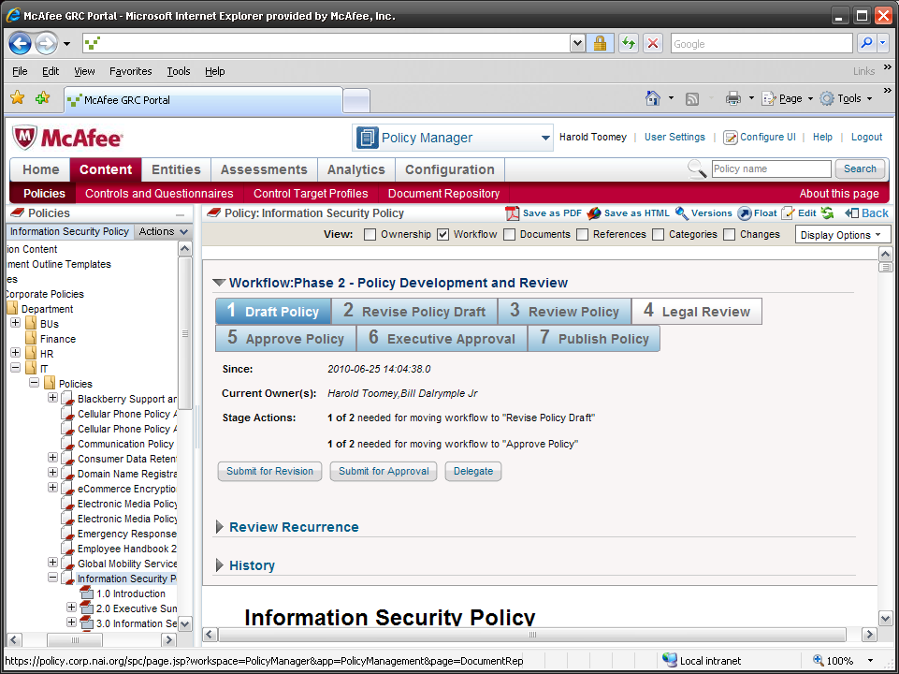
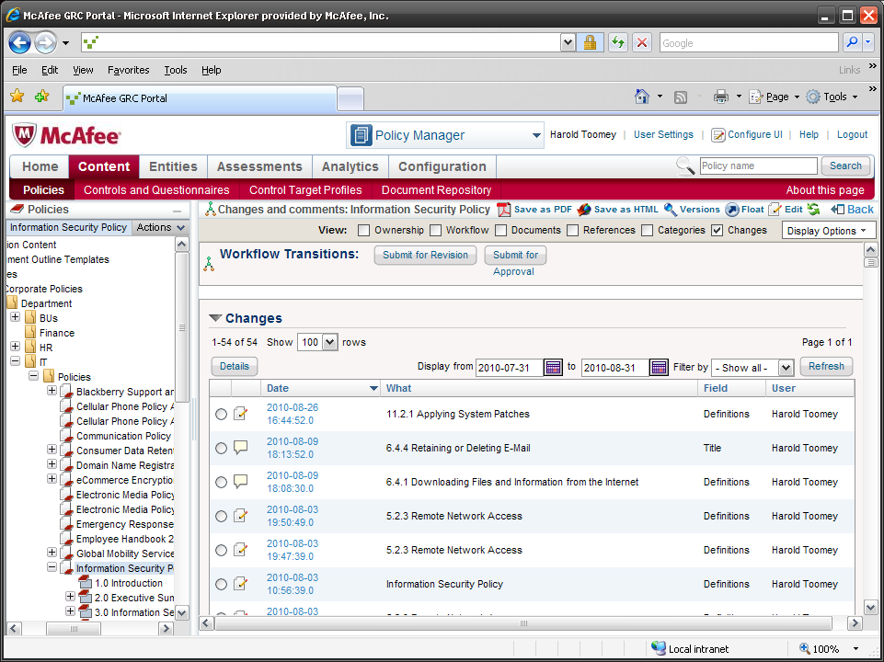
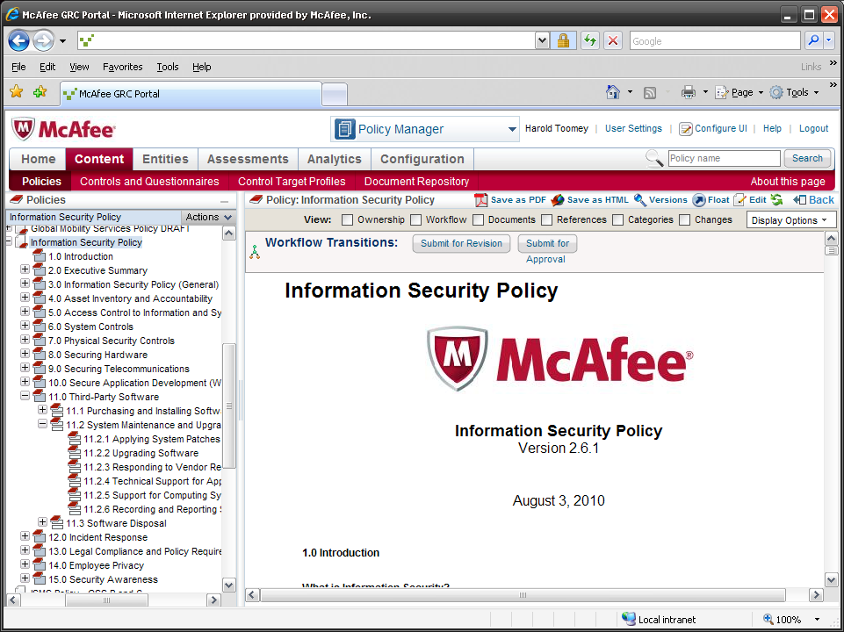
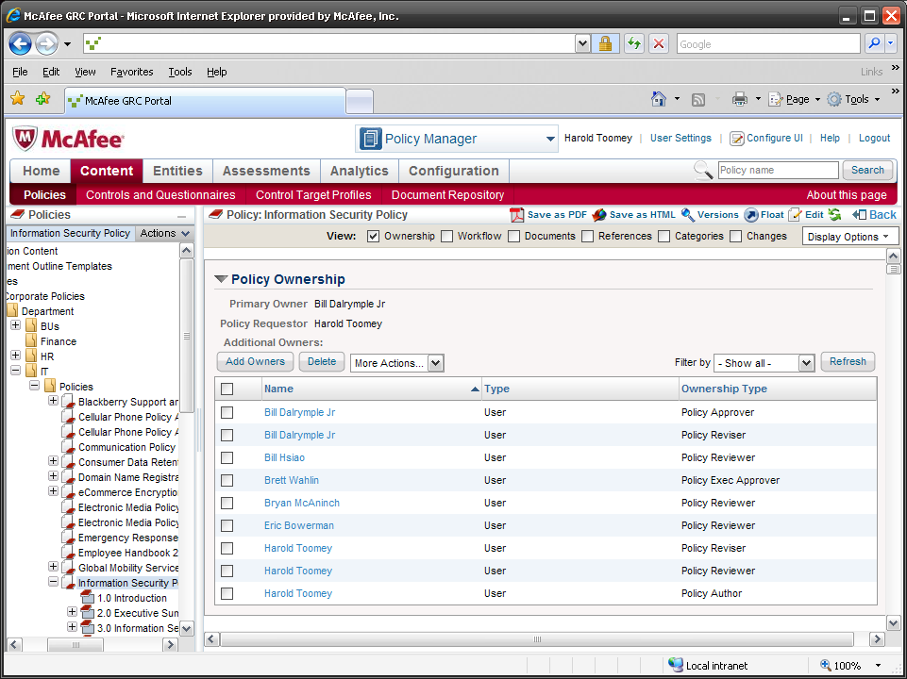
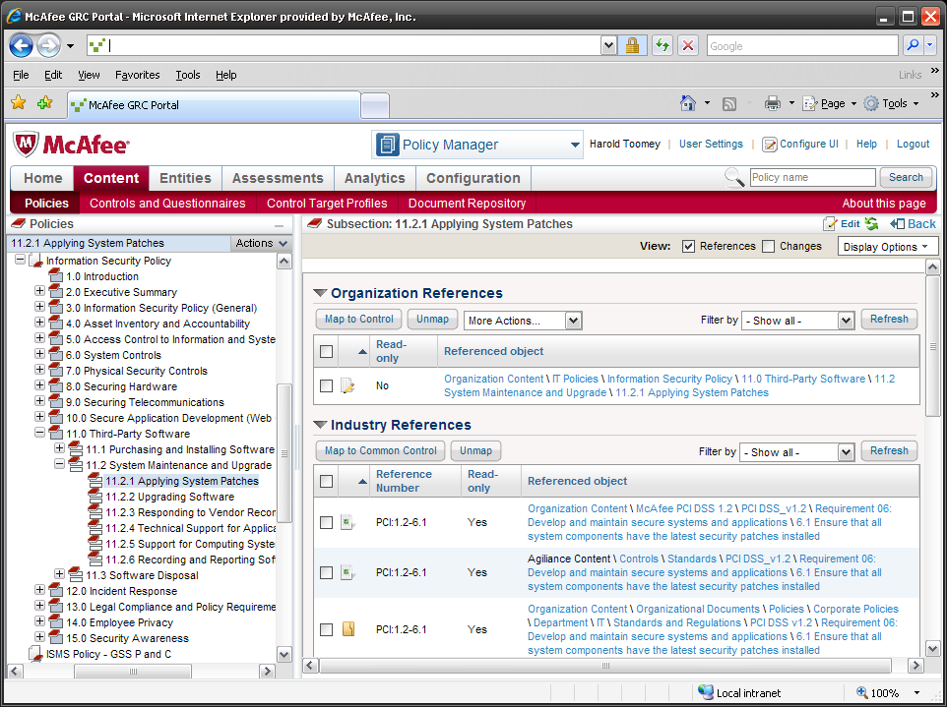
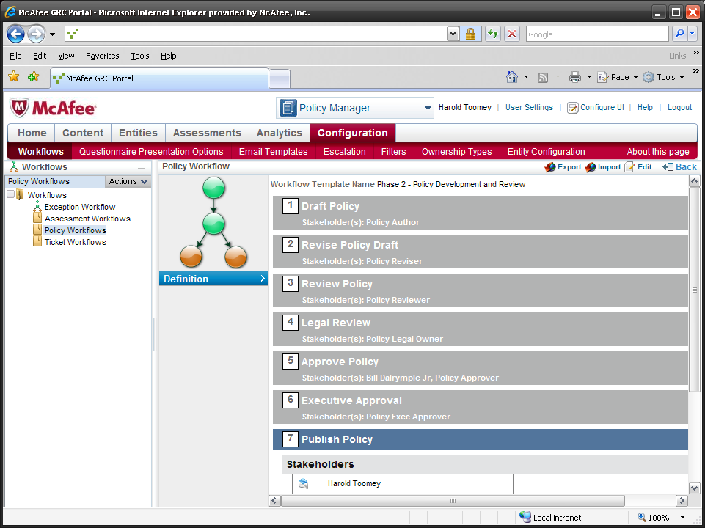
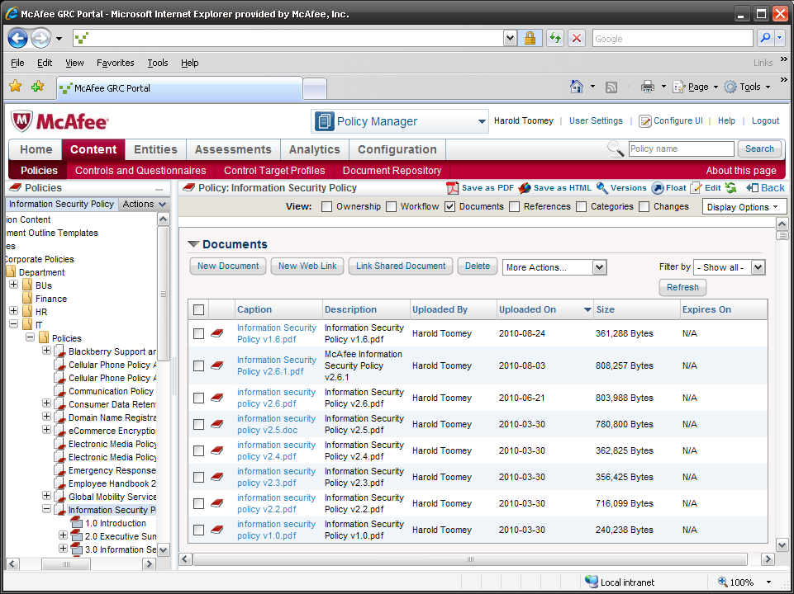
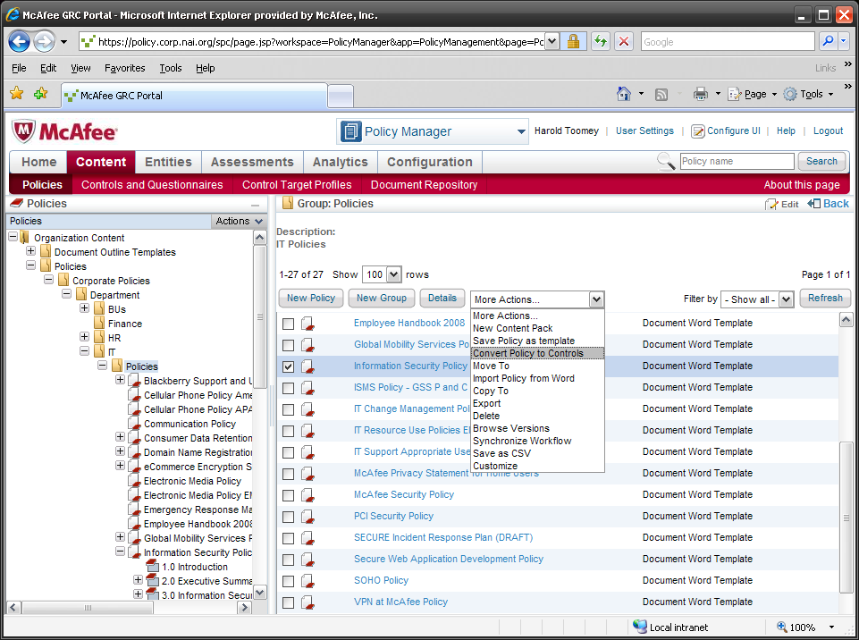
Notes:
Point out hierarchy on left. NEXT SLIDE: BILL
Key Message:
“Meta-data to manage policy vs. putting it all in the PDF or scattered elsewhere”
Meta-Data:
Ownership
Workflow
Documents
References
Categories
Changes
Example:
Bill H.’s Privacy Policy change vs. XLS with 26 rows of applicable regs.
NOTE: 2 minutes tops
NEXT SLIDE: BILL

Slide 15
Key GRC Component #2
Policy
Compliance
Risk Management
Security Awareness and Training
Notes:
BILL
In addition to Policy, another important aspect of governance is Compliance…

Slide 16
The Compliance Spectrum
Government Regulations
Industry Mandates
Industry Standards
Best Practices
Benchmarks
Government Regulation
SOx
HIPAA
EU privacy
Japan mark
Best Practice
SANS top 20
SQL Server 2005 security best practices
Industry Mandate / Standard
PCI DSS
ISO 27001
COBIT for SOx
COBIT for ITIL
Benchmark
CIS benchmark for Windows Server 2008
Notes:
…which is no easy task.
With Government Regulations,
Industry Mandates, Standards, best practices, and the proliferation of privacy laws at the state, national and international levels, plus new changes every day, compliance can be overwhelming.

Slide 17
Compliance Automation Process
Owner
Audit
Identifies assets and processes involved in audit transactions
Assigns Individual owners (sub-certifiers) of each asset or process
Maps requisite audit controls to each asset or process
Gathers information through survey and SAQ
  Creates automated reports & dashboards for compliance, risk assessment, etc.
Entity
Controls
Reports
Automated
Manual Process
Automated
Notes:
Compliance starts with knowing your systems
Entity: flexible
Assets – not just systems – can be processes, people, teams, data center
Owner:
Next is Ownership
Who owns the asset, the process, the entity
Controls:
Compliant controls and processes
It’s here that we can map both policies and controls to regs, standards, and to each other
ISO, COBIT, NIST, PCI, SOX
GRC Portal Feature:
Convert Policy to Controls
Convert Controls to Policy
Audit:
Ready for audit = reduced audit costs
Reports:
Effective reporting
enables continuous compliance
Facilitation of audits and assessments
AUTOMATION: Systems to replace process including this GRC Portal

Slide 18
Compliance Workflow for PCI Self Assessment
Owner
Stage 0 – Pre-Enter Evidence
Policy & Compliance Team
Stage 1 – Information Gathering
Policy Control Owner
Stage 2 – Sub-Certification by Manager
Sub-Certifier
Stage 3 – Review by Security Team
Security Owner
Stage 4 – Sign Off
Compliance Owner
Stage 5 – Closed
Complete
Notes:
Here’s an example of the workflow we used to manage our PCI assessment this year.
Identified
Assets in scope
Owners of the assets
The controls mapped to the 252 PCI requirements
Then created this workflow to gather the evidence and artifacts that mapped to each of the controls
NEXT SLIDE →

Slide 19
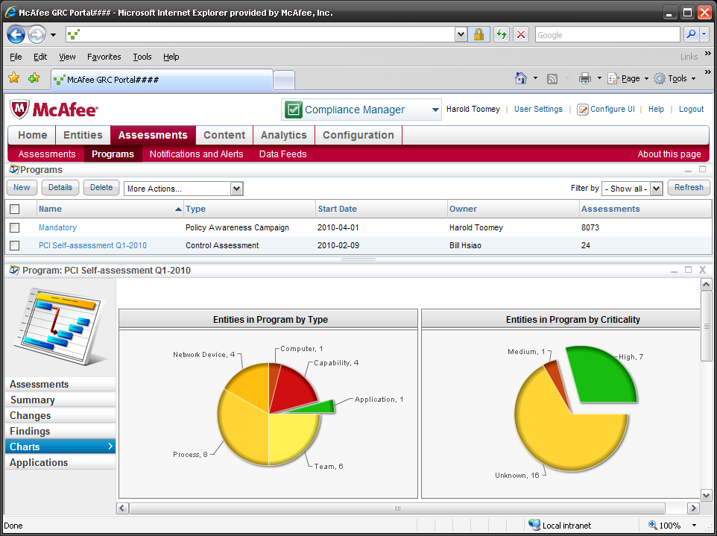
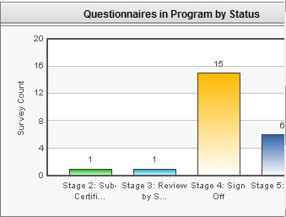
Notes:
And used the tool to create a survey project that NEXT SLIDE: HAROLD
automatically directed the proper document requests
to the appropriate requirement owner
Automate the audit, notifications, reminders, escalations, approvals, and provided reports and charts to track progress.
NEXT SLIDE: HAROLD

Slide 20
Key GRC Component #3
Policy
Compliance
Risk Management
Security Awareness and Training
Notes:
HAROLD

Slide 21



Common Controls and Risk-driven Policy
Audits are mapped to various controls
Policy Statement
Vulnerability,
Threat & Risk
Policy statements are each mapped to controls, standards & regulations
Compliance Control
MVM discovers entities and vulnerabilities which can be mapped to controls
Risk-Driven Policy
Notes:
The compliance control is the center of our world.

Slide 22
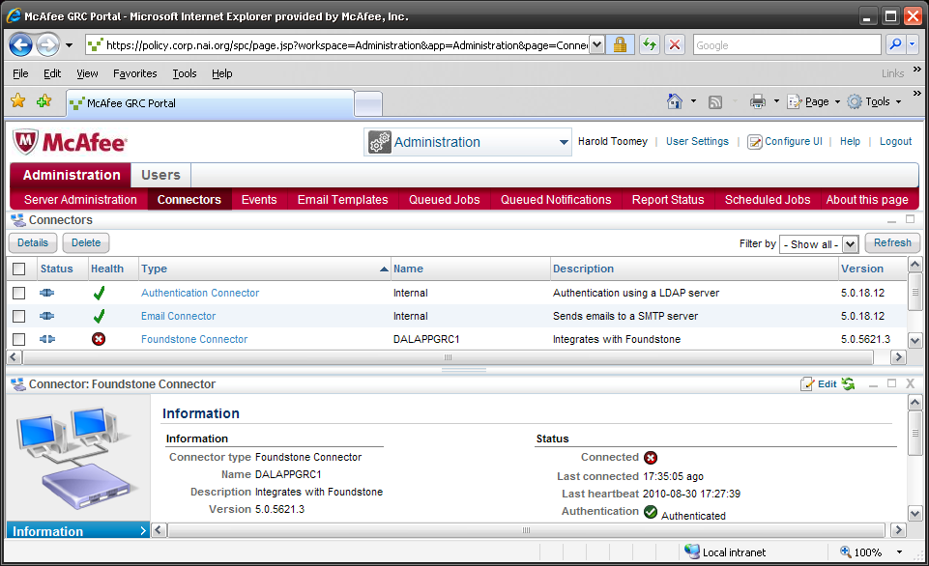
Connectors
Notes:
Today:
Authentication Connector
Uses Active Directory to authenticate users
Email Connector
Uses SNMP to email workflow change notifications and escalations
Foundstone Connector
MVM vulnerability scan data collection
Future:
Single Sign-On
Remove logon screen
Asset Management – CMDB
McAfee Configuration Control (Policy Auditor, Chg Mgmt)

Slide 23
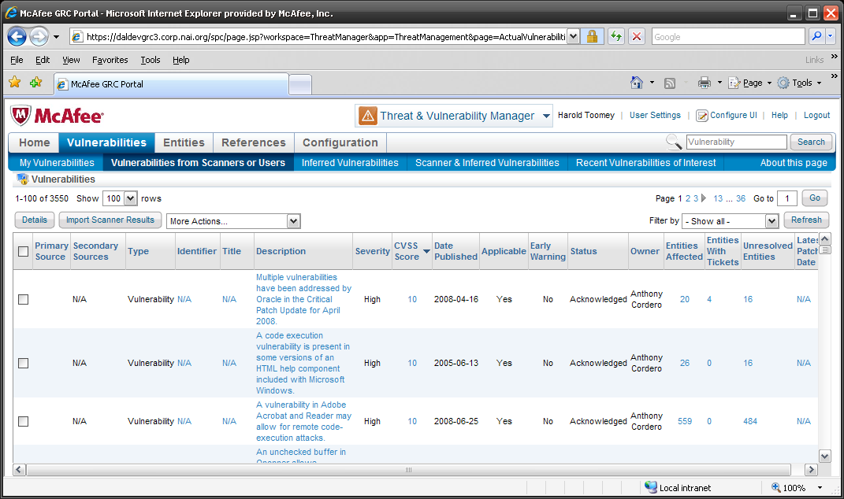
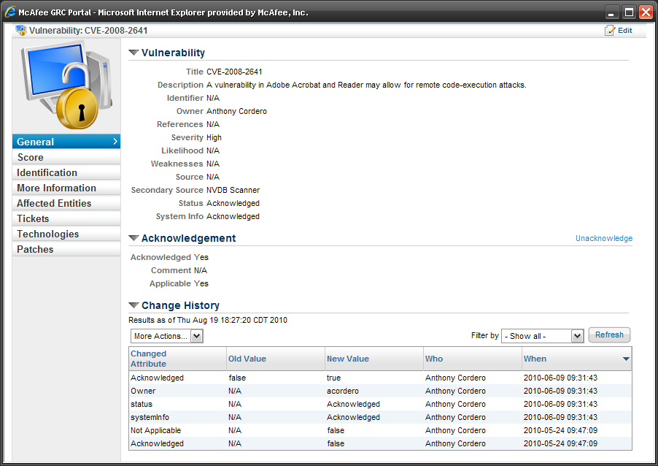
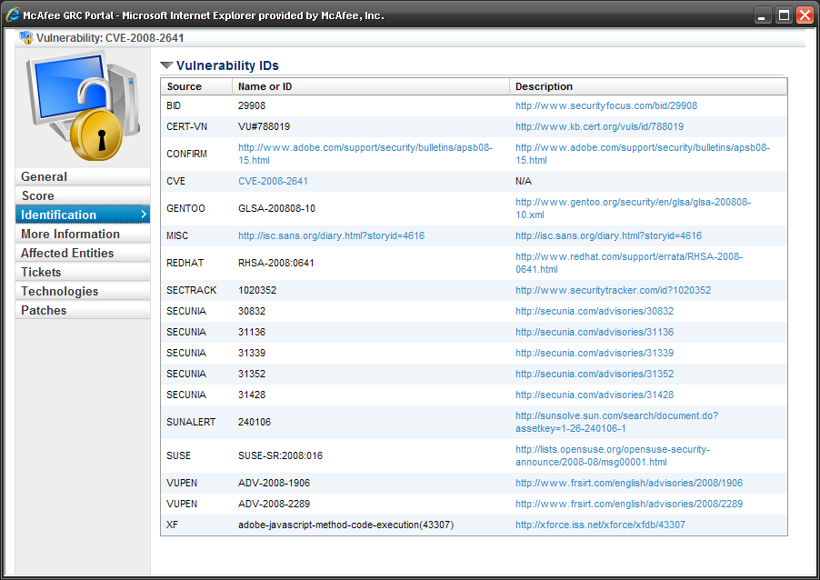
McAfee Vulnerability Manager Connector (Foundstone)

Slide 24
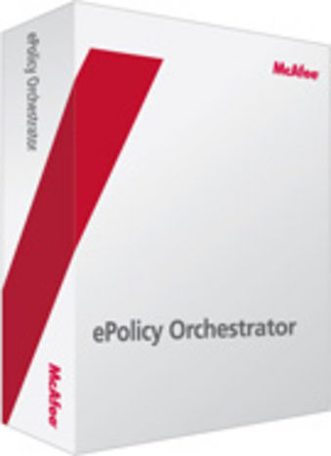
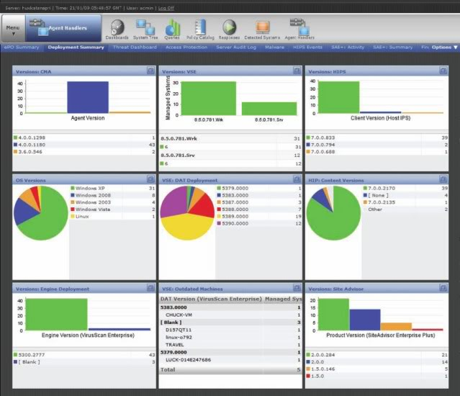
McAfee® ePolicy Orchestrator® Platform
The final piece of the equation is McAfee ePolicy Orchestrator (McAfee ePO™) platform!
Vendor currently has a beta McAfee ePO
platform connector
  Expect to get final release in
  mid Q4 ‘10
McAfee ePO platform gives us
  Asset info for managed and
  unmanaged devices
  Asset tags
  McAfee product data
    Properties
    Policy auditor
    DLP
    Many others
Notes:
We are an ePO shop.
NEXT SLIDE: BILL

Slide 25
People, Processes, Technology
Employee-Related
  Training and awareness
Human Intelligence
  State sponsored cybercrime
  Espionage
  Blackmail
  Insider
  Social engineering
Expand
Scope
PEOPLE
Asset-Related
  Classification
  Levels of protection
Repeatable
  Workflows
Establish
Robust
PROCESSES
Security Solutions
  Vulnerability scanning
  ID management and access control
  DLP
  Risk and compliance
  Situational awareness
Ensure
Right
TECHNOLOGY
Notes:
BILL
Compliant doesn’t always mean Secure >> BUT Secure usually means Compliant
For e.g. Vulnerability scans (ask audience) Quarterly to meet PCI Requirements? Or DAILY ➔ Continuous Compliance?
Secure + Compliant starts with
* Technology
* And good processes
*** PLUS *** PEOPLE – Don’t overlook People Compliance

Slide 26
Key GRC Component #4
Policy
Compliance
Risk Management
Security Awareness
and Training
Notes:
Which brings us to our last area of conversation for today…
Security Awareness and Training.

Slide 27
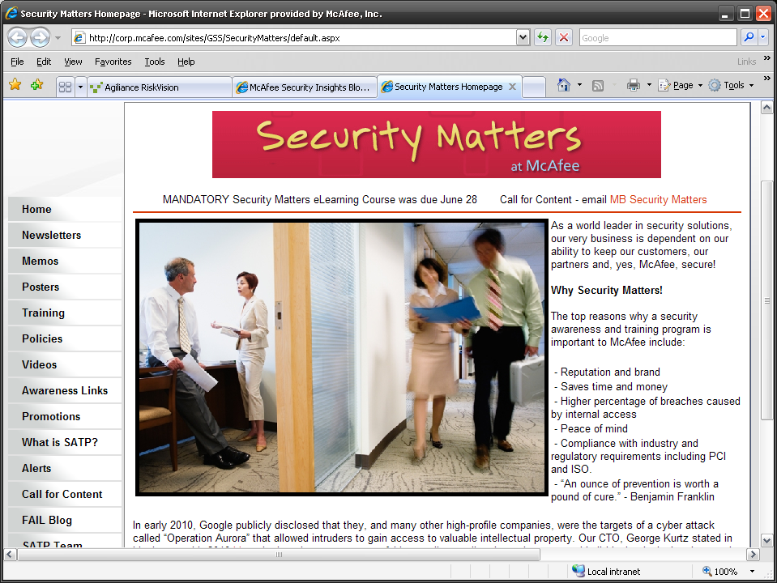
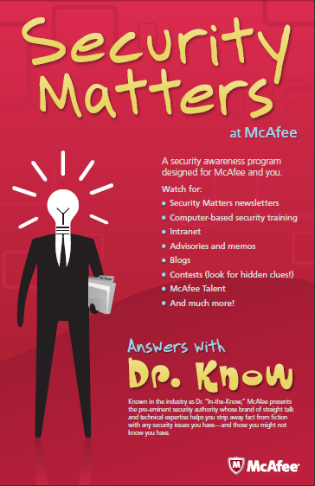
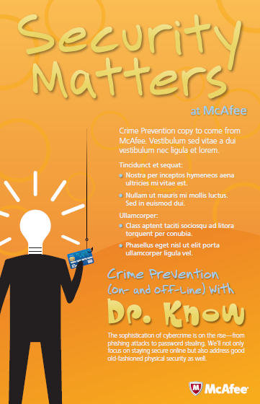
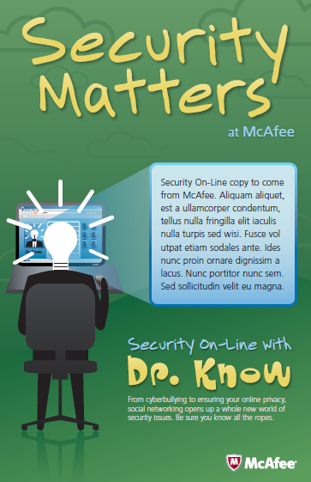
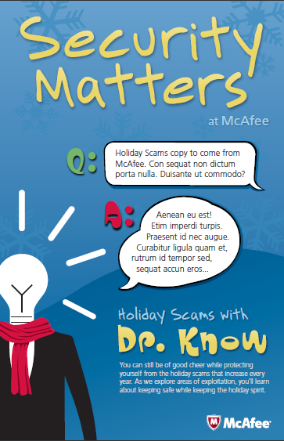
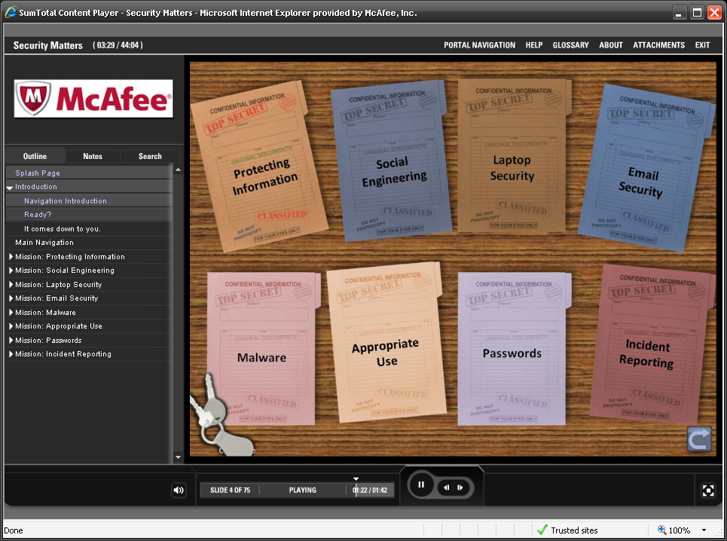
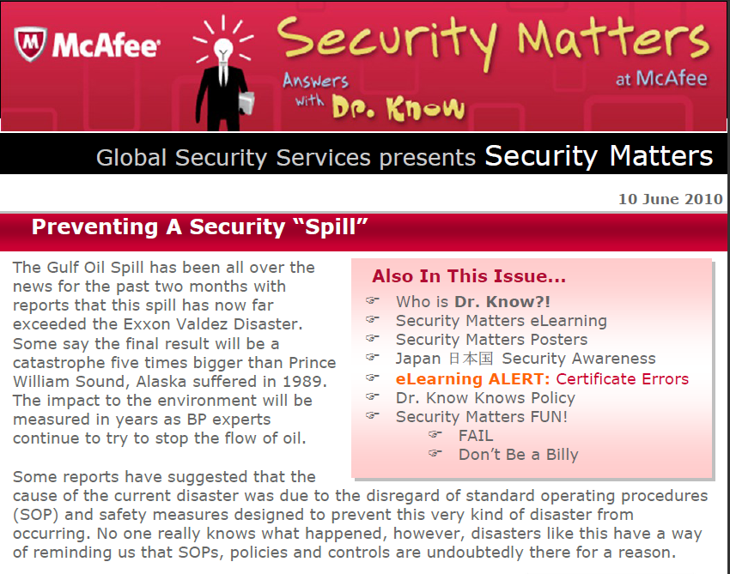
Security Awareness
PCI 12.6, ISO 27001 A.8.2.2
Requirement | Frequency | Delivery
Training | Annual | Annual Security Matters eLearning New Hire Awareness
Newsletter | Quarterly | GSS collaboration with McAfee Labs, IT, Marketing, Internal Comm.
Posters | Bi-Monthly | 6 posters per year, rotate every 3-4 years Posted at 40 locations
Intranet | Monthly | Intranet Web site
Memos | Incident Response | Email rapid response for timely security topics
Meetings | Quarterly | Plug into quarterly company meeting
Promotions | 3x year | Contests, author recognition, $25 gift cards
Acknowledge | Annual | Acknowledge McAfee Security Policy
Notes:
PCI DSS v1.2 Section 12.6
12.6.a Verify the existence of a formal security awareness program for all employees.
12.6.b Obtain and examine security awareness program procedures and documentation and perform the following: (a & b)
12.6.1.a Verify that the security awareness program provides multiple methods of communicating awareness and educating employees (for example, posters, letters, memos, web based training, meetings, and promotions).
12.6.1.b Verify that employees attend awareness training upon hire and at least annually.
12.6.2 Require employees to acknowledge at least annually that they have read and understood the company’s security policy and procedures.

Slide 28
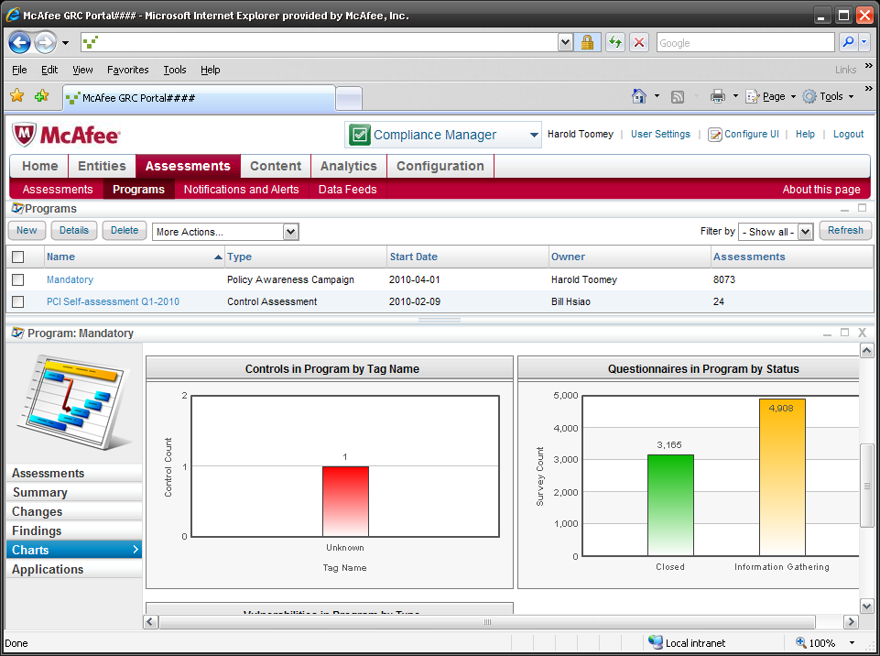
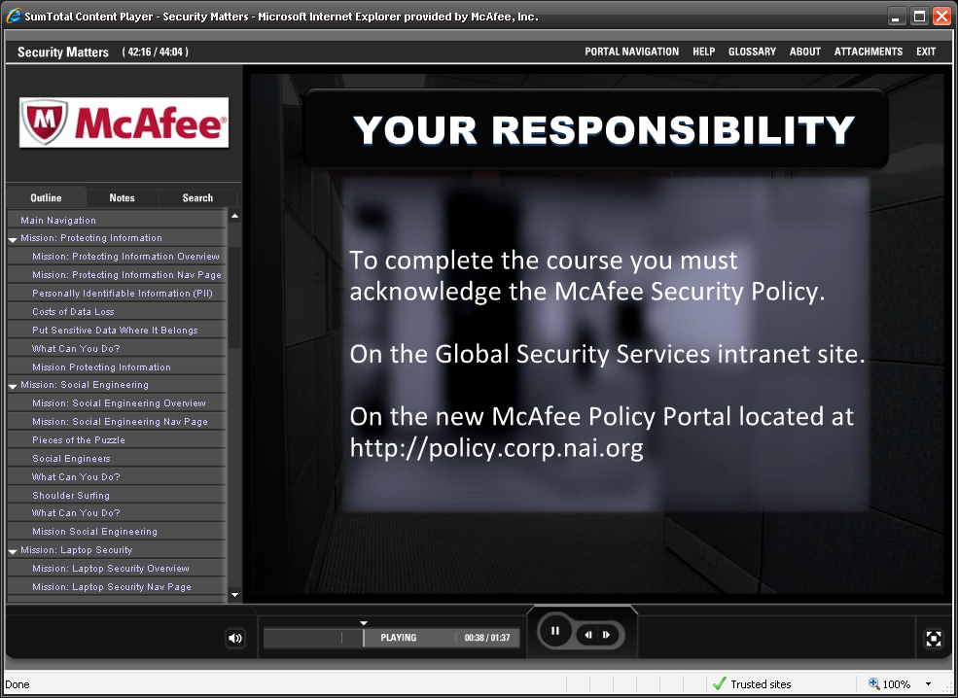
Acknowledgement
Notes:
Our GRC tool also helps us manage security awareness.
This past spring we released a new security training eLearning course called Security Matters.
As part of this course, we configured the GRC Portal to send a single-question attestation survey to every McAfee employee worldwide asking them to affirm that they had read The McAfee Security Policy.
PCI Req 12.6.2

Slide 29
Agenda
Managing GRC
GRC at McAfee
Summary
Q&A
Notes:
“Let me wrap this up.”

Slide 30
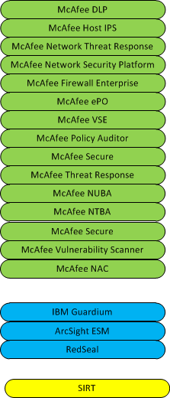
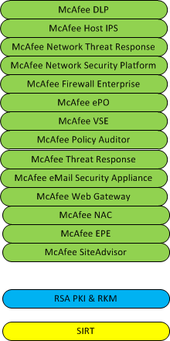
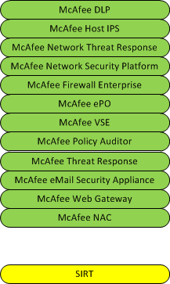
Systems Approach to Security
Prevention
Detection
Response
Agiliance

Slide 31




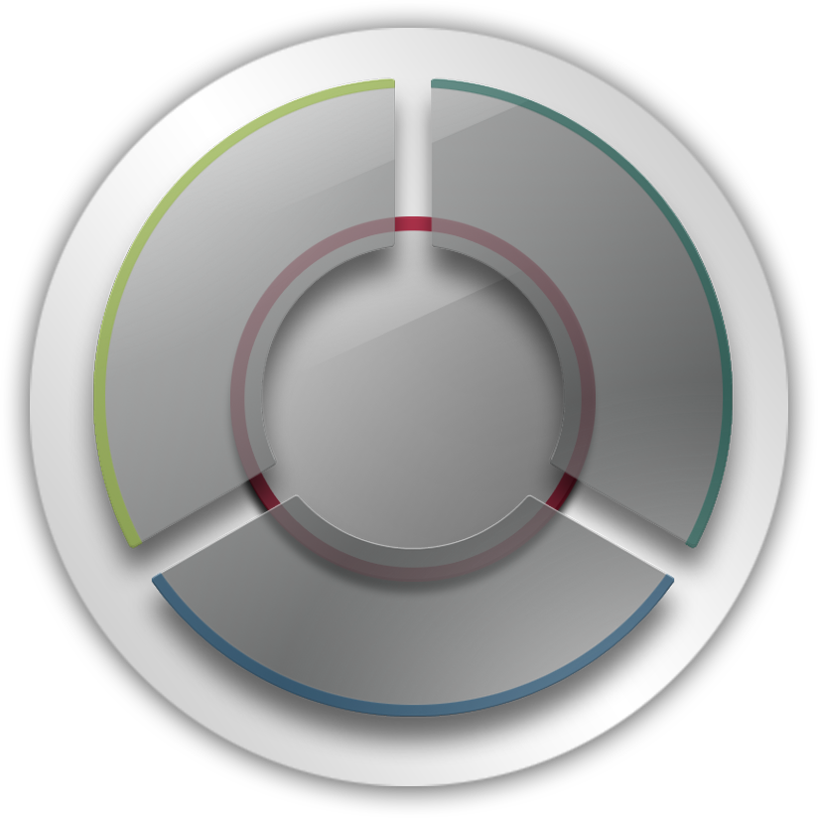





McAfee “Security Connected”
Security Management
Policy Management
Security Reporting
Mobile Management
Vulnerability Management
Risk Management
Compliance
Delivery
Open Security Platform
Network Security
Software
Security Innovation
Alliance
Next Generation Firewall
Network Intrusion Prevention
NAC Gateway
  Network User Behavior Analysis
  Network Threat Behavior Analysis
  Network Threat Response
  Content Security
  Email Gateway
  Web Gateway
  Data Loss Prevention
  Encryption
Appliance
Global Strategic
Alliances
SaaS
McAfee
Connected
Virtualized
  Endpoint Security
  Mac, UNIX/Linux AV
  Virtual Desktop
  Virtual Server
  Mobile Devices
  Anti-Virus & Anti-Spyware
  Host Intrusion Prevention
  Endpoint Encryption
  Application Whitelisting
  Desktop Firewall
  Device Control
  Policy Auditing
  NAC Endpoint
Email Server AV & Anti-Spam
SharePoint Protection
Website Reputation
October 14, 2010
31
Notes:
Secure = Compliant
And a systems approach is better than multiple point product solutions
Our goal is to integrate systems for security and compliance to enable us to achieve continuous compliance.
Next slide ➔
*************************************************************************************
Security Connected is our vision of optimized security within enterprises
Deliver security that protects the ubiquity of IT infrastructure
- Breadth and depth of security solutions
- Management capability that integrates disparate solutions and extends beyond a simple reporting dashboard
- Research capability for predictive threat protection
- Technology partner (open) ecosystem
McAfee concentrates the universe of point products into solutions
- Focus on 4 key platforms
Endpoint Security
Network Security
Content Security
Security Management
31

Slide 32

Maturity Model of Enterprise Security
Reactive
Compliant
Proactive
Optimized
Optimized spend ~4%
Very low risk
RISK
Compliant/Proactive
spend ~8% of
IT budget on security
Medium risk
Why has it been so challenging to reduce risk?
OPTIMIZATION
Reactive
spend ~3% of IT budget on security
High risk
Notes:
32
32
The last point I want to make today is the cost of maturity.
Why has it been so challenging to reduce risk?
At least part of the reason is the budgetary fears associated with security and compliance
Moving from Reactive to Compliant will mean an increase in security spending in your IT Budget, especially operationally.
But moving into Proactive and Optimized will result in
reduced operational costs,
lower risks, and
a more secure enterprise.
Plus better readiness and centralizing of evidence for audits ➔ lower audit costs.

Slide 33
GRC Portal Benefits
Centralized governance
  Centralized policy management with corporate-wide policies in one place
Brings consistency company-wide
  Common workflows and standard policy templates
Accessibility
  Easy access and archiving
  Search all policies simultaneously
Efficiencies in security operations
  Automates a previously manual process
    Similar to most of you, our previous GRC was called “excel” with “outlook”
  Reduced time spent learning and working in separate consoles
Compliance made easier
  Search all internal and external references, then map to policy
  Risk-driven by mapping policy, compliance and vulnerabilities to common controls
Great security shouldn’t mean great complexity

Slide 34



Closing Thoughts
Several GRC tool vendors to choose from
GRC portal is now a management tool
“Check box” vs. capability maturity
Remember - people, processes, technology
Next steps: considering vendor management module in 2011

Slide 35

Questions?
Notes:
While you are thinking about a question…
Story #1 – Policy
Describe what policy architectures worked for your organization.
Where are you on the Policy Maturity Scale?
Story #2 – PCI Compliance
Story #3 – SOx Audit
Story #4 - Vulnerability & Risk
Integration of McAfee and other security products. SIA partners.
Goal of Data driven full-automation?
Story #5 – Prepackaged SATP
PCI DSS requires us to have a SATP program.
How many of you would be interested in a pre-packaged SATP program from McAfee to use in your organization?

