Slide 1
Running an Agile Product Security Program
              “It’s a marathon, not a sprint.”
                Harold Toomey | Principal Product Security Architect & PSIRT Manager, McAfee
                | College Sub-Chapter Director, North Texas ISSA
September 27, 2014
1

Slide 2


Introduction
ISSA North Texas, President 2013
Day-Job Product Security Roles
  PSG program operations
  Define, build and manage the SDL, policies and processes
  Create, manage, and mentor the PSC team
  Manage PSIRT team
  Metrics
  Training program
  Certification support
Experience
  3 Years: R&D Product Security
  2 Years: IT Operational Security
  11 Years: Product Management
  10 Years: Software Development
CVSS Special Interest Group (SIG)
Harold Toomey
Principal Product
Security Architect
September 27, 2014

Slide 3
Agenda
What is Product Security?
SDL
People
Process
Technology
Metrics
Wish I Had Known
Agile SDL
PSIRT
Privacy
People
Process
Tech- nology
September 27, 2014

Slide 4
What is Product Security?
Securely developing software before handing it off to IT.
Software / Product Security
Pre-Launch
Dev
Post-Launch
IT
Application Security
September 27, 2014

Slide 5
What is Product Security? (cont.)
Product Security
    Processes, technology, and activities aimed at ensuring that software products do not contain exploitable conditions.
Application Security
    Protecting software and the systems that software runs in a post facto manner, only after development is complete.
Quality
(SDLC)
Security
SDL
Privacy
September 27, 2014
Notes:
What is product Security?
Processes, technology, and activities aimed at ensuring that software products do not contain exploitable conditions.
Secure Code vs. Quality Code
Secured code doesn’t mean quality code
You must know how to write quality code before you write secure code.
A developer can write very secure code that authorizes and authenticates every user transaction, logs the transactions, and cancels out all unwanted requests; however, if that code does not return the expected results, then this very secure code might never see the light of day.
Quality code doesn’t mean secure code
A developer can write efficient code that is easy to maintain and reusable; however, if that code allows an unauthorized user to access the application’s assets, then that code is of no use (Confidentiality, Integrity, and Availability).
Unlike software quality, software security tends to be less subjective. Sensitive information is either exposed or it is not, and there is no second chance of getting it right. The foundation of software applications and the development processes that produce them are based on common best principles of quality code and secure code.
These two attributes complement each other very nicely, and both make the overall software product really great.
The foundation of software applications and the development processes that produce
them are based on common best principles of quality code and secure code.
These two attributes complement each other very nicely, and both make the overall software product
really great.

Slide 6
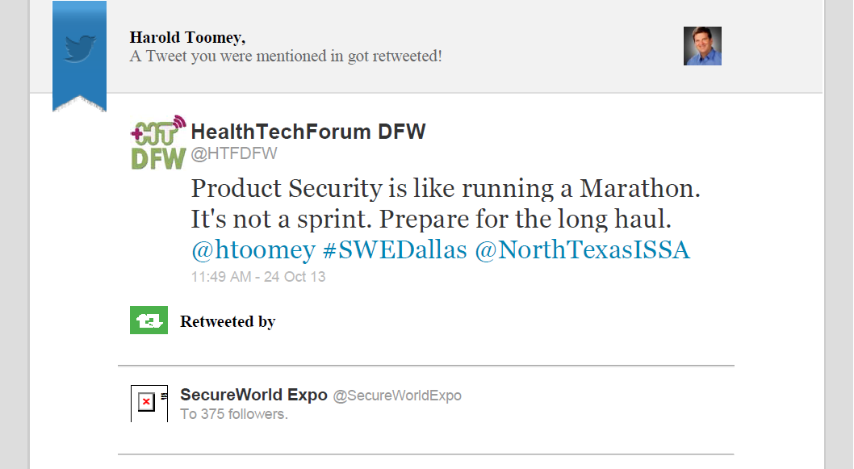

Product Security vs. Marathons
September 27, 2014

Slide 7

Running Analogy – Marathon Maniac
September 27, 2014

Slide 8
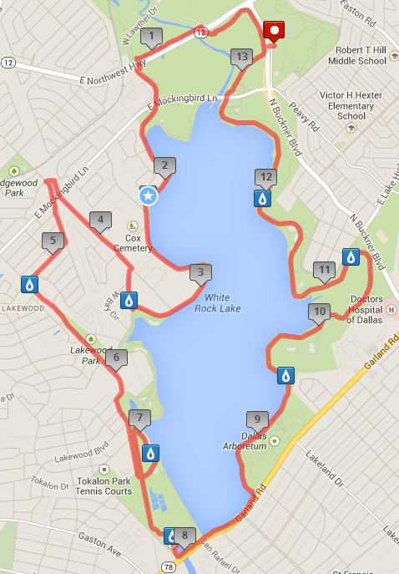
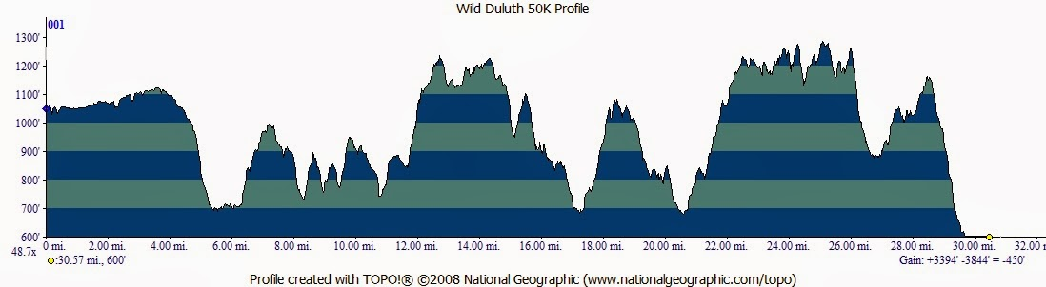
Running Analogy – Course Map
September 27, 2014

Slide 9
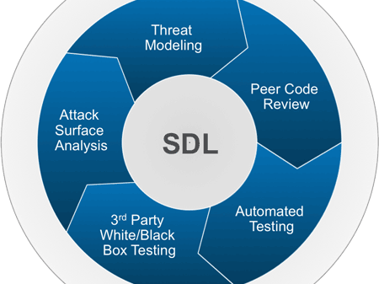
Security Development Lifecycle
September 27, 2014

Slide 10
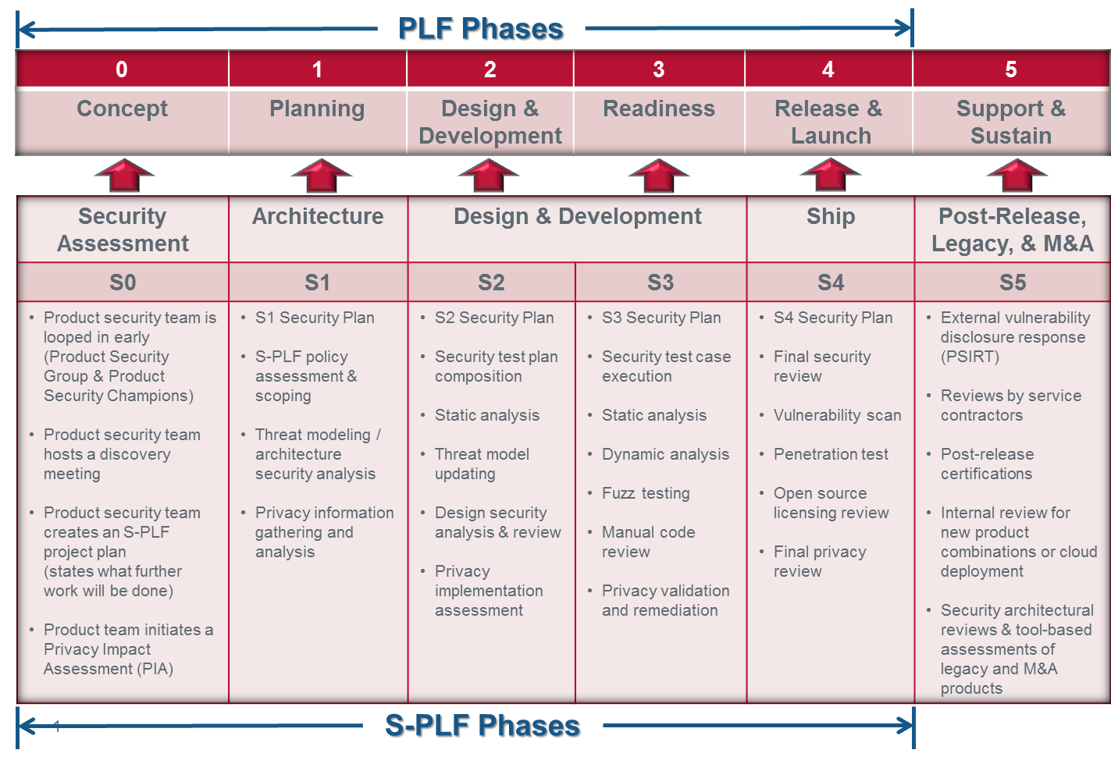
Secure Development Lifecycle (SDL)
Mapping the SDL to the SDLC
SDLC
SDL
September 27, 2014
Notes:
SDLs should not be confused with the software development lifecycle (SDLC). The SDL methodology, as the name suggests, is really aimed at developing secure software, not necessarily quality software.
The goals of SDL are twofold:
Reduce the number of security vulnerabilities and privacy problems
Reduce the severity of the vulnerabilities that remain
The elements of an SDL are typically very adaptive and are incorporated into the software development lifecycle for an organization, at which point the process is then called a secure software development lifecycle (SSDLC).

Slide 11

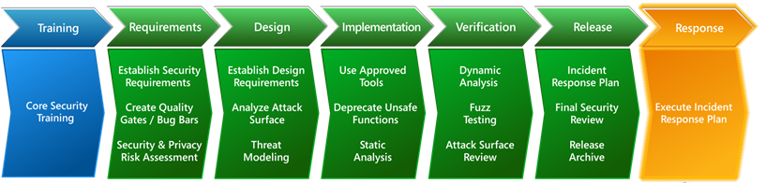
Other Popular SDLs
http://www.microsoft.com/security/sdl
ISO/IEC 27034-1:2011:
    Information technology -- Security techniques -- Application security -- Part 1: Overview and concepts.
    An SDL framework published in 2011.
September 27, 2014
11
Notes:
1) Microsoft SDL (Security Development Lifecycle)
The SDL is a set of principles and best-practices published by Microsoft that suggest how to develop secure applications
The goals of the SDL are to:
To reduce the number of vulnerabilities in the app before it ships
To reduce the severity of any undiscovered security issues
The SDL incorporates security activities into each stage of dev.
www.microsoft.com/security/sdl

Slide 12





Product Security Maturity Model – Operations
Level of Maturity
Continued improvement
2x PSAs
Tier-2 PSCs
Tool experts
Extensive training library
Security reviews
Dedicated PSIRT
Tight privacy partnership
Single crisis
SVP commitment
Tier-1 PSCs
3+ tools integrated
Mandatory training
PgM milestones
PSIRT defined
Privacy+security
Extended team
Developer-centric
Self-sustaining
Scalable
BU PSAs
Tier-3 PSCs
PSEs
Tools budget
McAfee SME training
Early reviews
Proactive PSIRT
Tight Intel integration
Tight privacy integration
M&A engaged
Mult. joint crises
X
Plan created
BU PSCs
1+ tools
PSIRT is IT
Privacy team
Awareness
No budget
Few tools
No reviews
Phase
None Initial Basic Acceptable Mature
September 27, 2014
12

Slide 13
McAfee DFS Level 1: (None)
Program: No Product Security Group (PSG) program exists
Process: Ad hoc - Inconsistent processes or a recent acquisition
Resources: Not properly resourced
Tools: May not have any security tools integrated within their build environments
Training: Have little or no product security training
Security Reviews: Ad hoc - local architectural reviews only. No standard defined.
PSIRT: No incident response procedures or team
Privacy: Privacy is not included with product security
Certification: Not included in product certifications
M&A: Not included in M&A source code reviews
September 27, 2014

Slide 14
McAfee DFS Level 2: (Initial)
Program: Aware and committed to adoption across the BU
Process: Long term strategic plan focused on resolving the BU business problem in the security assurance space
Resources: Have a dedicated Product Security Champion (PSC) for each R&D BU
Tools: Have at least one (1) product security tool integrated within their build environments
Training: Have identified and use free product security courses
Security Reviews: Standard review tasks defined
PSIRT: Setup and establish a partnership with IT Security
Privacy: A privacy program exists
Extended Team: Internal stakeholders and partners identified
September 27, 2014

Slide 15
McAfee DFS Level 3: (Basic)
Program: R&D/Product EVP/SVP committed to adoption across all products within BUs
Process: Demonstrates BUs’ ability to resolve current security assurance issues
Resources: Have a dedicated PSC for each Tier-1 product
Tools: Required security tools integrated in a supported build envir.
Training: Mandatory set of defined product security courses
Security Reviews: PgMs answer the 7 SDL Questions
PSIRT: Crisis management procedures defined and used
Privacy: Privacy works alongside product security
Certification: Certification team is fully integrated in the process
M&A: Ad hoc security reviews of potentially acquired product
Extended Team: Hold weekly product vulnerability status meetings
September 27, 2014

Slide 16
McAfee DFS Level 4: (Acceptable)
Program: Demonstrates BUs’ continued improvement efforts, community contribution, and leadership in product security
Process: Demonstrates BUs’ ability to independently resolve current and consider future security assurance issues
Resources: Have a dedicated PSC for each Tier-1 & Tier-2 product.
Tools: Trained experts on a core set of product security tools
Training: Major topics are delivered and internal processes are covered
Security Reviews: Product teams conduct and report on required reviews as defined in their project milestones
PSIRT: Dedicated PSG-managed team with well defined procedures
Privacy: Privacy is integrated with product security
Certification: Product IP protected during certifications
M&A: Product security source code review before acquisition
Extended Team: Can handle a single joint crisis
September 27, 2014

Slide 17
McAfee DFS Level 5: (Mature)
Program: Build and manage a developer-centric, self-sustaining, scalable product security program that is part of quality, includes privacy, using limited resources
Process: Consistently and repeatedly execute process. Policies and procedures are well documented and published.
Resources: Have a seasoned PSG Product Security Architect (PSA) dedicated to each R&D BU. Have a dedicated PSC for all products, including Tier-3. Have a Product Security Evangelist (PSE) program.
Tools: Necessary tools budgeted for, supported, and applied appropriately
Training: Keep program current. Subject Matter Expert (SME) provided training.
Security Reviews: Product teams engage their PSCs early
PSIRT: 24x7 coverage integrated with Intel/subsidiaries. Proactive.
M&A: Engages PSG early for all pending and active M&As
Extended Team: Can handle multiple joint crises
September 27, 2014

Slide 18

People
People
September 27, 2014

Slide 19
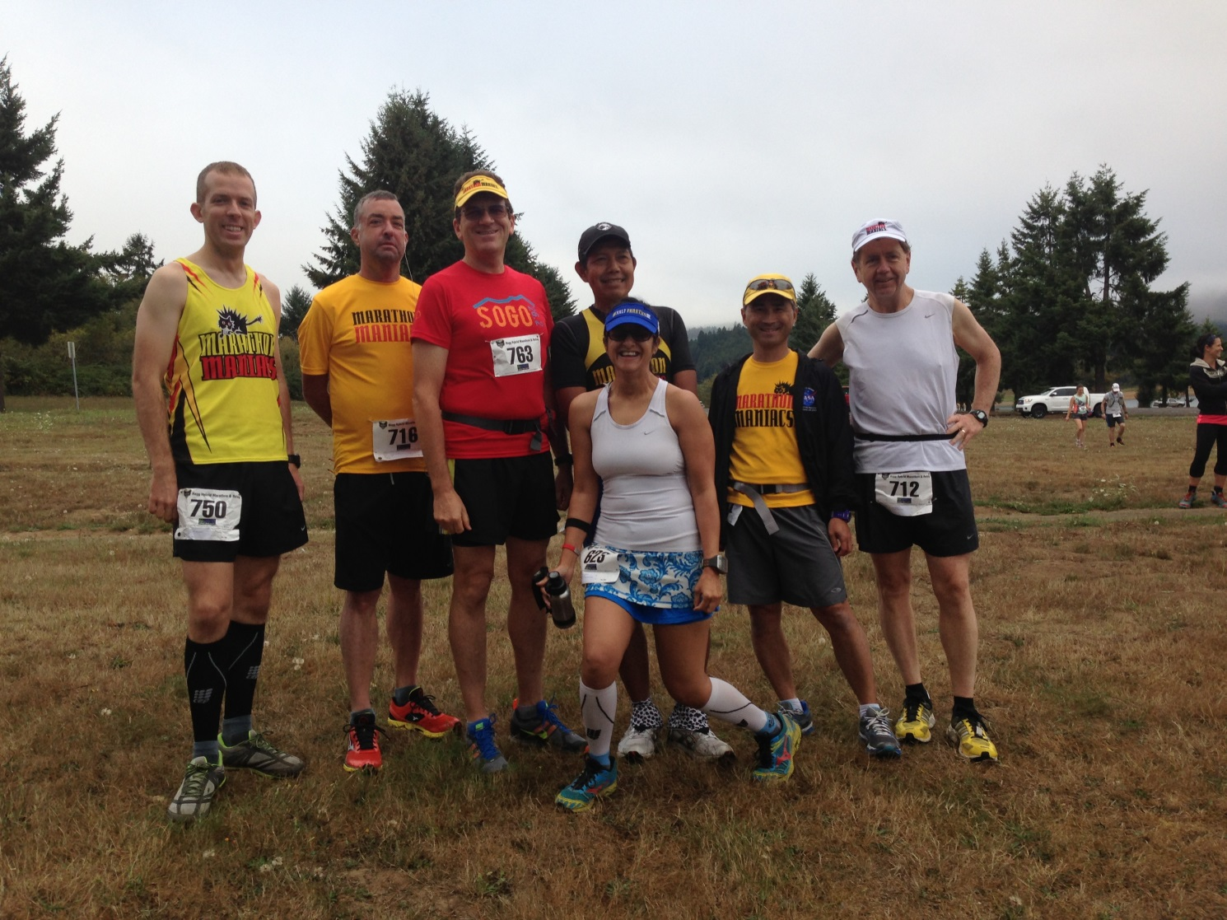
Running Analogy – Types of Runners
September 27, 2014

Slide 20
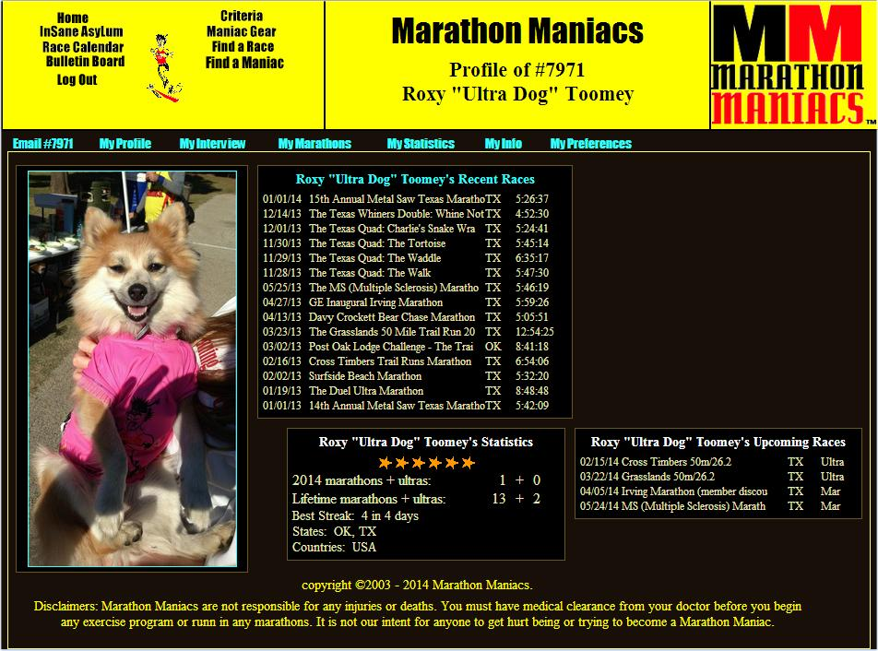

Running Analogy – Types of Runners (cont.)

Slide 21
People
IT (CSO) vs. Dev. (R&D)
# Security FTEs per n Developers
Full-Time vs. 10% - 20%
Training vs. Mentoring
Empowered vs. Recommenders
Developers/Architects vs. IT Security Experts
Quality vs. Quantity
People
September 27, 2014

Slide 22
Product Security Organization
Executive VP R&D (Dev.)
    VP Quality
      Sr. Director, Product Security Group (PSG)
        Principal Product Security Architects (PSA) x2
          Product Security Champions (PSC) x50
Extended Team
    IT Security / SOC • Technical Support
    Quality (QA) • Dev. Training
    Privacy • Legal
    Public Relations • Engineering Support
September 28, 2014
22

Slide 23
Roles & Responsibilities
A Product Security Group (PSG)
Role | Responsibilities
Sr. Director Product Security | Owns all product security within company
Product Security Architect (PSA) | Mentor PSCs for threat modeling, arch. reviews, security reviews, tools, PSIRT, training
PSC BU Lead | Over all BU PSCs and products w/out PSC
Product Security Champion (PSC) | Collocated security engineer/architect POC for a product
Software/Security Architect | (See PSC)
Product Security Evangelist (PSE) | Collocated security QA POC for a product
Tier-III Subject Matter Expert (SME) | Tech Support champion for a product
Privacy Champion | (See PSC)
September 27, 2014

Slide 24
Product Security Champion Staffing
BU A | BU B | BU C | BU D | BU E
BU | BU | BU | BU | BU
Product A1 | Product B1 | Product C1 | Product D1 | Product E1
Product A2 | Product B2 | Product C2 | Product D2 | Product E2
Product A3 | Product B3 | Product C3 | Product D3 | Product E3
Product A4 | Product B4 | Product C4 | Product D4 | Product E4
Product A5 | Product B5 | Product C5 | Product D5 | Product E5
Product A6 | Product B6 | Product C6 | Product D6 | Product E6
Product A7 | Product B7 | Product C7 | Product D7 | Product E7
Product A8 | Product B8 | Product C8 | Product D8 | Product E8
 | Product B9 | Product C9 | Product D9 | Product E9
 | Product B10 |  | Product D10 | Product E10
 | Product B11 |  | Product D11 | Product E11
KEY: | Product B12 |  | Product D12 | Product E12
Red – No PSC | Product B13 |  | Product D13 | Product E13
Yellow – BU PSC Only | Product B14 |  | Product D14 | Product E14
Green – Product Line PSC | Product B15 | Other | Product D15 | Product E15
 | Product B16 | Product F1 | Product D16 | Product E16
 | Product B17 | Product F2 | Product D17
September 27, 2014
24

Slide 25
Product Security Champion Qualifications
A minimum of 3-5 years software development experience (architects preferred)
A passion for or background in software security
Approved by the BU VP Engineering & BU PSC Lead
Dedicate 10% - 20% of their time doing product security tasks
Time to be trained in software security, tools, plans, and processes
Must not only know how to develop (build) software, but also know how to deconstruct it (take it apart) while “thinking like a hacker”
September 27, 2014
25

Slide 26
Product Security Champion Responsibilities
Enforce the SDL: Assist the PSG in assuring the security tenants of confidentiality, integrity, availability, and privacy are adhered to
Reviews: Assist the PSG’s software security architects in conducting architecture security analysis, reviews, and threat modeling
Escalations: Assist with Security Bulletins and patches for externally disclosed vulnerabilities (PSIRT)
Tools Expert: e.g. static, dynamic – which includes fuzzing, within each product development team, and/or business unit (BU)
Collocated: Be the eyes, ears, and advocate of the PSG within each product dev. team / BU
Attend Meetings: Participate in weekly Admin / Technical meetings as a team
September 27, 2014
26

Slide 27

Process
Process
September 27, 2014

Slide 28

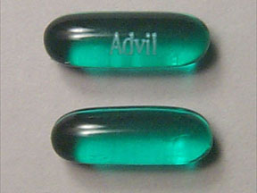
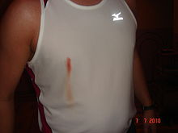

Running Analogy – Process
Weather
Course Review
Countermeasures
  Advil
  Bandages
  Body Glide
  Mustard
Recording
  Pictures
  Facebook Album
  Tumblr Blog
September 27, 2014

Slide 29

Running Analogy – Process (cont.)
  Facebook Album
September 29, 2014

Slide 30
Process
Process
Architecture Security Reviews / Threat Modeling
PSIRT
Training Program
Policies
M&A Code Reviews
Certifications and Redaction
Programmatic and Admin
September 27, 2014

Slide 31


You Made Your Bed, Now Sleep In It
PSIRT
Incident
Attack / Exploit
Vulnerability
Error
Defect
Insecure Coding
Security
Reviews
September 27, 2014
31

Slide 32
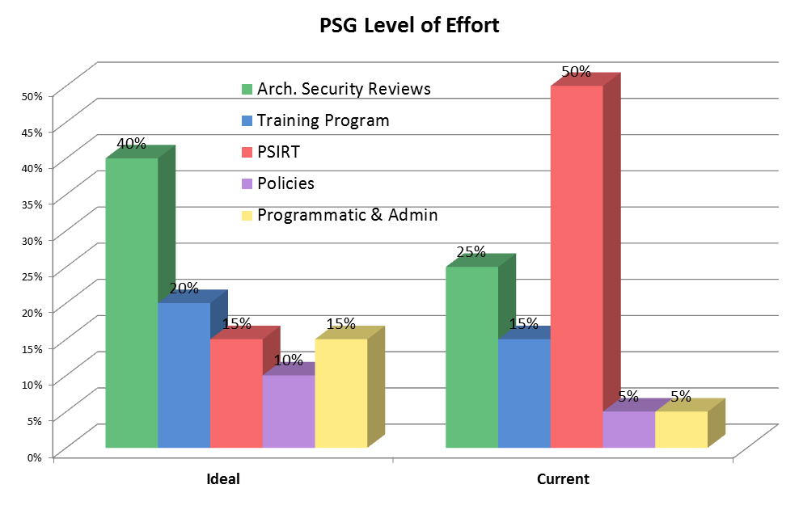
Level of Effort
New Headcount Justification?
September 27, 2014
32

Slide 33

Tools & Technology
Tech
September 27, 2014
Notes:
Tool
Purpose
URL
BackTrack 5
Linux penetration testing arsenal
http://www.backtrack-linux.org/wiki/index.php/Main_Page
Burp Suite Pro
Web Vuln Scanner
(some fuzzing)
http://portswigger.net/burp/
COMRaider
ActiveX Fuzzing
https://github.com/dzzie/COMRaider
Coverity
Static analyzer
http://beaappcov1:8080/docs/en/cov_checker_ref.pdf
Dranzer
ActiveX Fuzzing
http://www.cert.org/vulnerability-analysis/tools/dranzer.cfm?
DUH
I could only find a black hat preso…
https://www.blackhat.com/presentations/bh-dc-08/McFeters-Rios-Carter/Whitepaper/bh-dc-mcfeters-rios-carter-WP.pdf
Fortify Static Analysis
Static analyzer
http://www8.hp.com/us/en/software-solutions/application-security/
FxCop
.NET policy violation analyzer (C#)
http://msdn.microsoft.com/en-us/library/bb429476(v=vs.80).aspx
“HackingWindowsInternals” more properly should be: Sysinternals Suite
Windows debugging and analysis suite
http://technet.microsoft.com/en-us/sysinternals/bb842062
Intel Inspector
Memory analyzer and debugger
Free for McAfee use
EKATERINA ANTAKOVA <ekaterina.antakova@intel.com>
Ioctlbf
Windows IOCTL fuzzer
http://code.google.com/p/ioctlbf/
Kartoffel
Driver testing
http://kartoffel.reversemode.com
Mallory
Transparent TCP and UDP Proxy
https://intrepidusgroup.com/insight/mallory/
McAfee Vulnerability Manager
Runtime Stack and Web vuln scanner (2 different scanners)
Free license for internal use
McAfee download site & https://planet.mcafee.com/message/198941#198941
Memoryze
memory forensics
https://www.mandiant.com/resources/download/memoryze
Metasploit
Penetration testing platform. Includes many plugins for specific attack cases
http://www.metasploit.com
Mobisec
Test mobile environments for vulnerabilities
http://mobisec.professionallyevil.com
Nessus
Free: runtime stack scanner. Paid: + web vulnerability scanning, some fuzzing
http://www.tenable.com/products/nessus?gclid=Cj0KEQjwveufBRDlsNb3kb-twMIBEiQASNH0xr8KS8Hv595cEf6kMXSK17hfNFk6A7XVMqiOKeta2F8aAku38P8HAQ
Peach Fuzzer
Fuzzing platform
Open source: basic templates. Paid: +templates
http://peachfuzzer.com
PEBrowser
Windows executable disassembler
http://www.smidgeonsoft.prohosting.com/pebrowse-pro-file-viewer.html
PreFast
Windows static analyzer for small C/C++
Desktop format
http://msdn.microsoft.com/en-us/library/ms933794.aspx
Rational Purify
dynamic memory analysis
http://www-03.ibm.com/software/products/en/rational-purify-family
QAInspect
Enterprise license is expired.
Web vuln scanner, essentially, WebInspect repackaged
http://www.ndm.net/sast/hp-qainspect?gclid=Cj0KEQjwveufBRDlsNb3kb-twMIBEiQASNH0xtVu_j0oqYDtc_QKB2PUWdb2idHwbFVkiYehsQLBgOUaAkk-8P8HAQ
Samurai
Visualize thread dumps
http://samuraism.jp/samurai/en/index.html
Sh5ark
HTML5 Assessment platform
http://sh5ark.professionallyevil.com
ValGrind
dynamic memory analysis: linux, Android, Mac/Darwin
http://valgrind.org
Volatility
Windows memory dumps
http://code.google.com/p/volatility/

Slide 34
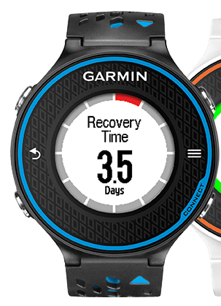



Running Analogy – Technology
Monitoring
  Heart Rate
  Muscle Fatigue
  Breathing
  Timing
September 27, 2014

Slide 35
Technology (Tools)
Critical methods used to ensure the development of secure code within an SDL:
Tech
Static Analysis:
  A method of examining software at compile time, reporting potential defects
Dynamic Analysis:
  A method of examining software at runtime, by executing the code over multiple test cases
Fuzz Testing:
  Providing unexpected, invalid, or random data to an application with the intention of triggering a bug
September 27, 2014

Slide 36


Static Analysis
Static analysis tools look for a fixed set of patterns or rules in the code in a manner similar to virus-checking programs.
  Think 3rd generation “Lint”
Static analysis tools can look at more of a program’s dark corners with less fuss than dynamic analysis, which requires actually running the code.
September 27, 2014

Slide 37
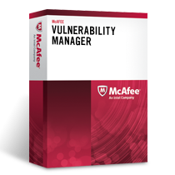

Dynamic Web Analysis
Dynamic Web Analysis is the evaluation of a program based on its execution. Dynamic web analysis relies on executing a piece of software with selected test data.
  McAfee MVM Web Scanner for web application security testing and assessment
  PortSwigger Burp Suite Pro for security testing of web applications
September 27, 2014
Notes:
Software Security Tool List
BackTrack 5
Burp Suite Pro
COMRaider
Coverity
Dranzer
DUH
Fortify Static Analysis
FxCop
HackingWindowsInternals
Ioctlbf
Kartoffel
Mallory
McAfee Vulnerability Manager
Memoryze
Metasploit
Mobisec
Nessus
Peach Fuzzer
PEBrowser
PreFast
QAInspect
Samura
Sh5ark
Volatility
Dynamic Analysis Tools:
AMP
Dynamic Analysis
QAInspect
Dynamic Analysis
DL Dynamic Analysis – QAInspect
DL Dynamic Analysis
WebInspect
Dynamic Analysis
DL Dynamic Analysis – WebInspect
DL Dynamic Analysis

Slide 38



Fuzz Testing
Fuzz testing or fuzzing is a software testing technique, often automated or semi-automated, that involves providing invalid, unexpected, or random data to the inputs of a computer program.
  The program is then monitored for exceptions such as crashes, or failing built-in code assertions or potential memory leaks.
  NOTE: Fuzzing is sometimes combined with dynamic memory analysis
September 27, 2014
Notes:
Fuzzing Tools:
Codenomicon
Fuzzing Analysis
DL Fuzzing Analysis – Codenomicon
DL Fuzzing Analysis
Peach Fuzzing
Fuzzing Analysis
DL Fuzzing Analysis – Peach
DL Fuzzing Analysis

Slide 39





Code Review Tools
CodeCollaborator
  Source Code Review
  In the San Jose Verizon Data Center
Black Duck
  Protex: Open Source Compliance
  Code Center: Open Source Governance
Bugzilla
Source Code Control
  SVN/Subversion
September 27, 2014
Notes:
Code Review Tools:
Bugzilla
Bug Tracking Database
CodeCollaborator
Source Code Review
DL CodeCollaborator
SVN
Source Code Control (Subversion)

Slide 40







Technology (cont.)
Free
Costs $$$
/analyze (Code Analysis) flag
September 27, 2014
Notes:
39 free security software tools
http://www.networkworld.com/news/2010/111510-free-security.html
Microsoft Visual C++
/analyze (Code Analysis)This compiler option activates code analysis that reports potential security issues such as buffer overrun, un-initialized memory, null pointer dereferencing, and memory leaks. By default, this option is off. For more information, see Code Analysis for C/C++ Overview.

Slide 41

Goals & Metrics
September 27, 2014

Slide 42
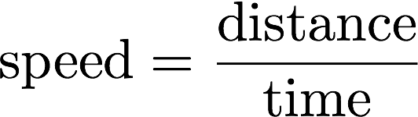
Running Analogy – Goals & Metrics
Distance
  ½ Marathon
  Marathon
  Marathon Maniacs
  50 States
  50M
  100K
  100M
  Triathlon
  Badwater
  Run across America
Speed
  6:00 Marathon Limit (US)
  5:00 Marathon Limit (EU)
  4:00 Marathon (25%)
  3:30 Boston Qualifier
  2:00 Marathon Glass Ceiling (2:02:57)
September 29, 2014
Notes:
28 Sep 2014:
Dennis Kimetto Breaks World Record at Berlin Marathon
Kenyan runs 2:02:57 to be the first to go under 2:03.
http://www.runnersworld.com/races/dennis-kimetto-breaks-world-record-at-berlin-marathon?cid=social32456356
29 Sep 2013:
The IAAF world record for men, subject to ratification, is 2:03:23, set by Wilson Kipsang of Kenya on September 29, 2013 at the Berlin Marathon.

Slide 43
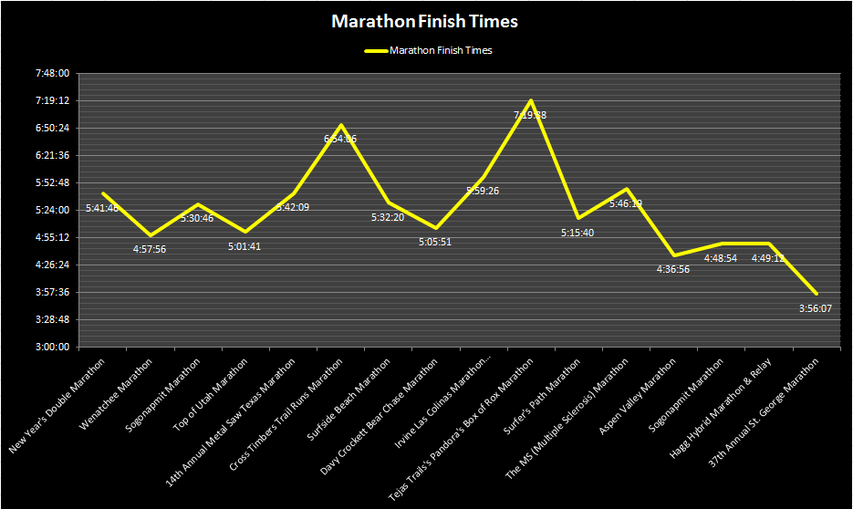
Running Analogy – Metrics

Slide 44

Product Security Dashboard
Overall Status and Definitions
Static Analysis – Percent Open (Found but not fixed)
    Proactive: 0% is ideal
    “Dismissed” means False Positive or As Designed
Security Reviews
    Proactive: The more the better
External Disclosures (PSIRT)
    Reactive: The less the better
Training
    Proactive: 100% is ideal
$$\% Open=\frac{Open}{Total−Dismissed}$$
September 27, 2014

Slide 45
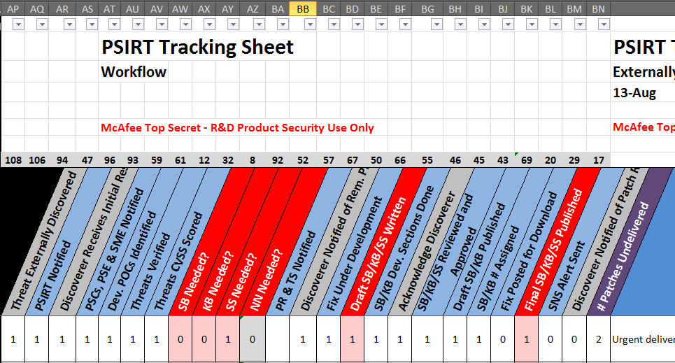
Metrics using a Spreadsheet
September 27, 2014
Notes:
Metrics must be designed to drive positive change
Metric reports must adapt to the audience
Executive Management
EVP of Engineering & Staff
VP Quality
Product Security Champions (our virtual team)
Metric creation should be automated
Currently automated in a spreadsheet
Static analysis data collection partially automated
Metric data entry and access should be distributed
Was tracked in PPT 2 years ago
Outgrowing the XLS
Looking for a Web-based database to remove bottleneck
Must constantly adapt and refine
Leverage best practices (company, standards, etc.)

Slide 46

Metrics using a Database
Technologies to Consider
    Bugzilla
    MS SharePoint
    MySQL + Tableau
  Benefits
    Concurrent data entry
    Relational database data mining
    Servers maintained by IT

Slide 47
Product Security Database
PSG maintains an extensive database with 3 years worth of data
Contains low-level details
    Product reviews
    Product vulnerability disclosures (PSIRT)
    Static analysis data
    Teams (PSC, Dev, QA, TS, PM, PgM, Arch., etc.)
    Shared technologies in McAfee products
    Product abbreviations
We mine this data for various metrics
      Automated metrics
      Trends (CWEs)
      Time to Resolution
      Heat maps & Charts
September 27, 2014

Slide 48
PSIRT Tracking Database
Status
    In Queue
    In Progress
    On Hold
    Patch Ready
    Completed
    Not Needed
Unique ID
  SB / KB / SS
  References
    Bugzilla #
    CVE # (vulnerability)
    CWE # (weakness)
    CAPEC # (attack)
    CERT/CC #, Other ID
Name
Product
BU
Priority
Criticality
  CVSS Scores
Time
    Date Reported
    Estimated Completion Date
    Fix Due Date
    Date Completed
    Work Days to Complete
Effort
    # Vulnerabilities
    Severity
    Probability
    # of Customers Impacted
    Damage to Customers Score
    Publicly Disclosed?
    Media Interest Expected?
    Media Interest Actual
    Bugzilla Only
    Zero Day or Malicious Discoverer?
    3rd Party Vulnerability?
    Extra Effort (days)
    Estimated Effort (days)
People
  Dev. Team POC(s)
  Discoverer
  PSG POC
  PSC Product Line POC
  PSC BU Lead POC
  PSE POC
  Tier-III SME POC
  Dev POC
  QA POC
  PM POC
  PgM POC
Workflow
Notes
September 27, 2014
48

Slide 49
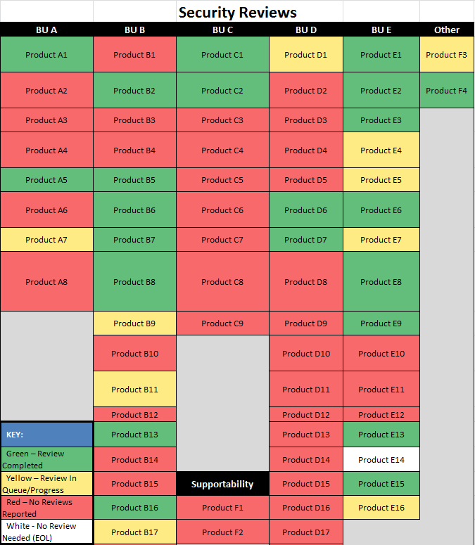
Metrics – Heat Maps
September 27, 2014

Slide 50
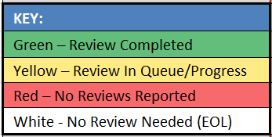
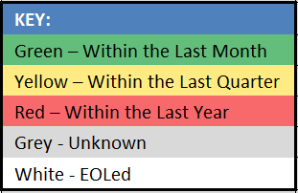
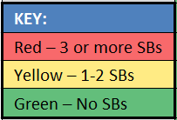
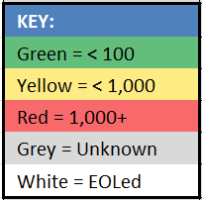
Metrics – Heat Maps (cont.)
Average Days Since Last Static Analysis Run
Outstanding
Static
Analysis
Defects
Security Reviews
Security Bulletins
September 27, 2014

Slide 51
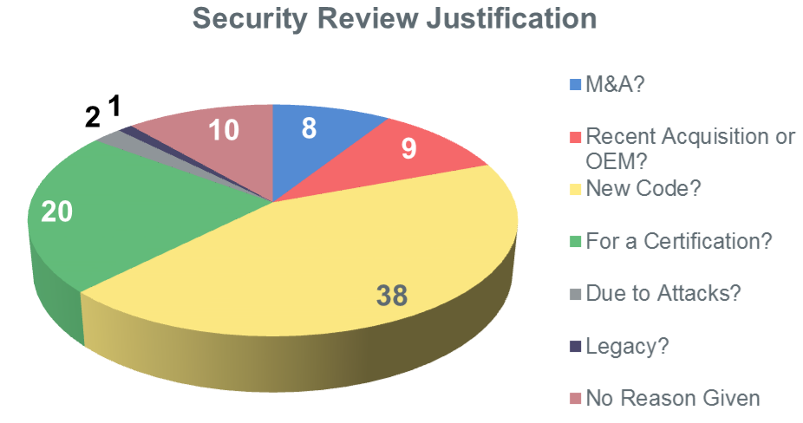
Metrics – Reason for Security Reviews
September 27, 2014

Slide 52
Product Security Maturity Model – Metrics
Level of Maturity
Partially automated
Multiple access
Detailed level
Patterns are apparent
PPT visuals
Key policies
Internally published policies
Mostly manual
Inefficient
Single access
High-level only
Stand-alone
Incomplete coverage
Key policies
Limited budget
Fully automated
Highly efficient
Real-time dashboard
All audience levels
Full coverage
Integrated
Externally published policies
Fully budgeted
X
All manual
Very inefficient
Incomplete
Immeasurable
Limited coverage
No policy
Awareness
No budget
Phase
None Initial Basic Acceptable Mature
September 27, 2014
52

Slide 53
What Makes This Program So Lean?
Core PSG group consists of a minimum of 3 people
  Sr. Director (Prior CSO)
  Security Review Expert (PSA)
  PSIRT / Program Manager (PSA)
Extended team is from co-located architects (50+) giving 10%-20% of their time, as opposed to having a core team of 20+ full-time PSAs (typical)
SDL includes PSIRT, which is unusual in this industry
Budget
  PSC get their travel budget from their BUs, not the PSG
  Cost of security tools and 3rd party reviews included in combined Dev. BU budgets
Leverage free / open source tools
September 27, 2014

Slide 54

Wish I Had Known (Tips)
Before purchasing and deploying in IT, ask 3rd party software providers about their SDL
  If they don’t have one, then big red flag
Running a PSG Team
  New PSCs must get upper management approval (SVP Eng.)
  Training vs. Mentoring
  Bi-weekly Business vs. Technical Meetings
  2x weekly PSG Staff Meetings (2 hours each)
  Must have published policies
    SDL
    PSIRT & Security Bulletin Templates
September 27, 2014

Slide 55

Running Analogy – The Reward
September 27, 2014

Slide 56
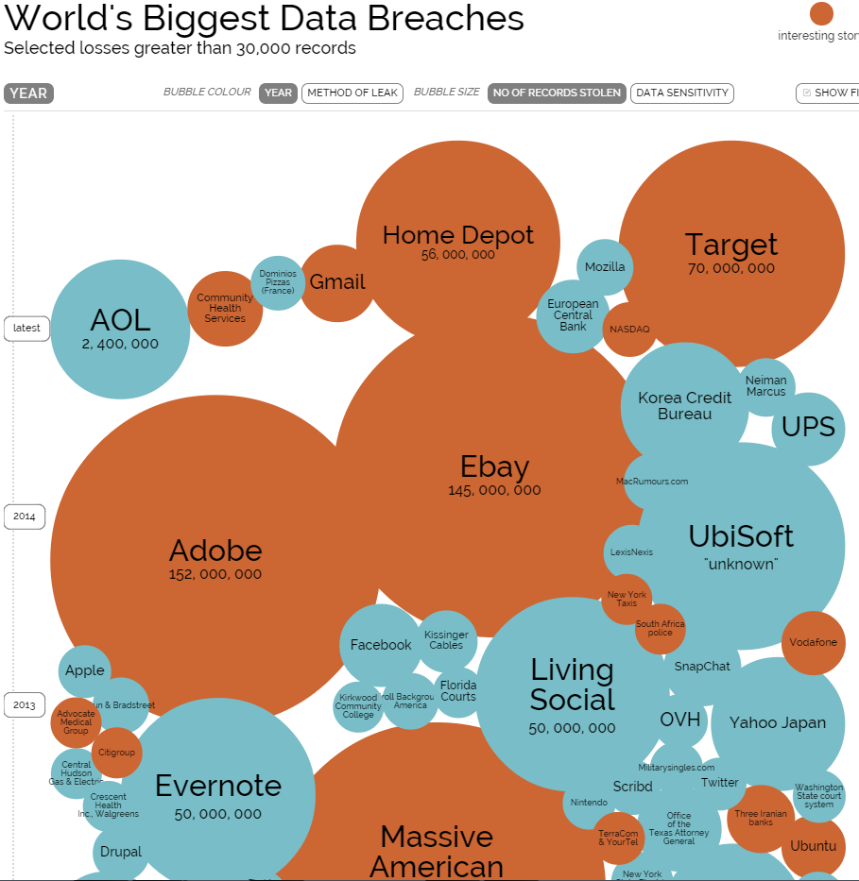
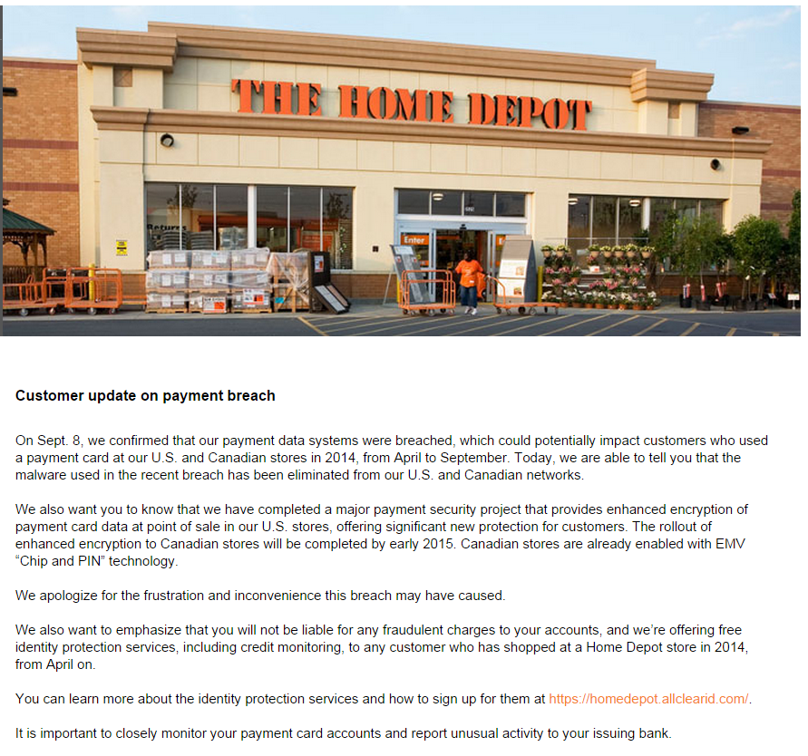
The Punishment Without …
September 29, 2014
Notes:
“World's Biggest Data Breaches”
http://www.informationisbeautiful.net/visualizations/worlds-biggest-data-breaches-hacks/

Slide 57
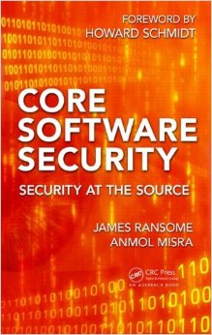

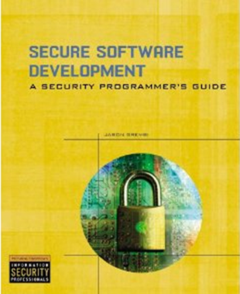

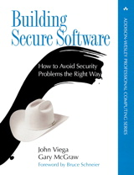

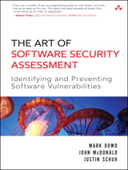

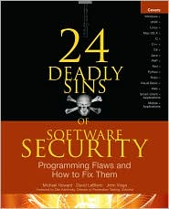
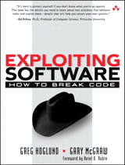


Recommended Reading List
Security Development Lifecycle
Think Like a Hacker and Adversary
September 27, 2014
57

Slide 58
Running an Agile Product Security Program – Part 2
              “It’s a marathon, not a sprint.”
                Harold Toomey | Principal Product Security Architect & PSIRT Manager, McAfee
                | College Sub-Chapter Director, North Texas ISSA
September 27, 2014
58

Slide 59

Agile SDL
September 27, 2014

Slide 60


Transition to Agile
Traditional PLF is a phased, gated, linear-flow process (waterfall)
As you move to Agile and Scaled Agile development, the SDLC will change to:
    A multi-level, continuous-flow process with regular checkpoints
    Reflect commitment to quality software developed on cadence and delivered on demand
    Shift from plan focus to value focus
The focus of the Agile SDL is on the why and the what, not the how

Slide 61
Agile SDL
Plan of
Intent
Program
Backlog
Release
Quality
Increment
(PSI)
Finished
Product
Team
Backlog
Stories
Daily
Scrum
Investment Themes,
Epics (Viability,
Feasibility, Desirability)
Release
Planning
Sprint
Planning
Development
& Test
Sprint
Review &
Retrospective
Release to
Customer
1-4 Weeks
Develop on a Cadence, Release on Demand
Plan-Of-Intent
Checkpoint
Release Planning
Checkpoint
Sprint Planning
Checkpoint
Sprint Checkpoint
Release Launch
Checkpoint
Notes:
Portfolio Level: multiple release trains
(ex: cloud initiatives)
Portfolio vision is aligned to business strategy, corporate vision, and investment intent (horizon planning)
Portfolio vision is enhanced by business and architectural epics which are cross-cutting across one or more programs
Program Level: 5-15 Agile teams working on a single release train
Program vision describes where the program is headed
Program Plan of Intent describes how the solution will evolve over time
Program backlog describes the features of the system
Agile Release Trains (long-lived team of Agile teams) , deliver value on a common cadence
Team Level: 7 +/- 2 multi-disciplinary team- members (developers, testers, product owners, etc.)
Agile team fully capable of defining, developing, testing, and delivering working and tested software to the program
Continuous Flow Process:
Sprint – is the smallest time-box (1 to 4 weeks)
Provides cadence and synchronization to facilitate planning, integration, and aggregation at the team level
Sprint planning is the most detailed planning done at the individual Scrum-team level.
Provides a quantum unit of thinking for the Program level considerations
PSI (super-sprint) - is the next development time-box (2-4 Sprints)
Provides cadence and synchronization to facilitate planning, integration, and aggregation at the program level
Provides a quantum unit of thinking for Portfolio level considerations
Release – Not time-boxed. Driven by business and customer needs.
Releases go to customers/external users.
A regular release cadence is encouraged, but not required.
Major releases usually align with a PSI boundary.

Slide 62

Agile SDL Sprint
Iterative
Design
Functional Testing
Build
Dynamic Testing
Web
Vuln.
Static Analysis
Secure Coding
Fuzzing
Code Review
Sprint_{n}
Sprint Checkpoint
September 27, 2014
62

Slide 63
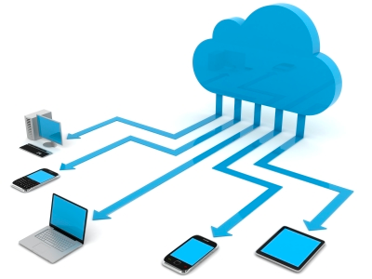



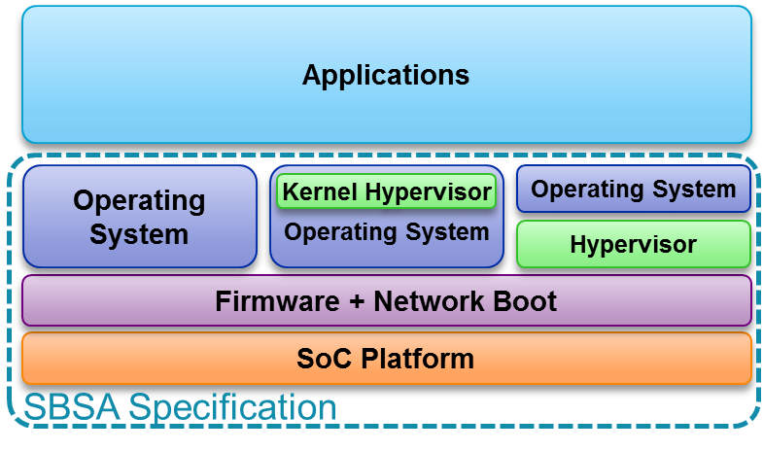
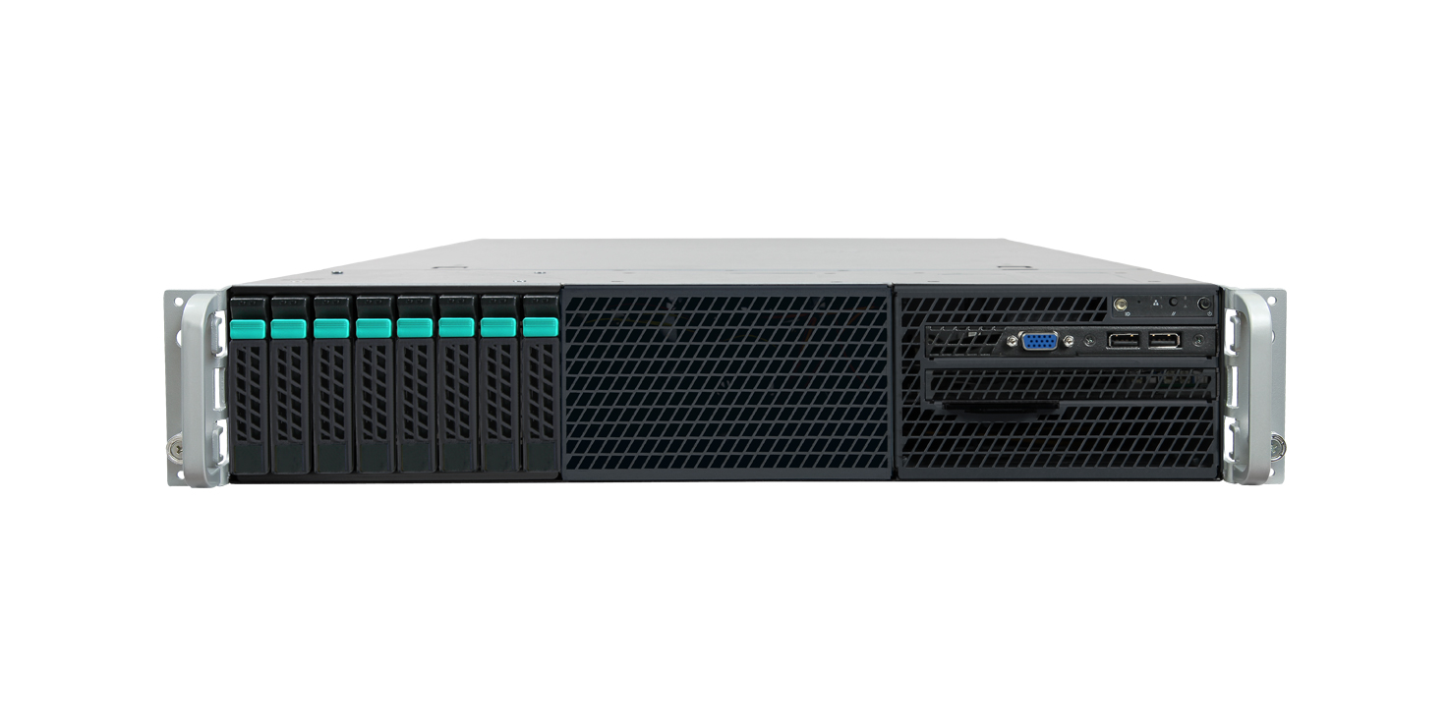
Core Architecture Types
COTS
Systems
Cloud/SaaS
Mobile
Endpoints
Consumer
Enterprise
Appliances
Underneath OS
September 27, 2014
63

Slide 64
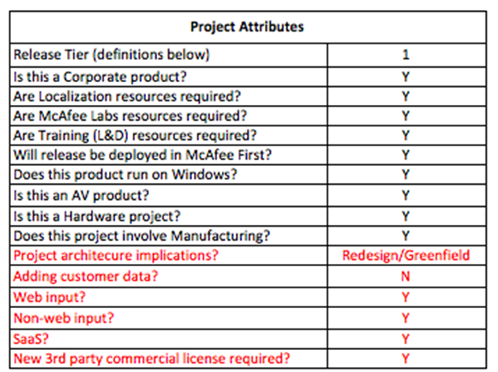
The 7 SDL Questions
What’s new?
  Greenfield, or
  Architecture change, or
  Adding security features
Adding 3rd party / open source?
Adding customer data (PII)?
System hosted by McAfee or
partner?
Is there a web server?
Are there other inputs? (any non-web input, config file, network, CLI, etc.)
Major release?
Notes:
There are seven key questions that can be asked at the start of every project. Based upon the answers, the correct "must-do" SDL activities will be chosen.
This process works for both waterfall and agile processes. Although, placement of the appropriate activities in each development process depends upon which Lifecycle is being used.
The first question, "What's new", is a pick-list choice. There should be one and only one choice (though these are not mutually exclusive, but rather, the second is a subset of the first choice. And security features is independent). The remainder of the questions are yes/no, binary.
The answer to each of these 7 questions determines, "What is the minimum set of required activities my project must perform?”
The questions and their associated task flow logic are embedded into the SDL Checklist used by the PgMs.

Slide 65

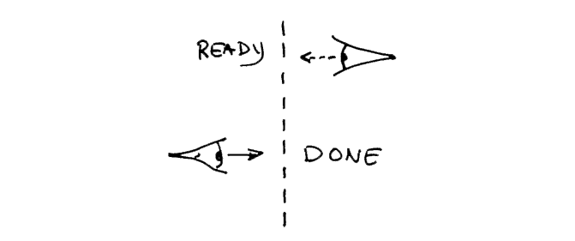
Security “Definition of Done” (DoD)
All code has been manually reviewed [defects fixed]
  Critical code senior or security SME reviewed
All code has been statically analyzed [defects fixed]
Web server interfaces have been dynamically tested [defects fixed]
All non-web program input paths have been fuzzed [defects fixed]
All functional tests have been passed
All tasks in the SDL S4 Security Plan are completed

Slide 66

PSIRT
Incident Response
September 27, 2014

Slide 67

What is PSIRT?
Product Security Incident Response Team
PSIRT =

Slide 68
Key Takeaways
PSIRT = Product Security Incident Response Team
Have a well defined PSIRT process
  PSIRT Policy and Procedures published on Intranet
Role-based Responsibilities
  PSIRT: Manage all issues for quality, accuracy and timeliness
  QA: Verify the vulnerability
  Dev: Patch the vulnerability
  PSC: Create a Security Bulletin (SB), CVSS Scoring
  Tier III SME: Contribute to SB, Approve Publication of SB, Create notif.
  TS: Publish SB
Only the PSG should communicate with the discoverers
Additional detailed presentations are available for PSIRT Processes & CVSS Scoring
If questions, contact Product Security Group
September 27, 2014

Slide 69
Secure Development Lifecycle (SDL)
e.g. Mapping the SDL to the SDLC
SDLC
SDL
September 27, 2014

Slide 70
PSIRT Process – High-Level
High-level process for all externally discovered product vulnerabilities:
①
PSIRT receives product vulnerability report from external source
②
Case opened with report details
③
PSA, Product Security Champions (PSCs), and Tier III SME assigned to the case
④
Product vulnerability verified with engineering, scored and ranked
⑤
Communication mechanism determined
⑥
Out-of-cycle fix or workaround developed, tested, and released
⑦
Platinum Support prepares KBs and SMS Alerts
⑧ Communication mechanism published, acknowledging issue, providing patch and CVSS score, and recognizing discoverer
⑨
Appropriate stakeholders notified
September 27, 2014
Notes:
The high-level process below is followed for all externally discovered product vulnerabilities:
PSIRT receives a product vulnerability report from an external source
A case is opened with report details
A Product Security Architect (PSA), Product Security Champions (PSCs), and Tier III SMEs are assigned to the case
The product vulnerability is verified with engineering, scored and ranked
Communication mechanism determined
An out-of-cycle fix or workaround is developed, tested, and released
Platinum Support prepares KBs and SNS Alerts
Communication mechanism published, acknowledging the issue, providing a patch and CVSS score, and recognizing the discoverer
Appropriate stakeholders are notified

Slide 71

PSIRT Process – Triage
Software / Product Security
Development
PSG
Operations
IT Sec
Application Security
security-alerts@mcafee.com
Triage Decision Tree: | Product Vulnerability | Application / Web Vulnerability | Product Performance Issue
Externally Reported | PSG → Security Bulletin | IT Sec → SOC | TS → KB Article
Internally Discovered | Eng → Bugzilla | IT Sec → SOC | Eng → Bugzilla
September 27, 2014

Slide 72
PSIRT Tracking Database
September 27, 2014

Slide 73
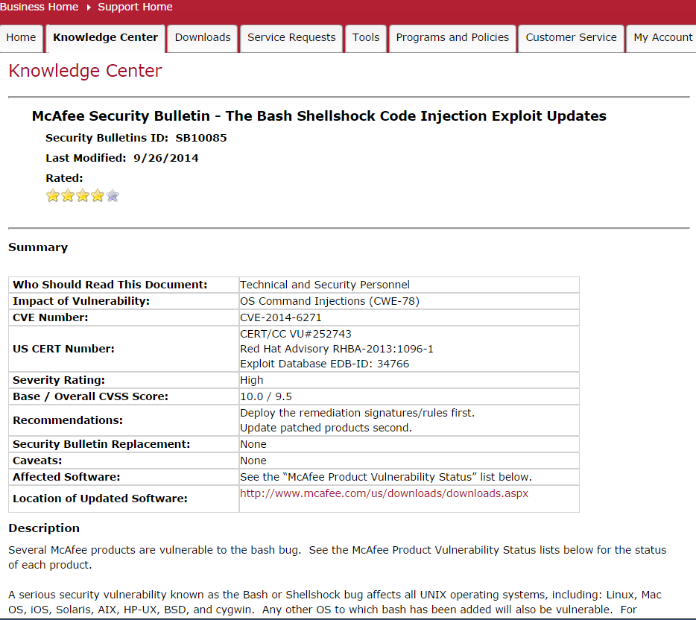
Security Bulletin – Bash / Shellshock
https://kc.mcafee.com/corporate/index?page=content&id=SB10085
September 27, 2014

Slide 74
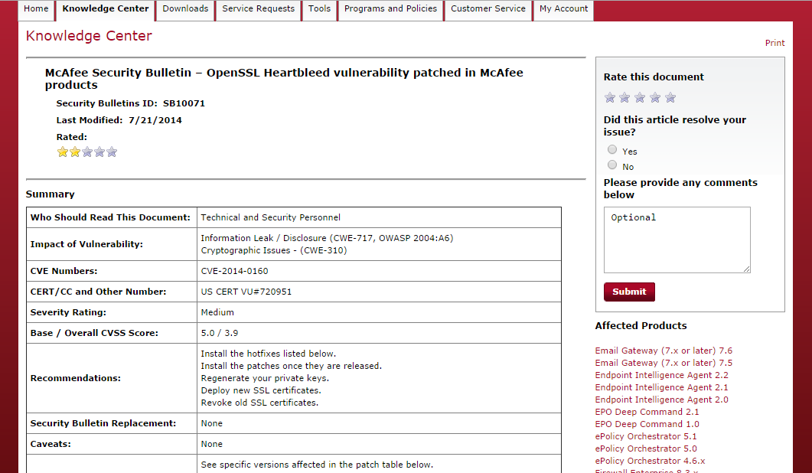
Security Bulletins
https://kc.mcafee.com/corporate/index?page=content&id=SB10071
September 27, 2014

Slide 75

Lessons Learned from Heartbleed
Joint parent company and subsidiary Incident Response
Team and escalation process
Shared technology inventory needed
  Internal Communication
  What you can tell customers (external comms.)
    Policy on communicating products known “Not Vulnerable”
    “Not Patched Yet” exception
  Process Education
Consolidated Security Bulletin w/buckets and KBs
  SNS Expectations – Early Notification, Security Experts (900K)
  Automated triggers
  PSIRT team consumed
  PSC response times (early vs. 5 days later)
Two (2) Incident Types (Heartbleed vs. IE)
September 27, 2014

Slide 76
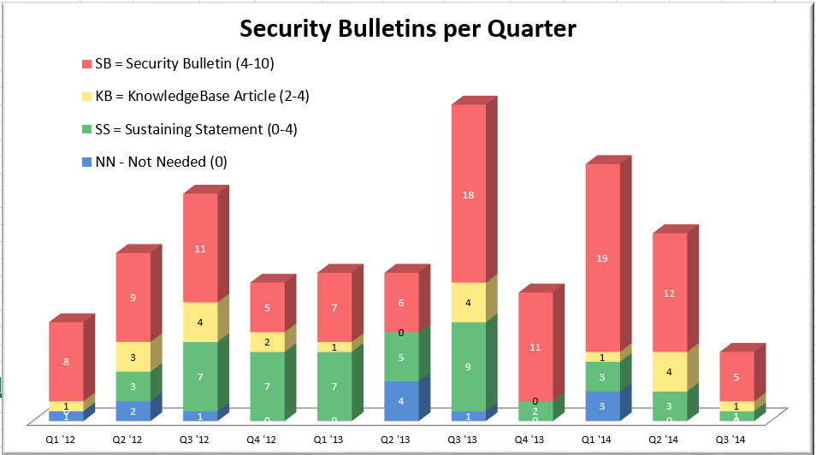
PSIRT - Security Bulletins per Quarter
September 27, 2014
76

Slide 77
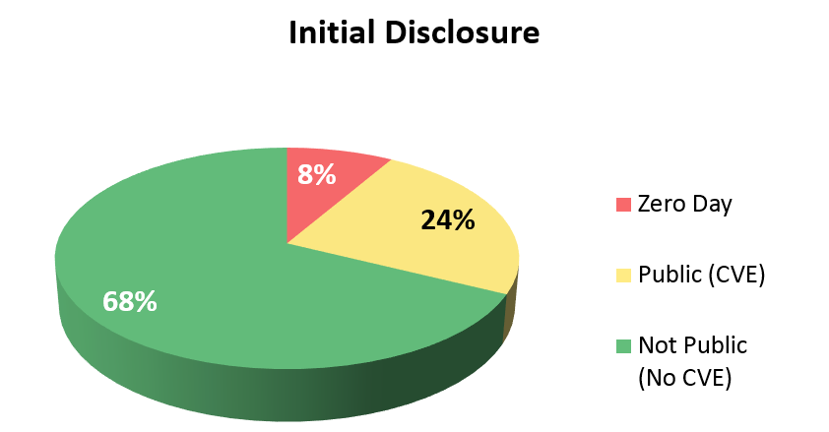
Discoverers
September 27, 2014
77

Slide 78

Fix Response
CVSS Severity Rankings
  7.0 – 10.0 High
  4.0 – 6.9 Medium
  0.0 – 3.9 Low
Fix Response
Priority | CVSS Score | Fix Response | SNS
P1 - Critical | 8.5-10.0 High | Must fix immediately (hotfix) | ALERT
P2 - High | 7.0-8.4 High | Must fix within a week (patch) | Notice
P3 - Medium | 4.0-6.9 Medium | Must fix within a month | Notice
P4 - Low | 0.0-3.9 Low | Must fix in next version update | Optional
P5 - Info | NA | Informational, will not fix | NA
September 27, 2014
Notes:
NVD Vulnerability Severity Rankings
NVD provides severity rankings of "Low," "Medium," and "High" in addition to the numeric CVSS scores, but these qualitative rankings are simply mapped from the numeric CVSS scores:
Vulnerabilities are labeled "Low" severity if they have a CVSS base score of 0.0-3.9.
Vulnerabilities will be labeled "Medium" severity if they have a base CVSS score of 4.0-6.9.
Vulnerabilities will be labeled "High" severity if they have a CVSS base score of 7.0-10.0.
http://nvd.nist.gov/cvss.cfm

Slide 79
Communication Response
Typical Communication Response
  SB – Security Bulletin
  KB – Knowledgebase Article
  SS – Sustaining Statement
  NN – Not Needed or Release Notes
SB / KB URL
  https://kc.mcafee.com/corporate
 | CVSS = 0 | 0 < CVSS < 4 Low | 4 ≤ CVSS < 7 Medium | 7 ≤ CVSS ≤ 10 High
External Disclosure (CVE) | KB if lots of attention, else NN | KB | SB + SMS | SB + SMS
Customer Disclosure | SS | SS | SB + SMS | SB + SMS
Internal (Bugzilla) | NN | NN | Document in release notes | SB (post-release)
September 27, 2014

Slide 80

Privacy
September 27, 2014

Slide 81
Privacy
Privacy focuses on the data lifecycle, not the product lifecycle
Collection
Accessing
Controlling
access
Organizing
Reporting
Analyzing
Adapting
Changing
Managing
Storage
Retrieving
Transmitting
Disseminating
Disclosing
Downloading
Destruction
Terminating Access
September 28, 2014

Slide 82
PIAs
Privacy Impact Assessments has five phases:
Business Process
Analysis
Reporting Results
Remediation
Verification
Data
Flows
Policies and Notices
Information Gathering
Remedy
September 27, 2014

Slide 83

Privacy Maturity Score
Current Status = 2.5 Goal State = 3~4
Privacy Policies | Account-ability | Identify and Classify | Incident and Breach Response | Notice Use | Access & Accuracy | Training | Privacy by Design | 3rd party Transfer | International Transfer | Retention & Disposal | Security
Maturity
High
5 - Optimized
4 - Managed
Recommended Minimum
3 – Defined
2 - Repeatable
1 –Ad hoc
Low
X = Subsidiary Score for each area
September 27, 2014
83

Slide 84

Q&A
Harold Toomey
College Sub-Chapter Director, ISSA North Texas
Harold_Toomey@McAfee.com
Harold@Toomey.org
(801) 830-9987
September 27, 2014

Slide 85
September 27, 2014
85

