Slide 1
Lessons learned as a PSIRT Manager
CERT Vendor Meeting – 20 April 2015
Harold Toomey | Principal Product Security Architect & PSIRT Manager
Intel Public
April 28, 2015
1
Notes:
Topic: “Lessons learned as a PSIRT Manager” (at Intel Security / McAfee)
It will cover:
Publishing a security bulletin before the TAMs are notified
Technology inventories (OpenSSL, 3rd party libraries)
Rogue discoverers (pie chart, form letters, recognition, PR)
Email overload and SBC IDs
Shared technologies security bulletin template
PSIRT Tracking tools and limitations
Metrics evolution from startup to 4 years later
Metrics peer pressure to inspire action
Updating security bulletins and release announcement surprises
Email vs. SharePoint surveys for metrics on security reviews and vulns
The Intel Security Product Security Maturity Model v1
Security bulletin listing vs CVE Numbering Authority
CWEs to look for trends in CVEs
CVSS Base Scores vs. Temporal Scores for action triggers
Reporting vulnerabilities to executives (triggers, oops, after a merge)
With each one I will present a scenario/problem and how it was solved (e.g. Problem slide / solution slide).

Slide 2
Introduction
Responsibilities
PSIRT Manager
Manage a team of 54 Sr. Security Architects (PSCs)
Manage the SDL, policies and PSG program
Training program
Metrics
Experience
4 Years: Eng. Software Security
2 Years: IT Operational Security
11 Years: Product Management
10 Years: Software Development (C++)
CVSS Special Interest Group (SIG)
ISSA North Texas Chapter, Past President
CISSP, CISA, CISM, CRISC, CGEIT, …
Harold Toomey
Principal Product
Security Architect
Intel Public
April 28, 2015
Notes:
Good afternoon.
My name is Harold Toomey.
I work for Intel Security.
I am here with my manager, Dr. James Ransome.
I attended this CERT Vendors meeting last year and wanted to contribute, so here I am.
I have worked for McAfee/Intel Security for the past 9 years.
Before that I worked for Symantec for 8 years.
For the past 4 years I have worked in software security.
I manage our PSIRT team as well as other SDL programs.
┘

Slide 3
Product Security Incident Response Team
PSIRT =
Intel Public
April 28, 2015
Notes:
As you all know, PSIRT stands for:
“Product Security Incident Response Team”
All vulnerabilities found in shipping products are reported to us.
We monitor over 110 consumer and enterprise products.
We get the vulnerabilities resolved quickly by working with engineering to verify and patch.
We also publish Security Bulletins with information on these vulnerabilities and their hotfixes, patches or updates.
I manage a virtual team of over 50 Senior Software Security Architects, or Product Security Champions (PSCs).
Each are collocated within the engineering teams all over the world.
They help us provide 24x7 monitoring worldwide.
┘

Slide 4
Lessons Learned
In Priority Order
Heartbleed post-mortem
CVSS / Risk Scores vs. SLAs
Email overload and case IDs
Email vs. SharePoint surveys
Metrics peer pressure to facilitate change
CWEs to look for trends in CVEs
Publishing a security bulletin before the TAMs are notified
Measuring how well teams do product security
Rogue discoverers
Syncing patches with published security bulletins
Reporting vulnerabilities to executives
Intel Public
April 28, 2015
Notes:
Lessons Learned
In Priority Order
As the PSIRT Manager for the past 4 years I have learned some important lessons.
I want to share and discuss some of them with you.
Feel free to interact and ask questions during my presentation.
I have listed 11 things I wish I had known, but don’t expect to get to them all in the time allotted to me.
Lets start at the top of my list – Heartbleed.
Heartbleed post-mortem
CVSS / Risk Scores vs. SLAs
Email overload and case IDs
Email vs. SharePoint surveys
Metrics peer pressure to facilitate change
CWEs to look for trends in CVEs
Publishing a security bulletin before the TAMs are notified
Measuring how well teams do product security
Rogue discoverers
Syncing patches with published security bulletins
Reporting vulnerabilities to executives
┘

Slide 5
1. Heartbleed Post-Mortem
Listing All Products in Advisories
Problem
Policy states only publish a security bulletin if there is a patch or workaround (something actionable).
Customers demand to know immediately if their products are vulnerable or not to highly publicized named vulnerabilities.
Intel Public
April 28, 2015
Notes:
1. Heartbleed Post-Mortem
Listing All Products in Advisories
Post-Mortem = Retrospective
Problem
Policy states only publish a security bulletin if there is a patch or workaround (something actionable).
Customers demand to know immediately if their products are vulnerable or not to highly publicized named vulnerabilities.
Facts
April 8, 2014 – The Heartbleed OpenSSL vulnerability was announced.
This vulnerability went undetected for several years.
OpenSSL is widely used in the public.
We have seen it used in about ¼ of our products.
(See next few slides)
Lessons Learned
Created a shared technologies security bulletin template
Updated PSIRT Procedures with the “Crisis Scenario”
For publicly known high-severity vulnerabilities affecting multiple products
Consolidated Security Bulletin listing all enterprise products into buckets
“Being Investigated” bucket only used if vulnerability is readily identified by customers
Shared technology inventory needed
What you can tell customers
Policy on communicating products known “Not Vulnerable”
“Not Patched Yet” exception
SNS Expectations – Early Notification
┘

Slide 6
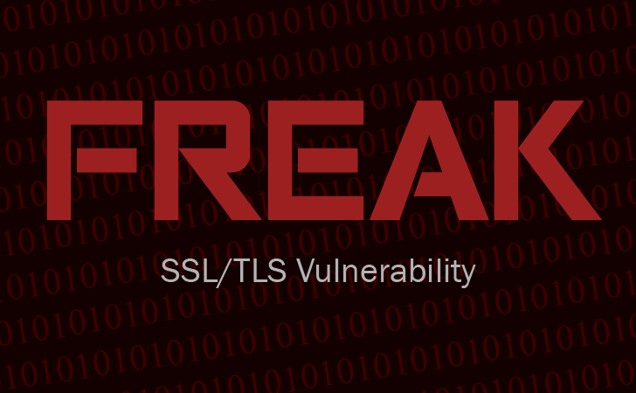
OpenSSL
“The gift that keeps on giving.”
Date | Description | # Vuln. Products | SB
11 May 2012 | CVE-2012-2110 | 1 | KB75482
28 Jan 2013 | CVE-2013-6450 | 1 | SBC
8 Apr 2014 | Heartbleed | 19 | SB10071
2 Jun 2014 | Heartbleed II | 22 | SB10075
9 Jun 2014 | GnuTLS Buffer Overflow | 1 | SB10078
16 Apr 2014 | CVE-2014-3511 | 2 | SB10084
22 Aug 2014 | CVE-2014-3507 | 1 | SB10105
14 Oct 2014 | POODLE | 28 | SB10090
14 Oct 2014 | 3 SSLv3 CVEs | 15 | SB10091
9 Jan 2015 | 8 OpenSSL CVEs | 2 | SB10102
4 Mar 2015 | FREAK | 3 | SB10108
19 Mar 2015 | 14 OpenSSL CVEs | 22 | SB10110
Summer 2015 | OpenSSL Security Audit | TBD | TBD
Intel Public
April 28, 2015
Notes:
OpenSSL
Trends:
In 2012 & 2013, we only saw one (1) OpenSSL vulnerability per year.
Then, in April 2014 we saw our first cutely named vulnerability - “Heartbleed”.
Every quarter since then we have seen a new named OpenSSL vulnerability.
We call OpenSSL “The gift that keeps on giving.”
We expect to see more OpenSSL vulnerabilities.
Cryptography Services, a part of the Linux Foundation's Core Infrastructure Initiative (CII), has begun an extensive audit of OpenSSL security.
Preliminary results of the audit could be out by the beginning of the summer, Cryptography Services said.
http://gcn.com/blogs/cybereye/2015/03/openssl-audit.aspxu ┘

Slide 7
Other Named Vulnerabilities
Linux/UNIX
Date | Description | # Vuln. Products | SB
24 Sep 2014 | Shellshock/BASH | 23 | SB10085
27 Jan 2015 | GHOST | 28 | SB10100
FACT: Heartbleed. The first logo ever designed for an internet security flaw.
Intel Public
April 28, 2015
Notes:
Other Named Vulnerabilities
Linux/UNIX
The crisis created by the Heartbleed bug fed into our concern about open source software overall.
I am sure you have all heard of other named vulnerabilities, such as Shellshock and GHOST.
Both have a CVSS score of 10.0.
Both primarily impact Linux and UNIX systems.
Shellshock affected only the Linux and Unix operating systems.
This vulnerability allows malicious code execution within the Bash shell.
GHOST was caused by a Linux glibc library vulnerability.
It allows attackers to remotely take complete control of the target system without having any prior knowledge of system credentials.
┘

Slide 8
Lessons Learned from Heartbleed
Process Improvements
Shared technologies security bulletin template listing all enterprise products into buckets
“Crisis Scenario” Procedures
Shared technology inventory
Communication Protocol
Early Notification Expectations
Intel Public
April 28, 2015
Notes:
Lessons Learned from Heartbleed
Process Improvements
Here is a list of what we learned after the Heartbleed post-mortem.
Lessons Learned
Created a shared technologies Security Bulletin template
Replaced having to publish 25 individual security bulletins – one per product.
This consolidated Security Bulletin lists all 80+ enterprise products, organized into buckets
These buckets are:
Vulnerable and Updated
Vulnerable and Not Yet Updated
Vulnerable but Not Exploitable
Vulnerable but Low Risk
Not Vulnerable
Being Investigated*
Updated PSIRT Procedures with the “Crisis Scenario” for publicly known, high-severity vulnerabilities affecting multiple products.
A crisis scenario exists if all of the below conditions are met:
Lots of media coverage (actual or anticipated) / Already viral
Multiple products expected to be or confirmed vulnerable (3 or more)
Mid-medium to high severity vulnerability (CVSS Base score of 5.0 – 10.0)
Customers suspect or can easily verify that their Intel Security product is vulnerable
* “Being Investigated” bucket only used if vulnerability is readily identified by customers
Shared technology inventory needed
We track many third party libraries for all 110+ products
Allows us to respond quickly
4) Communication protocols
What you can tell customers statement created for Technical Support
Policy on communicating products known “Not Vulnerable”
“Not Patched Yet” exception
SMS Expectations – Early Notification
Customers want us to be the first to tell them there is a threat
“Don’t worry about spamming us.” We take a quick look and delete it or act.
Speed vs. taking 4-8 hours to prepare a security bulletin first
What are the triggers?
┘

Slide 9
2. CVSS / Risk Scores vs. SLAs
Action Triggers
Problem
Customer was upset since CVSS base score was a medium and we had not published a patch yet after 25 days
vs.
Intel Public
April 28, 2015
Notes:
2. CVSS / Risk Scores vs. SLAs
Action Triggers
Problem
Customer was upset since CVSS base score was a medium and we had not published a patch yet after 25 days
Facts
Internal response SLAs depend upon scores
MITRE.org published CVEs
NIST.gov assigns CVSS Base scores
CVSS Temporal scores take time and always lower the base score
Ideal score is a Risk score which factors in the base score and how each product is affected by a vulnerability
Our unpublished SLA is 30 days for Medium risk vulnerabilities
Lessons Learned
Use CVSS base score to assign the initial risk score
Actual risk score assigned as soon as we hear back from the engineers as to how their products are impacted
Published statement on PSIRT site explaining CVSS Base Score vs. Risk Score
┘

Slide 10
SLA Guidelines
Do we need to drop everything and fix immediately?
CVSS Severity Rankings
7.0 – 10.0 High
4.0 – 6.9 Medium
0.0 – 3.9 Low
Fix Response
Priority | CVSS/Risk Score | Fix Response | SNS
P1 - Critical | 8.5-10.0 High | Must fix immediately (hotfix) | ALERT
P2 - High | 7.0-8.4 High | Must fix within a week (patch) | Notice
P3 - Medium | 4.0-6.9 Medium | Must fix within a month | Notice
P4 - Low | 0.0-3.9 Low | Must fix in next version update | Optional
P5 - Info | NA | Informational, will not fix | NA
Intel Public
April 28, 2015
Notes:
SLA Guidelines
Do we need to drop everything and fix immediately?
CVSS Severity Rankings
7.0 – 10.0 High
4.0 – 6.9 Medium
0.0 – 3.9 Low
Fix Response Guidelines
Priority CVSS/Risk Score Fix Response SNS
P1 – Critical 8.5-10.0 High Must fix immediately (hotfix) ALERT
P2 – High 7.0-8.4 High Must fix within a week (patch) Notice
P3 – Medium 4.0-6.9 Medium Must fix within a month Notice
P4 – Low 0.0-3.9 Low Must fix in next version update Optional
P5 – Info NA Informational, will not fix NA
Actual time frames not published on PSIRT website since these are still guidelines, not enforceable SLAs.
┘

Slide 11
3. Email Overload and Case IDs
Email Management
Problem
Too many email threads going on for multiple cases. Can’t track.
Intel Public
April 28, 2015
Notes:
3. Email Overload and Case IDs
Problem
Too many email threads going on for multiple cases. Can’t track.
Lessons Learned
Assign Security Bulletin Candidate (SBC) ID initially
Format: SBC<YYMMDDn>
Include on the subject line of all emails for that case
Change to Security Bulletin ID after it is published
Format: SB10<nnn>
Must reign in multiple threads by replying with
“Please include “SBC1504201” in the subject line for this issue.”
┘

Slide 12
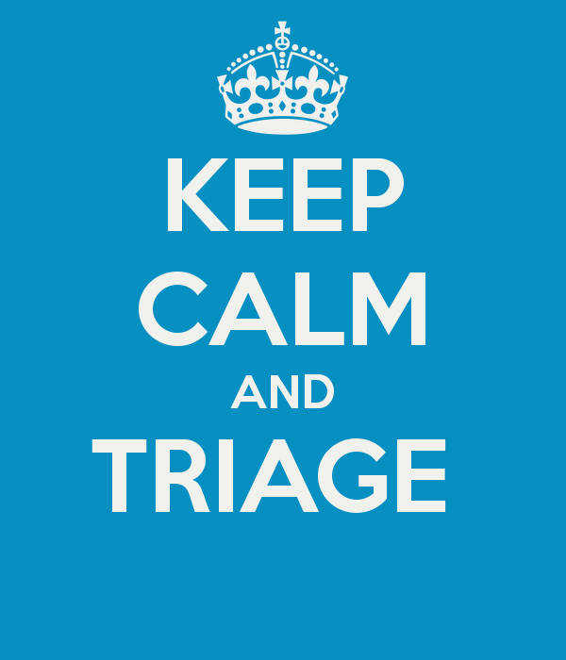
4. Email vs. SharePoint Surveys
For triaging vulnerabilities and recording security reviews
Problem
How do you quickly determine which of 100+ products are vulnerable to a CVE?
Intel Public
April 28, 2015
Notes:
4. Email vs. SharePoint Surveys
For triaging vulnerabilities and recording security reviews
Problem
How do you quickly determine which of 100+ products are vulnerable to a new vulnerability or CVE?
Facts
Possible ways:
Accurate product inventory
Query a tool like Black Duck Code Center
Call all 50+ PSCs
Contact the 6 PSC BU Leads then have them contact their BU’s PSCs
Send an email to all 50+ PSCs
Send a link to a SharePoint Survey to all PSCs
Lessons Learned
Form email with table works, but still have email overload
Having a survey where all PSCs can record and update their product’s vulnerability status is even better
Microsoft Office SharePoint Server (MOSS) has built-in graphs and metrics
A template can easily be created then reused per vulnerability
┘

Slide 13
5. Metrics Peer Pressure to Facilitate Change
Adage: “Everyone is out of step except Johnny.”
Problem
Every product needs a Product Security Champion (PSC) assigned by a Sr. VP or GM.
One of the product groups was not taking this seriously.
Intel Public
April 28, 2015
Notes:
5. Metrics Peer Pressure to Facilitate Change
Adage: “Everyone is out of step except Johnny.”
Problem
Every product needs a Product Security Champion (PSC)
PSCs are assigned by a Sr. VP of Engineering or GM so we have executive buy-in
One of the product groups was not taking this seriously.
Facts
We published our staffing metric to the head of engineering
He took notice
The BU Engineering VP saw that everyone else was with the program but his BU
We had a lead PSC and multiple product PSCs assigned within 2 weeks
Lessons Learned
Metrics should drive positive change
A little peer pressure based on facts is often all that is needed
┘

Slide 14
Product Security Champion (PSC) Staffing
Software Group #1 | Software Group #2 | Software Group #3 | Software Group #4 | Software Group #5
BU | BU | BU | BU | BU
Prod 1A | Prod 2A | Prod 3A | Prod 4A | Prod 5A
Prod 1B | Prod 2B | Prod 3B | Prod 4B | Prod 5B
Prod 1C | Prod 2C | Prod 3C | Prod 4C | Prod 5C
Prod 1D | Prod 2D | Prod 3D | Prod 4D | Prod 5D
Prod 1E | Prod 2E | Prod 3E | Prod 4E | Prod 5E
Prod 1F | Prod 2F | Prod 3F | Prod 4F | Prod 5F
Prod 1G | Prod 2G | Prod 3G | Prod 4G | Prod 5G
Prod 1H | Prod 2H | Prod 3H | Prod 4H | Prod 5H
 | Prod 2I | Prod 3I | Prod 4I | Prod 5I
 | Prod 2J | Prod 3J | Prod 4J | Prod 5J
 | Prod 2K | Prod 3K | Prod 4K
 | Prod 2L |  | Prod 4L
 | Prod 2M |  | Prod 4M
KEY: |  |  | Prod 4N
Red – No PSC |  |  | Prod 4O
Yellow – BU PSC Only |  |  | Prod 4P
Green – Product PSC
Intel Public
April 28, 2015
Notes:
Product Security Champion (PSC) Staffing
This is similar to how the staffing metric looked.
As you can see, Software Group #2 has not assigned a PSC for each and every product.
After sharing this metric with all of the Software Groups, SG #2 had assigned PSCs to all products within 2 weeks.
┘

Slide 15
Product Security Dashboard
Overall Status and Definitions
Static Analysis – Percent Open (Found but not fixed)
Proactive: 0% is ideal
“Dismissed” means False Positive or As Designed
Security Reviews
Proactive: The more the better
External Disclosures (PSIRT)
Reactive: The less the better
Training
Proactive: 100% is ideal
$$\% Open=\frac{Open}{Total−Dismissed}$$
Intel Public
April 28, 2015
Notes:
Product Security Dashboard
The primary metrics that we report to executive management are:
Static Analysis – Percent Open (Found but not fixed)
Goal: Reduce technical debt
Security Reviews
Goal: All products have security reviews at least every 2 years
External Disclosures (PSIRT)
Goal: Clean software so we have less disruptive hotfixes and security bulletins
Training
Goal: 100% of engineers get trained on core courses
For the top three (3) metrics we use heat maps to provide a single view of truth.
┘

Slide 16
6. CWEs to Look for Trends in CVEs
See BSIMM-V CR1.6 Know which bugs matter (for training)
Problem
How do we identify reoccurring issues so we can provide company-specific training?
Recurring Common Security Weaknesses
CWE-22: Path Traversal to a Restricted Directory
CWE-428: Unquoted Search Path or Element
CWE-759: Use of a One-Way Hash without a Salt
Intel Public
April 28, 2015
Notes:
6. CWEs to Look for Trends in CVEs
See BSIMM-V CR1.6 Know which bugs matter (for training)
Problem
How do we identify reoccurring issues so we can provide company-specific training?
Facts
Mitre.org has published a list of Common Weaknesses called CWE.
A CWE categorizes multiple CVEs into the root cause
CWEs are listed with each CVE by NIST.gov (not mitre.org) at the bottom of the page
See BSIMM-V CR1.6 (Build Security In Maturity Model version 5 – Code Review Practice – Level 1, Number 6)
OBJECTIVE: Know which bugs matter (for training)
ACTIVITY: Use centralized reporting to close the knowledge loop and drive training (T: strategy/metrics)
Lessons Learned
Record CWEs with each issue
Include in metrics to see trends
Create product-specific training for PSCs and engineering using actual data
CWE-22: Path Traversal to a Restricted Directory
CWE-428: Unquoted Search Path or Element
CWE-759: Use of a One-Way Hash without a Salt
┘

Slide 17
7. Publishing a Security Bulletin Before the TAMs are Notified
Text Message Timing – “Cart before the horse”
Problem
A new Security Bulletin is published.
An onsite TAM is visited by that company’s security manager for more information.
This is the first the TAM has heard of it.
Intel Public
April 28, 2015
Notes:
7. Publishing a Security Bulletin Before the TAMs are Notified
Text Message Timing – “Cart before the horse”
Problem
A new Security Bulletin (or SB) is published.
An onsite TAM is visited by that company’s security manager for more information.
This is the first the TAM has heard of it.
Facts
Once a patch is ready for customer download, engineering want to get the work out immediately
Pressure is on to get the Security Bulletin published externally
The PSIRT used to give the final approval to have an SB go live.
Lessons Learned
Modified Process:
Technical Support SMEs must approve SBs for publication
They must first submit an SNS (text alert)
They must also contact Support Readiness
They send the info to our employees first (20 min – 2 hours)
┘

Slide 18
8. Measuring How Well Teams Do Product Security
The Intel Security Product Security Maturity Model (PSMM)
Problem
We have an SDL. How well are the product teams following it?
Intel Public
April 28, 2015
Notes:
8. Measuring How Well Teams Do Product Security
The Intel Security Product Security Maturity Model (PSMM)
Problem
We have an SDL. It is well defined for both waterfall and agile. How well are the product teams following it?
Facts
This metric indicates how well the BUs are implementing the product security program.
Lessons Learned
We designed our own MM to match our SDL
Engineers asked for a spreadsheet with drop-downs so they can easily rate their product teams
Automation
Peer review
┘

Slide 19
PSMM Parameters
Operational Technical
Program
Process
Resources
Training
Security Reviews
Tools
PSIRT
SDL
Policy
Privacy
Certification
M&A
Extended Team
Threat Modeling / Architecture Reviews
Static Analysis
Dynamic Analysis (Web Apps)
Fuzz Testing
Vulnerability Scans / Penetration Testing
Manual Code Reviews
Secure Coding Standards
Open Source / 3rd Party Libraries
Tracking Tools
Intel Public
April 28, 2015
19
Notes:
PSMM Parameters
Our simple maturity model categorizes 22 parameters into two categories:
Operational for the program and
Technical for the engineers.
Operational
Program
Process
Resources
Training
Security Reviews
Tools
PSIRT
SDL
Policy
Privacy
Certification
M&A
Extended Team
Technical
Threat Modeling / Architecture Reviews
Static Analysis
Dynamic Analysis (Web Apps)
Fuzz Testing
Vulnerability Scans / Penetration Testing
Manual Code Reviews
Secure Coding Standards
Open Source / 3rd Party Libraries
Tracking Tools
┘

Slide 20
Intel Security Product Security Maturity Model (PSMM) – Operational
SVP commitment
Tier-1 PSCs
Mandatory training
3+ tools integrated
PgM milestones
PSIRT defined
SDL used
Privacy + security
Extended team
Developer-centric
Self-sustaining
Scalable
BU PSAs
Tier-3 PSCs
PSEs
SME training
Early reviews
Tools budget
Proactive PSIRT
Agile/waterfall, HW/SW SDL
Tight integration
Policy executive support
Tight privacy integration
M&A engaged
Multiple crises
Level of Maturity
Continued improvement
2+ PSAs
Tier-2 PSCs
Extensive training library
Security reviews
Tool experts
Dedicated PSIRT
ISO 27034 compliance
Tight privacy partnership
Single crisis
Plan created
BU PSCs
1+ tools
PSIRT is CSIRT
SDL adopted
Privacy team
Awareness
No budget
No reviews
Few tools
No PSIRT
Tribal knowledge
PSMM Phase
None Initial Basic Acceptable Mature
Intel Public
April 28, 2015
20
Notes:
Like all maturity models, you go from low to high maturity based on your activities.
We have them defined in detail for our PSCs to ascertain what level their teams are operating at.
The Operational parameters are about the program as a whole.
┘

Slide 21
Intel Security Product Security Maturity Model (PSMM) – Technical
Level of Maturity
All releases threat modeled
Defect rates decreasing
Fuzzing scripts written
Accept risks of open source
Tracking DB w/dashboard
Preventive measures modeling
Defect rates near 0
Best-in-class tools
All products pen tested
Open source SLAs
Standards adapted to environment
Metrics integrated into risk mgt. tools
Major releases threat modeled
All primary tools used
BlackDuck
Standards adopted
PSIRT XLS
Major attack vectors addressed
Freeware tools used
Standard awareness
Frequent attacks
No reviews
No constraints
Email tracking
PSMM Phase
None Initial Basic Acceptable Mature
Intel Public
April 28, 2015
21
Notes:
The Technical parameters are about how well the engineers are practicing secure principles and using their tools.
┘

Slide 22
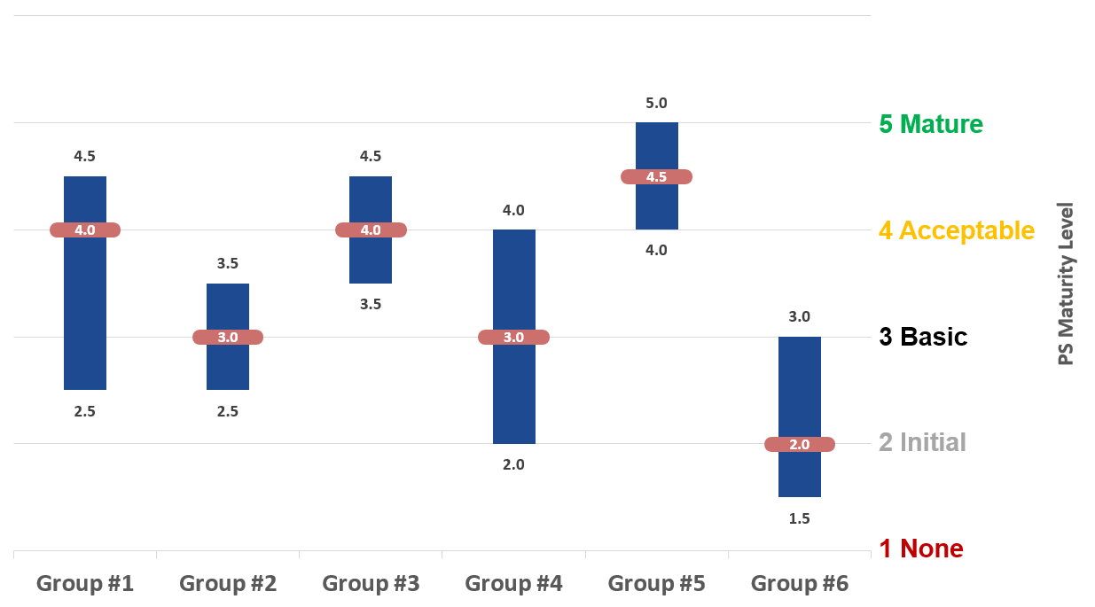
Product Security Maturity Model (PSMM) by BU
This metric indicates how well the BUs are implementing the product security program.
Intel Public
April 28, 2015
Notes:
Product Security Maturity Model (PSMM) by BU
Again, this metric indicates how well the BUs are implementing the product security program.
Each Software Groups has multiple engineering team located in different development centers.
Some are more mature security-wise than others.
The data above is fictitious, of course. It was created using a stock chart in MS Excel.
We record the groups highest and lowest scores, along with the average.
Newly acquired companies tend to be lower on the scale.
PSCs peer review each other for self policing.
┘

Slide 23
9. Rogue Discoverers
“Look how smart I am!”
Problem
A discoverer threatens to publish their findings before we can patch
Intel Public
April 28, 2015
Notes:
9. Rogue Discoverers
“Look how smart I am!”
Problem
A discoverer threatens to publish their findings before we can patch
Lessons Learned
Work with Public Relations (PR) to draft a holding statement in case the discover goes rogue
We give credit to external vulnerability discoverers only if:
They desire to be identified as a discoverer.
They did not “zero day” us or make their research public before the SB or KB is published.
Use an email template to respond with:
Acknowledgement
Anticipated fix timeframe
Security Bulletin (SB) published with them acknowledged
<See pie chart (8%)>
┘

Slide 24
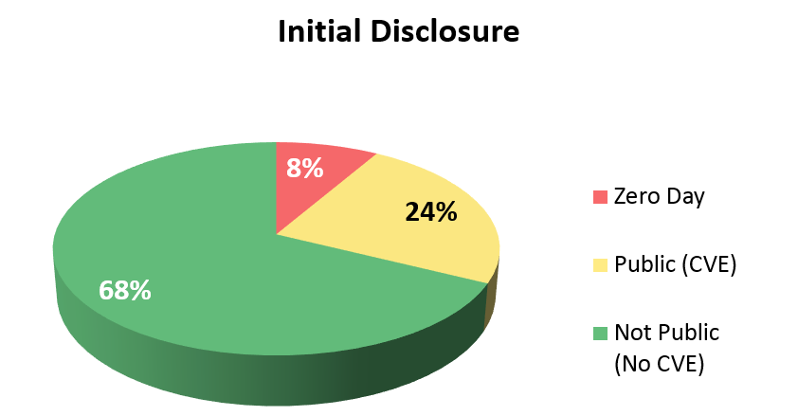
Product Vulnerability Discoverers
Intel Public
April 28, 2015
24
Notes:
We created this pie chart with 4 years of solid date collected.
We see that ~8% of all reported product vulnerabilities are Zero-Days.
Two (2) years ago this was at 10%.
Another 24% are from published CVEs.
The remaining are reported to us by customers and “benevolent discoverers”.
┘

Slide 25
10. Syncing Patches with Published Security Bulletins
Updating security bulletins and release announcement surprises
Problem
How do you keep a Security Bulletin up to date with product patches if the engineering team forgets to tell you when their patch was released?
Intel Public
April 28, 2015
Notes:
10. Syncing Patches with Published Security Bulletins
Problem
How do you keep a Security Bulletin up to date with product patches if the engineering team forgets to tell you when their patch was released?
Facts
Some engineering team are better than others in informing us of patches and updates that address a vulnerability in a published Security Bulletin.
Lessons Learned
Subscribe to the weekly Tech Support email newsletter.
They list all product patches released.
We then can reconcile that list with our PSIRT database and update Security Bulletins.
┘

Slide 26
11. Reporting PSIRT Vulnerabilities to Executives
Technical Speak ≠ Business Speak
Intel Public
April 28, 2015
Notes:
11. Reporting PSIRT Vulnerabilities to Executives
Technical Speak ≠ Business Speak
Lessons Learned
Technical Speak ≠ Business Speak
Just because an engineer names an issue doesn’t make it accurate
May need to reword for executive summaries
┘

Slide 27
Q&A
Harold Toomey
Principle Product Security Architect
Product Security Group
Intel Security
Harold_Toomey@IntelSecurity.com
(801) 830-9987
Intel Public
April 28, 2015

Slide 28
Intel Public
April 28, 2015
28

