Slide 1
Software Security – My Other Marathon
Harold Toomey
Past President, ISSA North Texas, 2013
Principal Product Security Architect & PSIRT Manager
Intel Security
April 24, 2015

Slide 2
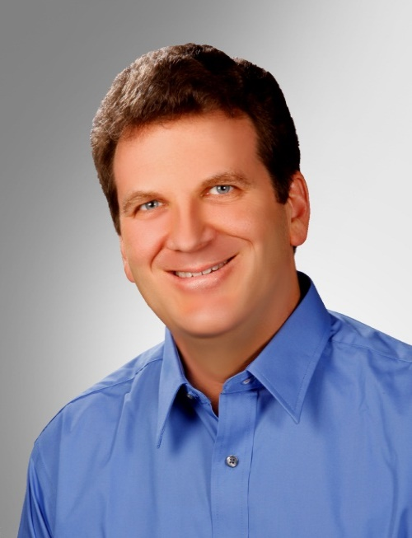
Introduction
Responsibilities
PSIRT Manager
Manage a team of 50+ Sr. Security Architects (PSCs)
Manage the SDL, policies and PSG program
Training program
Metrics
Experience
4 Years: Eng. Software Security
2 Years: IT Operational Security
11 Years: Product Management
10 Years: Software Development (C++)
ISSA North Texas Chapter, Past President
CISSP, CISA, CISM, CRISC, CGEIT, ITIL, …
CVSS Special Interest Group (SIG)
Harold Toomey
Principal Product
Security Architect
Notes:
Good morning.
My name is Harold Toomey.
I work for Intel Security.
I attended the first Cyber Security Conference last year and wanted to contribute more this year, so here I am.
I have worked for McAfee/Intel Security for the past 9 years.
Before that I worked for Symantec for 8 years.
For the past 4 years I have worked in software security.
I manage our PSIRT team as well as other SDL programs.

Slide 3
Agenda
Plot #1: Developing Secure Software
Plot #2: Running a 100 Mile Ultra Marathon
Which is easier?
vs.
Notes:
“Product Security is like running a marathon. It’s not a sprint. Prepare for the long haul.”

Slide 4
Scenario #1 – Secure Software
110+ Enterprise and consumer security products
4,000+ software engineers
200M+ customers
Someone reports a vulnerability
Now what?
How did this happen?

Slide 5
Scenario #2 – 100M Ultra Run
You gained 50 pounds over the past 10 years
You hear running gets you healthy again
You sign up for a 100 mile ultra marathon
Are you crazy? (yes, of course)
How long will it take for you
to pull this off?

Slide 6
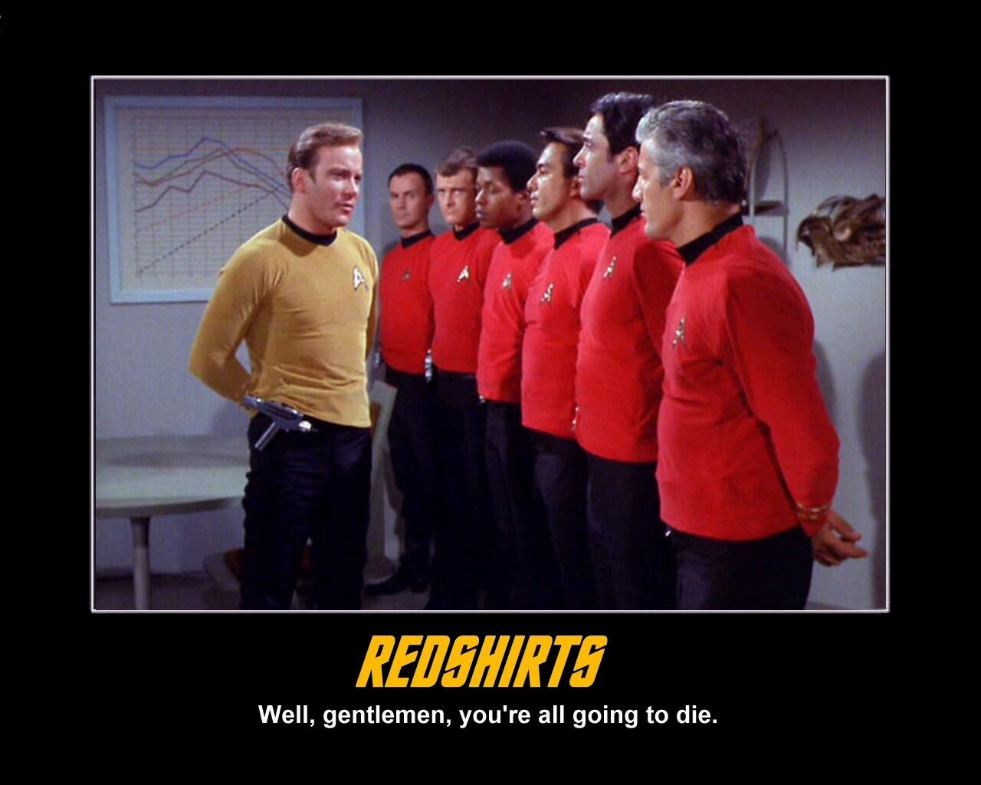
#1 The Development Team
Executive Support
Software Engineering Teams
Product Security Group / PSIRT
Product Security Champions (PSCs)
Tier III Technical Support
Knowledgebase Team
Extended Team
IT, PR, Legal, Training
Notes:
Redshirts
“Well gentlemen, you’re all going to die.”
Product Security Champions (PSCs)
Qualification:
A minimum of 3-5 years software development experience (architects preferred)
A passion for or background in software security
Approved by the BU General Manager & BU PSC Lead
Dedicate 10% - 20% of their time doing product security tasks
Time to be trained in software security, tools, plans, and processes
Must not only know how to develop (build) software, but also know how to deconstruct it (take it apart) while “thinking like a hacker”
Responsibilities:
Enforce the SDL: Assist the PSG in assuring the security tenants of confidentiality, integrity, availability, and privacy are adhered to
Reviews: Assist the PSG’s software security architects in conducting architecture security analysis, reviews, and threat modeling
Escalations: Assist with Security Bulletins and patches for externally disclosed vulnerabilities (PSIRT)
Tools Expert: e.g. static, dynamic – which includes fuzzing, within each product development team, and/or business unit (BU)
Collocated: Be the eyes, ears, and advocate of the PSG within each product development team / BU
Attend Meetings: Participate in weekly Admin / Technical meetings as a team

Slide 7
#2 Your Running Crew
Supportive spouse
Trainer
Running buddies
Your dog (Roxy)
Facebook running friends
Marathon Maniacs
Race volunteers
Pacers

Slide 8
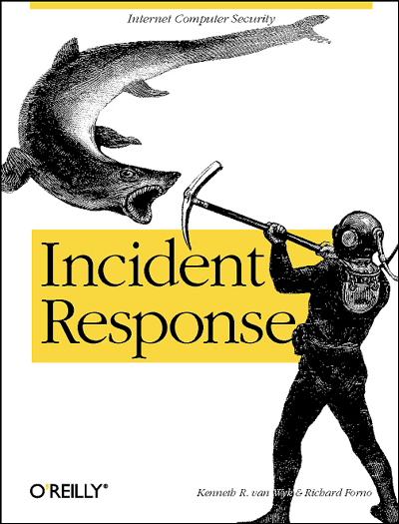
#1 PSIRT Process
Contact engineering network (PSCs)
Verify the vulnerability
Score the vulnerability’s severity (CVSS)
Communicate fix schedule to the discoverer
Develop and publish the patch
Publish Security Bulletin
Next week: “lather, rinse, repeat”

Slide 9
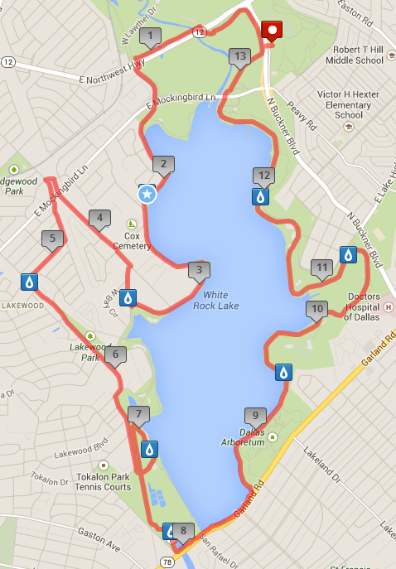
#2 Ultra Training
Start running
Sign up for weekend races (milestones)
Set goals
Read about it
Friend like minded runners
Learn by experience (pain)
Build up to it

Slide 10
#2 Possible Training Goals
Year 1
Run a 5K to see how out of shape you are
Run a half marathon after 6 months
Run a full marathon after 1 year
Year 2
Run a half marathon or farther every weekend
Year 3
Run an ultra every month, with 2x 100M by end of year
Try Sprint and Olympic Ironman Triathlons
Year 4
Run a 100 miler every month (Jun – Feb)

Slide 11
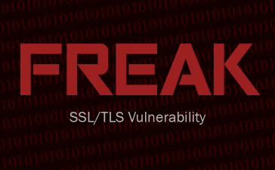
#1 Named Vulnerabilities
Date | Description | # Vuln. Products | SB
8 Apr 2014 | Heartbleed | 19 | SB10071
2 Jun 2014 | Heartbleed II | 22 | SB10075
24 Sep 2014 | Shellshock/BASH | 23 | SB10085
14 Oct 2014 | POODLE | 28 | SB10090
14 Oct 2014 | 3 SSLv3 CVEs | 15 | SB10091
27 Jan 2015 | GHOST | 28 | SB10100
4 Mar 2015 | FREAK | 3 | SB10108
19 Mar 2015 | 14 OpenSSL CVEs | 22 | SB10110
Summer 2015 | OpenSSL Security Audit | TBD | TBD
“OpenSSL: The gift that keeps on giving.”
Notes:
OpenSSL
Facts
April 8, 2014 – The Heartbleed OpenSSL vulnerability was announced.
This vulnerability went undetected for several years.
OpenSSL is widely used in the public.
We have seen it used in ¼ of our products.
In 2012 & 2013, we only saw one (1) OpenSSL vulnerability per year.
Then, in April 2014 we saw our first cutely named vulnerability - “Heartbleed”.
Every quarter since then we have seen a new named OpenSSL vulnerabilities.
We call OpenSSL “The gift that keeps on giving.”
We expect to see more OpenSSL vulnerabilities.
Cryptography Services, a part of the Linux Foundation's Core Infrastructure Initiative (CII), has begun an extensive audit of OpenSSL security.
Preliminary results of the audit could be out by the beginning of the summer, Cryptography Services said.
http://gcn.com/blogs/cybereye/2015/03/openssl-audit.aspx
Linux/UNIX
The crisis created by the Heartbleed bug fed into our concern about open source software overall.
I am sure you have all heard of other named vulnerabilities, such as Shellshock and GHOST.
Both have a CVSS score of 10.0.
Both primarily impact Linux and UNIX systems.
Shellshock affected only the Linux and Unix operating systems.
This vulnerability allows malicious code execution within the Bash shell.
GHOST was caused by a Linux glibc library vulnerability.
It allows attackers to remotely take complete control of the target system without having any prior knowledge of system credentials.

Slide 12
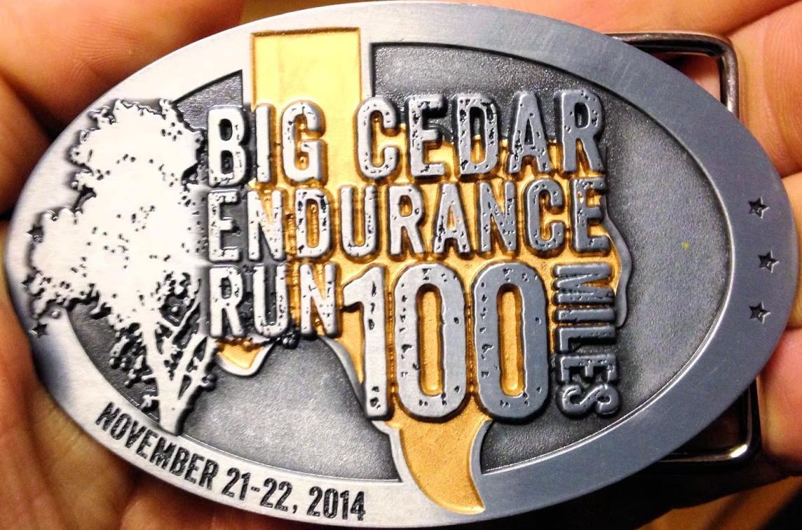
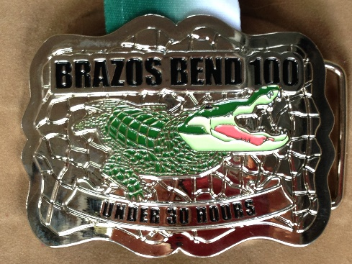
#2 Popular/Local Races
Boston Marathon (20 Apr 2015)
Badwater 135 (28-30 July 2015)
Big Cedar 100M (30-31 Oct 2015)
Brazos Bend 100M (11-12 Dec 2015)
Rocky Raccoon 100M (1-2 Feb 2016)

Slide 13
#1 Doing the Basics
Minimum SDL activities
Compile with security flags set
Remove banned C/C++ functions
Fix high severity vulnerabilities
Complete Static/Dynamic Analysis/Fuzzing
Manual code reviews
Validate inputs
Build in privacy/protect PII
Remove debugging code
Scan for viruses/malware
Don’t implement backdoors

Slide 14
#2 Doing the Basics
You can’t outrun a bad diet
15% Exercise
85% Diet
Sleep
Regular run schedule
Buy good equipment
Positive attitude (“Never give up”), but
Never run on an injury

Slide 15
#1 Proactive Measures – Waterfall
0 | 1 | 2 | 3 | 4 | 5
Concept | Planning | Design & Development | Readiness | Release & Launch | Support & Sustain
SDL
Security Assessment | Architecture | Design & Development |  | Ship | Post-Release, Legacy, & M&A
S0 | S1 | S2 | S3 | S4 | S5
Product security team is looped in early (Product Security Group & Product Security Champions) Product security team hosts a discovery meeting Product security team creates an SDL project plan (states what further work will be done) Product team initiates a Privacy Impact Assessment (PIA) | S1 Security Plan SDL policy assessment & scoping Threat modeling / architecture security analysis Privacy information gathering and analysis | S2 Security Plan Security test plan composition Static analysis Threat model updating Design security analysis & review Secure coding Privacy implementation assessment | S3 Security Plan Security test case execution Static analysis Dynamic analysis Fuzz testing Manual code review Privacy validation and remediation | S4 Security Plan Final security review Vulnerability scan Penetration test Open source licensing review Final privacy review | External vulnerability disclosure response (PSIRT) Reviews by 3rd party service contractors Post-release certifications Internal review for new product combinations or cloud deployment Security architectural reviews & tool-based assessments of legacy and M&A products
Notes:
Static Analysis:
A method of examining software at compile time, reporting potential defects
Dynamic Analysis:
A method of examining software at runtime, by executing the code over multiple test cases
Fuzz Testing:
Providing unexpected, invalid, or random data to an application with the intention of triggering a bug

Slide 16
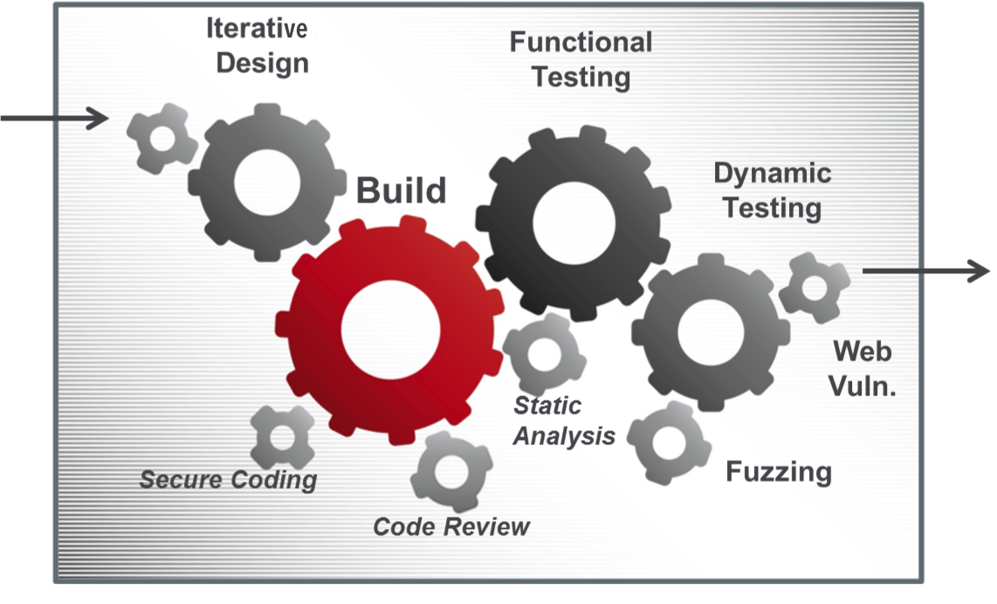
#1 Proactive Measures – Agile
User/abuser stories
(chewable design bites)
Potentially
Shippable
Increments
(PSI)
Sprint
Notes:
Static Analysis:
A method of examining software at compile time, reporting potential defects
Dynamic Analysis:
A method of examining software at runtime, by executing the code over multiple test cases
Fuzz Testing:
Providing unexpected, invalid, or random data to an application with the intention of triggering a bug

Slide 17
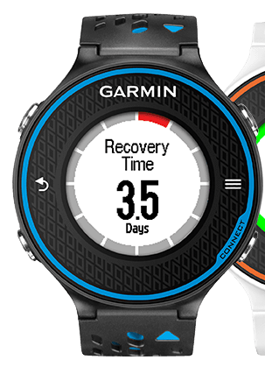
#2 Proactive Measures
Heart Rate
Muscle Fatigue
Pain Killers
Breathing
Timing

Slide 18
#1 Learn from Pain
Lessons Learned from Heartbleed
New “Crisis Scenario” policy
Updated security bulletin template
Product buckets
Customer communication policy
Shared technology inventory
Early notification expectations
PSIRT process training
Notes:
1. Heartbleed Post-Mortem
Listing All Products in Advisories
Post-Mortem = Retrospective
Problem
Policy states only publish a security bulletin if there is a patch or workaround (something actionable).
Customers demand to know immediately if their products are vulnerable or not to highly publicized named vulnerabilities.
Facts
April 8, 2014 – The Heartbleed OpenSSL vulnerability was announced.
This vulnerability went undetected for several years.
OpenSSL is widely used in the public.
We have seen it used in ¼ of our products.
Lessons Learned
Created a shared technologies security bulletin template
Updated PSIRT Procedures with the “Crisis Scenario”
For publicly known high-severity vulnerabilities affecting multiple products
Consolidated Security Bulletin listing all enterprise products into buckets
“Being Investigated” bucket only used if vulnerability is readily identified by customers
Shared technology inventory needed
What you can tell customers
Policy on communicating products known “Not Vulnerable”
“Not Patched Yet” exception
SNS Expectations – Early Notification

Slide 19
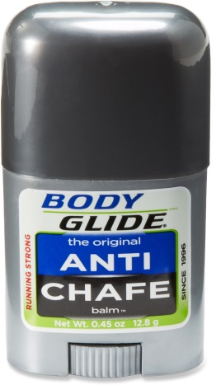
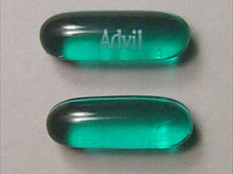
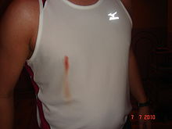
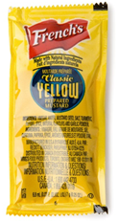
#2 Learn from Pain
Countermeasures
Advil
Bandages
Body Glide
Mustard
Weather
Sun screen
Mosquito repellant
Course Review

Slide 20
#1 Do it Better
Level of Maturity
All releases threat modeled
Defect rates decreasing
Fuzzing scripts written
Accept risks of open source
Tracking DB w/dashboard
Preventive measures modeling
Defect rates near 0
Best-in-class tools
All products pen tested
Open source SLAs
Standards adapted to environment
Metrics integrated into risk mgt. tools
Major releases threat modeled
All primary tools used
BlackDuck
Standards adopted
PSIRT XLS
Major attack vectors addressed
Freeware tools used
Standard awareness
Frequent attacks
No reviews
No constraints
Email tracking
PSMM Phase
None Initial Basic Acceptable Mature
Notes:
8. Measuring How Well Teams Do Product Security
The Intel Security Product Security Maturity Model (PSMM)
Problem
We have an SDL. It is well defined for both waterfall and agile. How well are the product teams following it?
Facts
This metric indicates how well the BUs are implementing the product security program.
Lessons Learned
We designed our own MM to match our SDL
Engineers asked for a spreadsheet with drop-downs so they can easily rate their product teams
Automation
Peer review

Slide 21
#1 PS Maturity Model Parameters
Operational Technical
Program
Process
Resources
Training
Security Reviews
Tools
PSIRT
SDL
Policy
Privacy
Certification
M&A
Extended Team
Threat Modeling / Architecture Reviews
Static Analysis
Dynamic Analysis (Web Apps)
Fuzz Testing
Vulnerability Scans / Penetration Testing
Manual Code Reviews
Secure Coding Standards
Open Source / 3rd Party Libraries
Tracking Tools
Notes:
PSMM Parameters
Our simple maturity model categorizes 22 parameters into two categories:
Operational for the program and
Technical for the engineers.
Operational
Program
Process
Resources
Training
Security Reviews
Tools
PSIRT
SDL
Policy
Privacy
Certification
M&A
Extended Team
Technical
Threat Modeling / Architecture Reviews
Static Analysis
Dynamic Analysis (Web Apps)
Fuzz Testing
Vulnerability Scans / Penetration Testing
Manual Code Reviews
Secure Coding Standards
Open Source / 3rd Party Libraries
Tracking Tools

Slide 22
#2 Push Farther / Faster
Distance
5K (3.1)
10K (6.2)
½ Marathon (13.1)
Marathon (26.2)
50K (31.1)
50M
100K (62.2)
100M
72 Hour Endurance
Speed
6:00 Marathon Limit (US)
5:00 Marathon Limit (EU)
4:00 Marathon (25%)
3:30 Boston Qualifier
2:00 Marathon Glass Ceiling (2:03:23)
12:00 100M USA Record (11:59:28)
Notes:
100-Mile American Record Smashed
On October 4, 2013 Jon Olsen ran 11:59:28 to break 24-year old record.

Slide 23
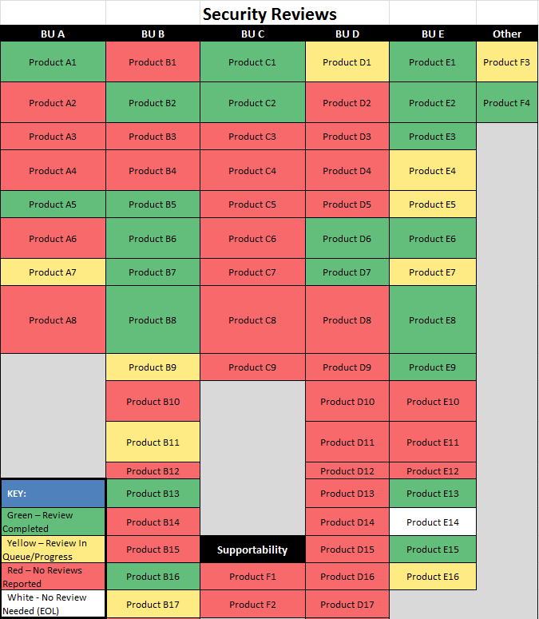
#1 Metrics

Slide 24
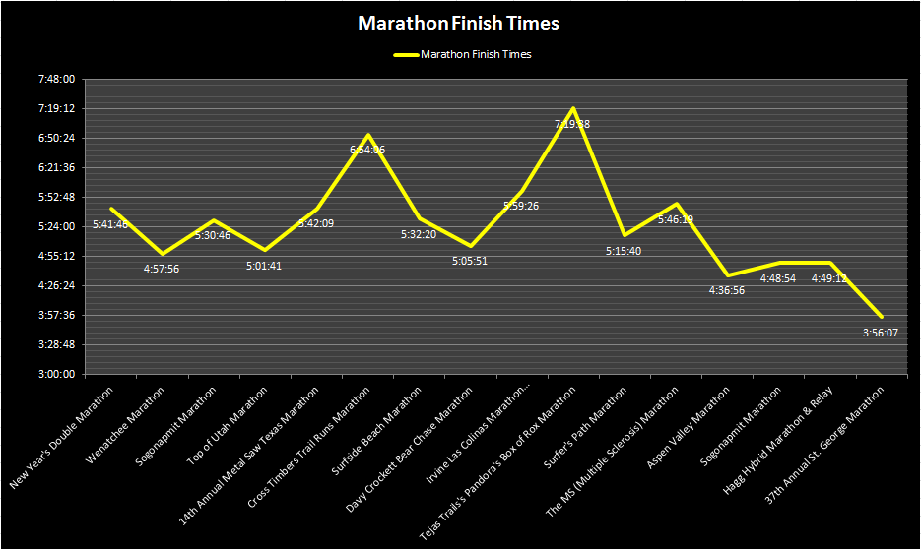
#2 Measuring Progress

Slide 25
Continual Evolution
There is always a better way – find it
Notes:
8. Measuring How Well Teams Do Product Security
The Intel Security Product Security Maturity Model (PSMM)
Problem
We have an SDL. It is well defined for both waterfall and agile. How well are the product teams following it?
Facts
This metric indicates how well the BUs are implementing the product security program.
Lessons Learned
We designed our own MM to match our SDL
Engineers asked for a spreadsheet with drop-downs so they can easily rate their product teams
Automation
Peer review

Slide 26
#1 The Reward
Secure code = Less fire stomping (PSIRT)
Customer satisfaction = Increased business
Protects the brand
Meets compliance requirements

Slide 27
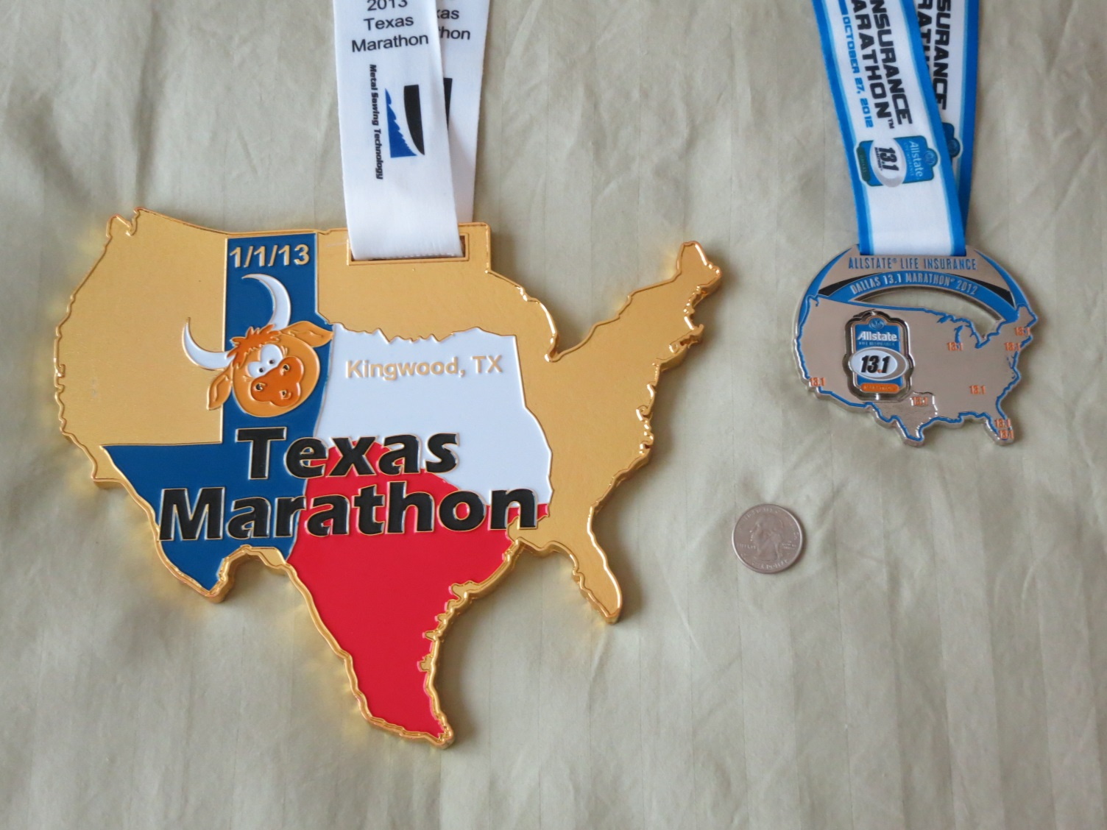
#2 The Reward

Slide 28
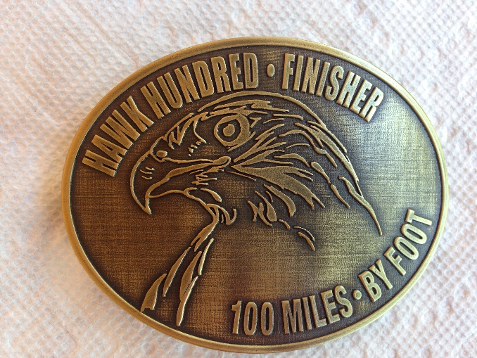
Finishing the Hawk Hundred
13 Sep 2014
Finish Time: 31:38

Slide 29
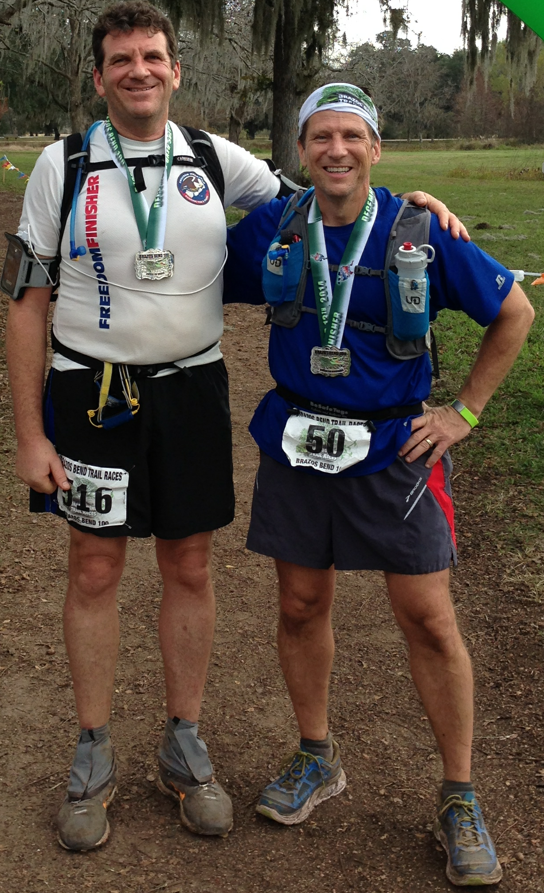
Finishing the Brazos Bend 100
13 Dec 2014
Finish Time: 28:22

Slide 30
Conclusion
Plot #1: Developing Secure Software
Plot #2: Running a 100 Mile Ultra Marathon
Which is easier?
vs.
Notes:
May vary by individual.
I feel an Ultra is easier since, unlike software security, it has an end … until you sign up for another ultra.

Slide 31
Q&A
Harold Toomey
Principle Product Security Architect
Product Security Group
Intel Security
Harold_Toomey@IntelSecurity.com
(801) 830-9987

Slide 32
Thank you
The Collin College Engineering Department
Collin College Student Chapter of the North Texas ISSA
North Texas ISSA (Information Systems Security Association)

