Slide 1
Intel's Product Security Maturity Model (PSMM)
29 Feb 2016
Harold Toomey | Sr. Product Security Architect & PSIRT Manager, Intel Security
James Ransome | Sr. Director Product Security, Intel Security
Notes:
Session Format:
======================
Individual Speaker
Session Type:
======================
Standard Session: 30 minute technical breakout
Session Track:
======================
CISO
Session Title:
======================
Intel's Product Security Maturity Model (PSMM)
Session Abstract:
======================
What happens (or doesn't happen) in product development upstream impacts IT security downstream. How mature are your company's software security practices? ISO 27034 covers the *what* of product security. The Intel Product Security Maturity Model (PSMM) measures *how well* the operational and technical side of product security is being done.
Three Key Takeaways:
======================
1) PSMM: A simple yet powerful way to measure the maturity of your product security program
2) SDL: Best practices in developing truly secure products / software
3) Product security metrics to drive positive change, security and efficiency
Session Detail:
======================
Every software development company needs a solid product security program.
Just because they are compliant with the ISO 27034: Application Security standard doesn't mean they are doing it well. Compliance vs. Security.
Hiring outside vendors and consultants to measure the maturity of their program is costly.
Intel Security's Product Security Group has developed a simple yet powerful maturity model that measures how well the software security program is being run and how well engineering is implementing security.
We use it daily as we build security into each Intel product.
The PSMM measures the following parameters:
Operational
1. Program
2. Resources
3. SDL
4. PSIRT
5. Policy
8. Process
7. Training
8. Reporting & Tracking Tools
Technical
1. Security Requirements Plan [Waterfall] / Definition of Done (DoD) [Agile]
2. Architecture and Design Reviews
3. Threat Modeling
4. Security Testing
5. Static Analysis
6. Dynamic Analysis
7. Fuzz Testing
8. Vulnerability Scans / Penetration Testing
9. Manual Code Reviews
10. Secure Coding Standards
11. Open Source / 3rd Party COTS Libraries
12. Privacy
The end result will be a CISO measuring their program's maturity using a free tool that is measured by their own security architects and product security team.
CISOs can then drive towards a more mature program and reap the rewards of highly secure software and efficient operations.
Various metrics using COTS solutions will be shared.
Session Level:
======================
Beginner to Intermediate
Session Tags:
======================
Software Security
Security Metrics and Reporting
Speakers:
======================
Harold Toomey

Slide 2
Introduction
Responsibilities
PSIRT Manager
Manage a team of 72 Sr. Security Architects (PSCs)
Manage the PSG program, Agile SDL and policies
Training program
Metrics / Reporting
Experience
4 Years: Software / Application Security
2 Years: IT Operational Security
11 Years: Product Management
10 Years: Software Development (C++)
CVSS Special Interest Group (SIG)
ISSA North Texas Chapter, Past President
CISSP, CISA, CISM, CRISC, CGEIT, …
Harold Toomey
Sr. Product Security Architect
Notes:
Good afternoon.
My name is Harold Toomey.
I work for Intel Security.
I am here with my manager, Dr. James Ransome.
I have worked for McAfee/Intel Security for the past 9 years.
Before that I worked for Symantec for 8 years.
For the past 4 years I have worked in software security.
I manage our PSIRT team as well as other SDL programs.
┘

Slide 3
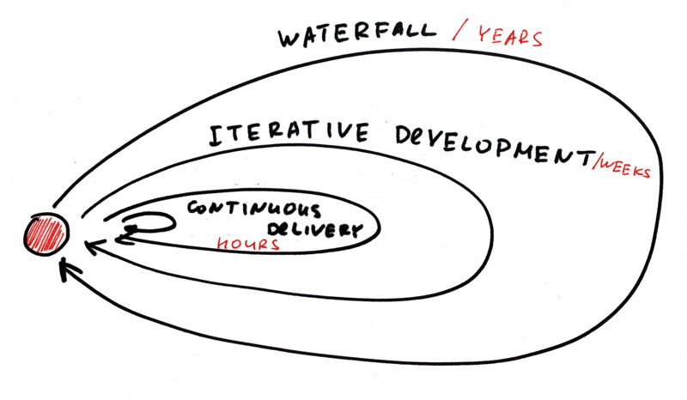
SDLCs / SDLs
Waterfall
Current methodology for Hardware side of Intel
Was used by McAfee 5 years ago
Agile
Current methodology for Software side of Intel
95% of Intel Security (McAfee) uses
Continuous Delivery
Fastest growing methodology for Cloud technology

Slide 4
McAfee Waterfall SDL (SDLC)
SDLC Phases
0 | 1 | 2 | 3 | 4 | 5
Concept | Planning | Design & Development | Readiness | Release & Launch | Support & Sustain
Security Assessment | Architecture | Design & Development |  | Ship | Post-Release, Legacy & M&A
S0 | S1 | S2 | S3 | S4 | S5
Product security team is looped in early (Product Security Group & Product Security Champions) Product security team hosts a discovery meeting Product security team creates an SDL project plan (states what further work will be done) Product team initiates a Privacy Impact Assessment (PIA) | S1 Security Plan SDL policy assessment & scoping Threat modeling / architecture security analysis Privacy information gathering and analysis | S2 Security Plan Security test plan composition Static analysis Threat model updating Design security analysis & review Privacy implementation assessment | S3 Security Plan Security test case execution Static analysis Dynamic analysis Fuzz testing Manual code review Privacy validation and remediation | S4 Security Plan Final security review Vulnerability scan Penetration test Open source licensing review Final privacy review | External vulnerability disclosure response (PSIRT) Reviews by service contractors Post-release certifications Internal review for new product combinations or cloud deployment Security architectural reviews & tool-based assessments of legacy and M&A products
SDL Phases

Slide 5
Intel Security Agile SDLC
Plan of Intent
Program
Backlog
Release Quality
Increment
(PSI)
Finished Product
Team
Backlog
Stories
Daily Scrum
Investment Themes,
Epics (Viability,
Feasibility, Desirability)
Release
Planning
Sprint
Planning
Development
& Test
Sprint
Review &
Retrospective
Release to Customer
1-4 Weeks
Develop on a Cadence, Release on Demand
Plan-Of-Intent Checkpoint
Release Planning Checkpoint
Sprint Planning Checkpoint
Sprint / Release Readiness Checkpoint
Release Launch Checkpoint
Post Release
Sustainment

Slide 6
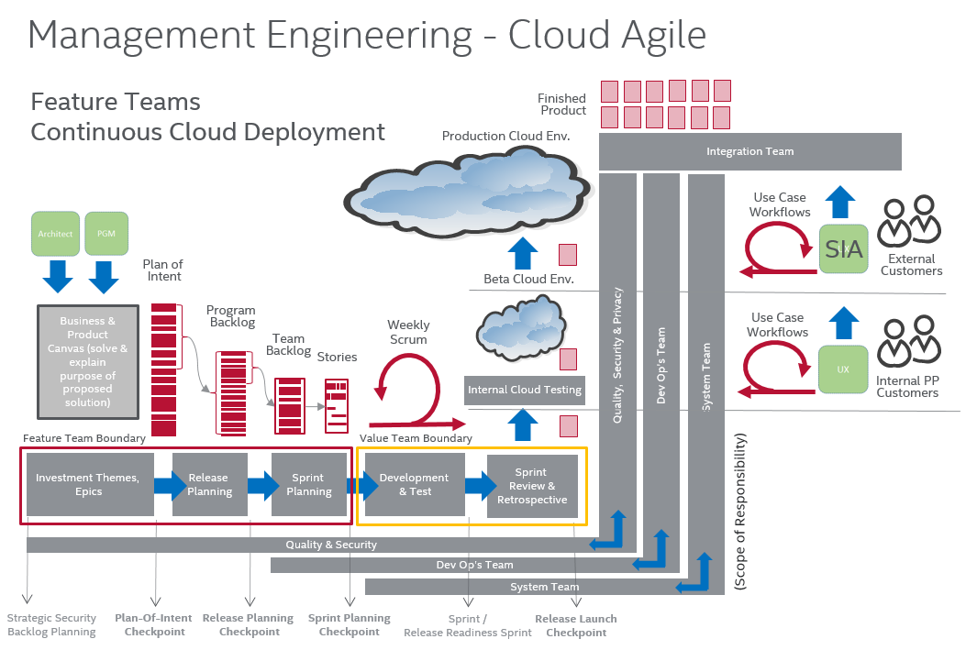
Intel Security Agile SDL Adapted to the Cloud
Notes:
Cloud ePO deployment model.

Slide 7
Problem Statement
Problem: We have an SDL. How well are the product teams following it?
Notes:
8. Measuring How Well Teams Do Product Security
The Intel Security Product Security Maturity Model (PSMM)
Problem
We have an SDL. It is well defined for both waterfall and agile. How well are the product teams following it?
Facts
This metric indicates how well the BUs are implementing the product security program.
Lessons Learned
We designed our own MM to match our SDL
Engineers asked for a spreadsheet with drop-downs so they can easily rate their product teams
Automation
Peer review ┘

Slide 8
Maturity Models
Common SDL Maturity Models
BSIMM: Build Security In Maturity Model – Cigital
SAMM: Software Assurance Maturity Model – OWASP
DFS: Design For Security – Intel
Microsoft SDL: Optimized Model
Other SDL Frameworks
ISO 27034: Application Security Controls

Slide 9
PSMM Design Constraints
No budget for cool applications
Use COTS tools
No budget for additional auditors
Peer review
Be simple
Automated, not weighted, minimal training and effort
Low overhead
Minimal burden on engineering teams
Produce insightful metrics

Slide 10
PSMM Implementation Requirements
Provide a detailed MS Word doc fully listing requirements for each parameter level
Provide simple drop-down lists in MS Excel
Allow and adjust for “0 – Not Applicable”
Map PSMM to other maturity models
Allow for phased roll-out, reporting at different org. levels

Slide 11
Solution
Solution: The Intel Product Security Maturity Model (PSMM)
Measures how well both the operational and technical aspects of product security are being performed
Provides a simple, yet powerful, model which has been adopted and is being used company-wide
Data is collected at multiple levels to improve accuracy

Slide 12
Solution (cont.)
Five maturity levels
None
Basic
Initial
Acceptable
Mature
Focus on process, quality of activity execution, and outcomes

Slide 13
20 PSMM Parameters
Operational
Technical
Program
Resources
SDL
PSIRT
Policy
Process
Training
Reporting & Tracking Tools
Security Requirements Plan [Waterfall] / Definition of Done (DoD) [Agile]
Architecture and Design Reviews
Threat Modeling
Security Testing
Static Analysis
Dynamic Analysis
Fuzz Testing
Vulnerability Scans / Penetration Testing
Manual Code Reviews
Secure Coding Standards
Open Source / 3rd Party COTS Libraries
Privacy
Notes:
PSMM Parameters
Our simple maturity model categorizes 20 parameters into two categories:
Operational for the program and
Technical for the engineers.
Operational
Program
Resources
SDL
PSIRT
Policy
Process
Training
Reporting
Technical
Security Requirements Plan
Architecture Reviews
Threat Modeling
Security Testing
Static Analysis
Dynamic Analysis
Fuzz Testing
Vulnerability Scans / Penetration Testing
Manual Code Reviews
Secure Coding Standards
Open Source / 3rd Party Libraries
Privacy
┘

Slide 14
PSMM – Overall State of the Company – Technical
Level of Maturity
Security reviews
All releases threat modeled
Defect rates decreasing
Fuzzing scripts written
Accept risks of 3rd party libs
Tight privacy partnership
Major releases threat modeled
All primary tools used
BlackDuck
Standards adopted
Privacy + security
Early reviews
Preventive measures modeling
Defect rates near 0
Best-in-class tools
Continuous security testing
All products pen tested
Open source SLAs
Standards adapted to environment
Tight privacy integration
Major attack vectors addressed
Freeware tools used
Standard awareness
Privacy team
X
Frequent attacks
No reviews
No constraints
PSMM Phase
None Initial Basic Acceptable Mature
Notes:
The Technical parameters are about how well the engineers are practicing secure principles and using their tools.
┘

Slide 15
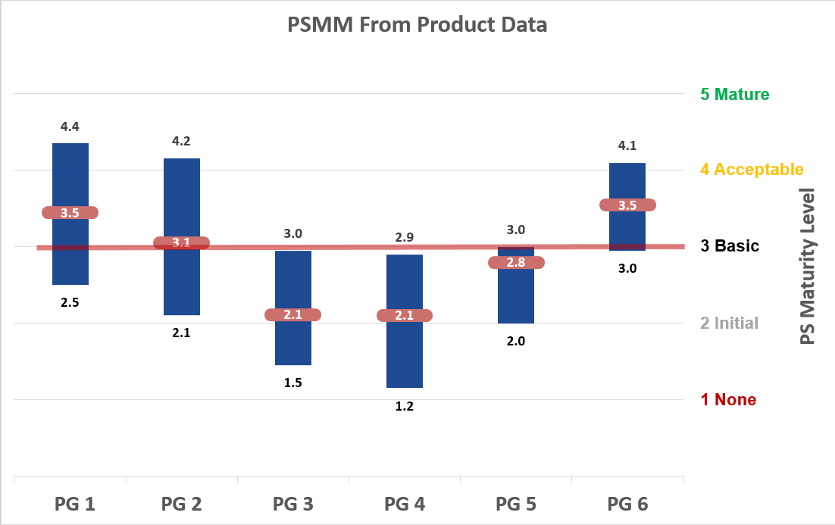
PSMM – State by Product Group / BU
Notes:
Product Security Maturity Model (PSMM) by LOB
Again, this metric indicates how well the LOBs are implementing the product security program.
Each Software Groups has multiple engineering team located in different development centers.
Some are more mature security-wise than others.
The data above is fictitious, of course. It was created using a stock chart in MS Excel.
We record the groups highest and lowest scores, along with the average.
Newly acquired companies tend to be lower on the scale.
PSCs peer review each other for self policing.
┘

Slide 16
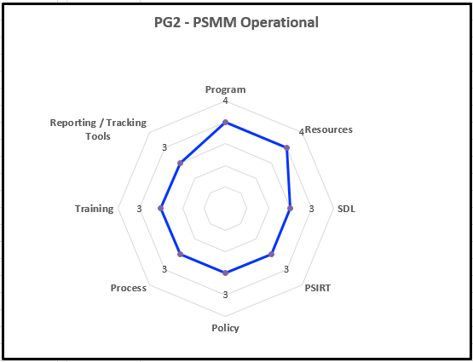
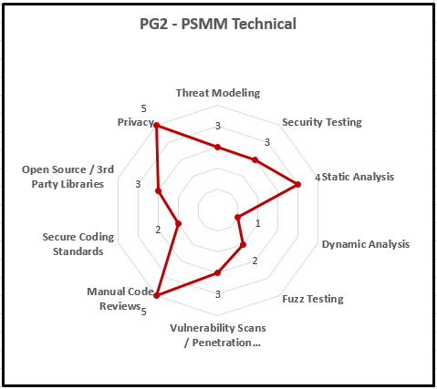
PSMM - Product / Product Group Spider Diagrams

Slide 17
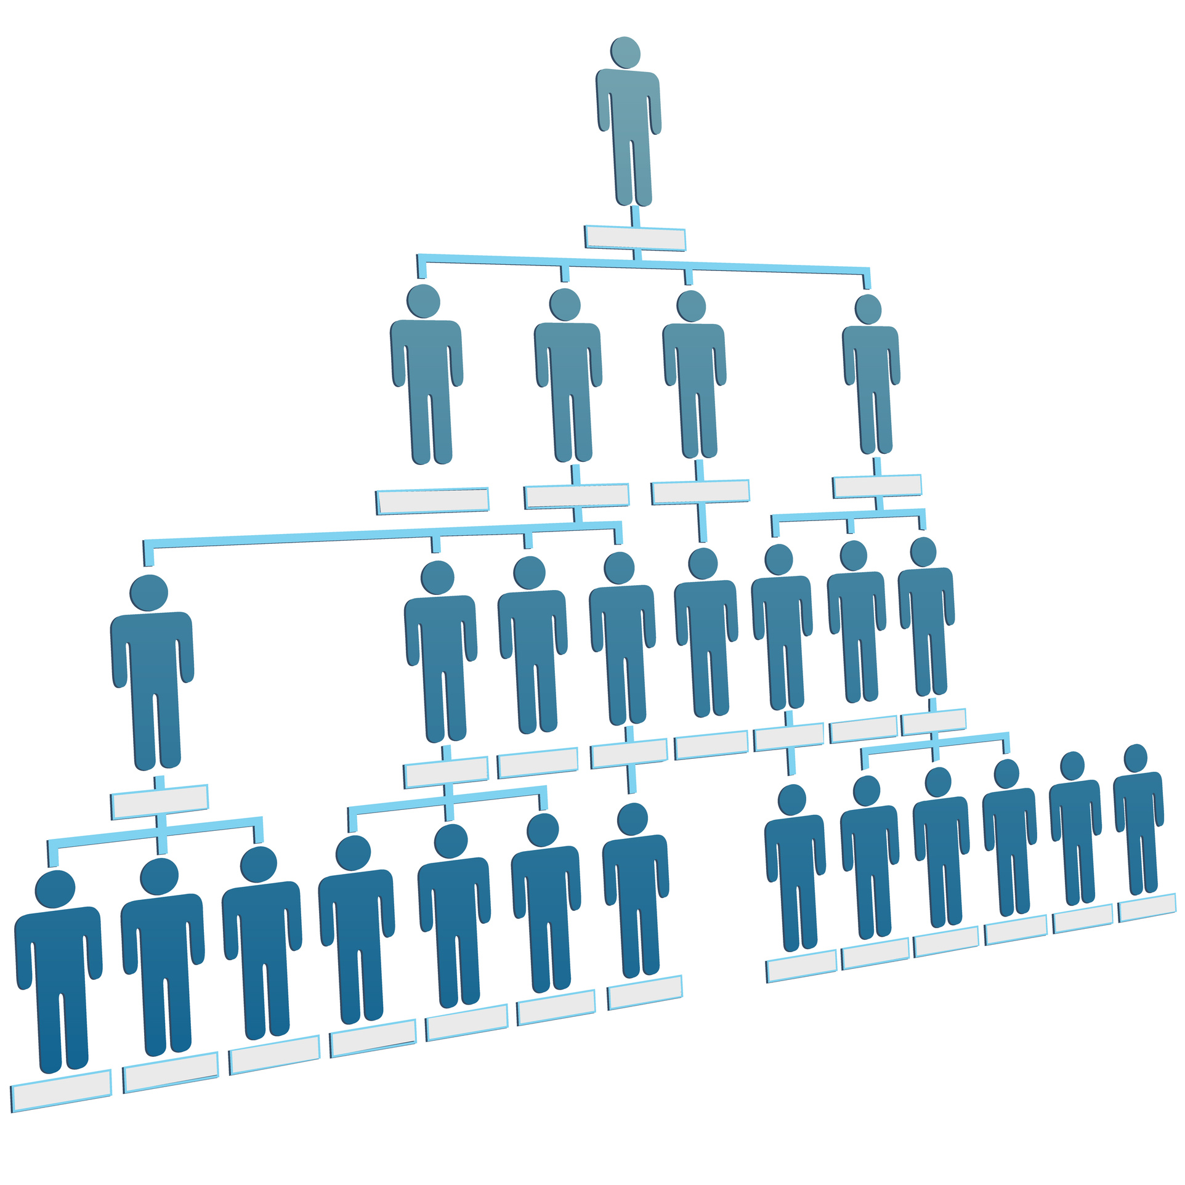
PSMM Data Collection Levels
PSMM Data Levels
Entire Corp.
All Corp. BUs side-by-side
Single Corp. BU
All Product Groups in a Single Corp. BU
Single Product Group
Single Product Line
Agile Team (optional)
Individual (training only)
Data can be collected at any and all levels; the lower the better
Data should be refreshed every 6 months

Slide 18
Organizational Structure – Who Collects the Data
Single Corp. BU
EVP & GM
VP
Sr. Director
Sr. Architect
SVP Engineering
VP Engineering
Architect
Sr. Engineer
QA Engineer
Product Quality Group
Product Security Group
Principle Product Security Architect
…
Sr. Product Security Architect
Engineering Product Development Group
…
Product Group #1
Product Group #n
PSC Lead
…
PSC Lead
…
PSC
PSC
…
PSE
PSE

Slide 19
Objectively Measuring PSMM Levels
Validation: How do we keep it honest? Peer Review
Individual PSCs score their own products
If they do not know the answers then they should engage their product teams to get accurate answers
PSCs from one product group are assigned to review metrics from their peers in a different product group
PSC Leads score their entire product group from their perspective
PSC Leads review the scores of their product group’s PSCs and other product group leads to identify and correct gross inaccuracies
The Product Security and Privacy Governance Team (SDLGov) performs rolling audits to ensure compliance, accuracy and consistency

Slide 20
Simple Scoring
PSMM Level | Min. Score | Max. Score | Considered “In” Score
0-NA | 0 | 19 | 0-19
1-None | 20 | 39 | 20-29
2-Basic | 40 | 59 | 30-49
3-Initial | 60 | 79 | 50-69
4-Acceptable | 80 | 94 | 70-84
5-Mature | 95 | 100 | 85-100
Simple addition to compute scores (20 x 5 = 100)
Non-weighted
Operational, Technical, and Combined scores

Slide 21
Detailed MS Word Doc – PSIRT
4.4 PSIRT
This parameter measures how well the company’s brand and customers are protected from externally reported product vulnerabilities. PSIRT = Product Security Incident Response Team.
Level 1 None
No incident response team
No incident response procedures

Slide 22
Detailed MS Word Doc – PSIRT
4.4 PSIRT
Level 2 Initial
Setup and establish a partnership with the Computer Security Incident Response Team (CSIRT)
Security Architects become PSCs and form an early warning system
BSIMM-CMVM1.1: Create or interface with incident response

Slide 23
Detailed MS Word Doc – PSIRT
4.4 PSIRT
Level 3 Basic
Crisis management procedures defined and used
PSCs trained on Security Bulletin creation
Must be able to achieve PSIRT SLA response times
BSIMM-CMVM1.2: Identify software defects found in operations monitoring and feed them back to development

Slide 24
Detailed MS Word Doc – PSIRT (cont.)
4.4 PSIRT
Level 4 Acceptable
Dedicated PSG-managed team with well-defined procedures
PSCs create quality Security Bulletins
Must be able to consistently achieve all PSIRT SLA response times
BSIMM-CMVM2.1: Have emergency codebase response
BSIMM-CMVM2.2: Track software bugs found in operations through the fix process

Slide 25
Detailed MS Word Doc – PSIRT (cont.)
4.4 PSIRT
Level 5 Mature
24x7 coverage integrated with entire company
PSCs are fast, accurate, and follow process
Consistently achieve all PSIRT SLA response times
BSIMM-CMVM3.1: Fix all occurrences of software bugs found in operations
BSIMM-CMVM3.2: Enhance the SSDL to prevent software bugs found in operations
BSIMM-CMVM3.3: Simulate software crisis
BSIMM-CMVM3.4: Operate a bug bounty program (optional)

Slide 26
Intel PSMM Level 4: Acceptable
Technical
Security Requirements Plan/DoD: Product teams conduct and report on required security tasks as defined in their security plan for their project milestones
Architecture and Design Reviews: Frequent architecture reviews are conducted
Threat Modeling: Trained security architects oversee frequent reviews accounting for all known attack vectors
Security Testing: Security testing performed completely several times
Static Analysis: Majority of products analyzed frequently, defect rate decreasing
Dynamic Analysis: Applicable products analyzed frequently, high and medium severity issues fixed. Defect rate near zero (0) in finished product.
Fuzz Testing: Scans run frequently, high and medium severity issues fixed, new custom scripts created
Penetration Testing: Resident pen testing expert available, defects in Bugzilla
Manual Code Reviews: Conducted on all potentially risky code using a shared tool
Secure Coding Standards: Following adopted standards
Open Source/3rd Party COTS Libraries: Fully maintaining all documented 3rd party libraries and versions shipped across all supported releases
Privacy: Privacy is integrated with product security

Slide 27
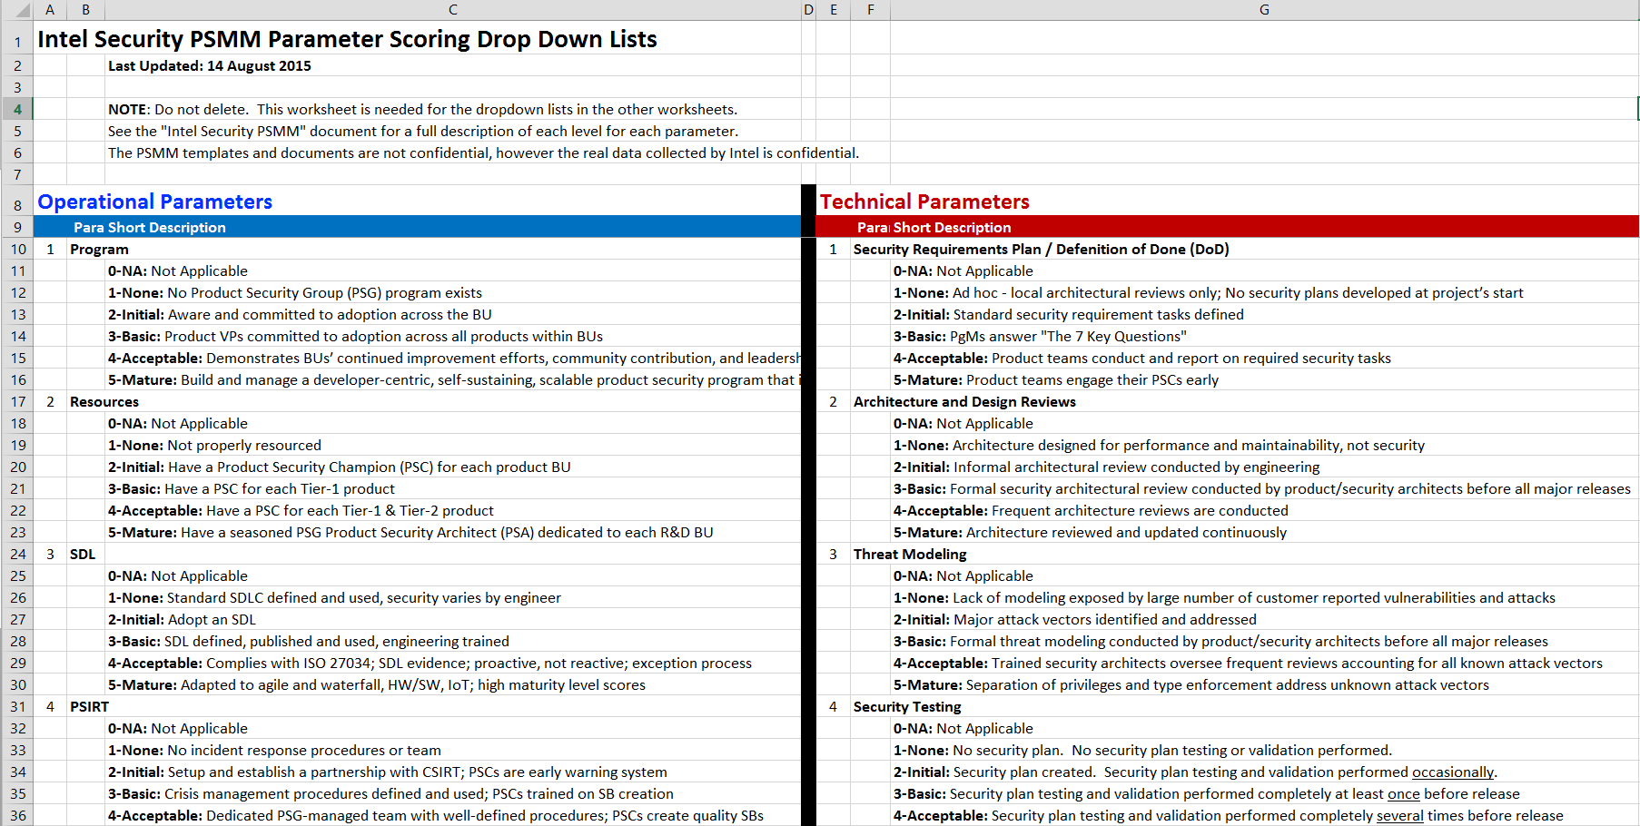
MS Excel Drop Down Lists

Slide 28
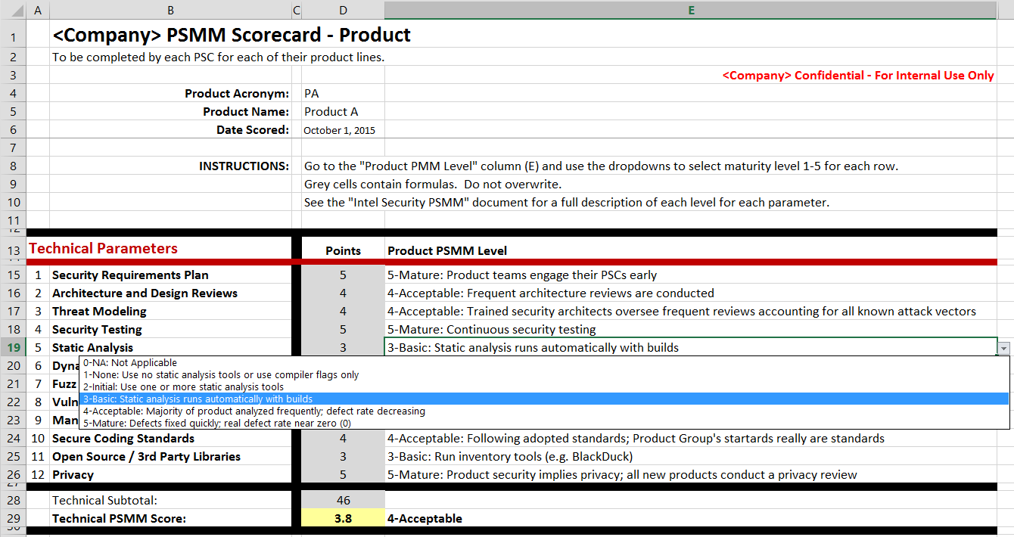
MS Excel Product Scorecard

Slide 29
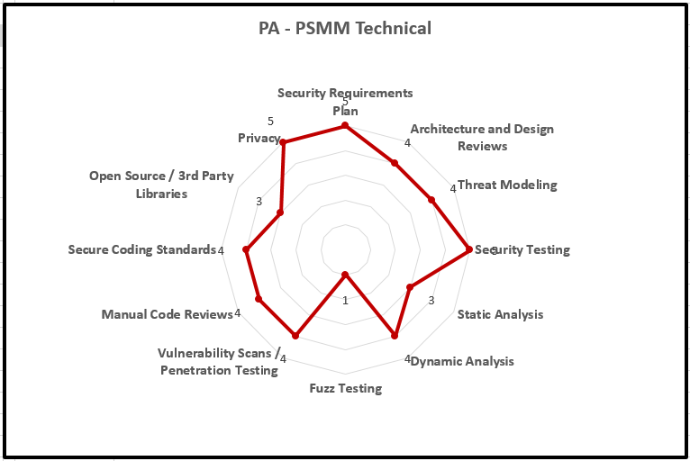
MS Excel Product Spider Diagram

Slide 30
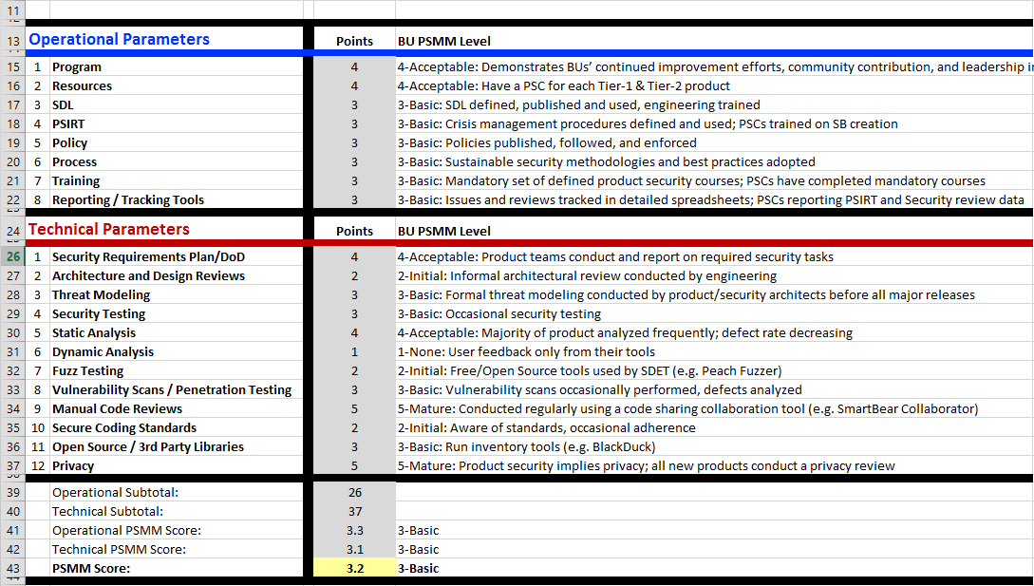
MS Excel Product Group Scorecard

Slide 31
MS Excel Product Group Spider Diagrams

Slide 32
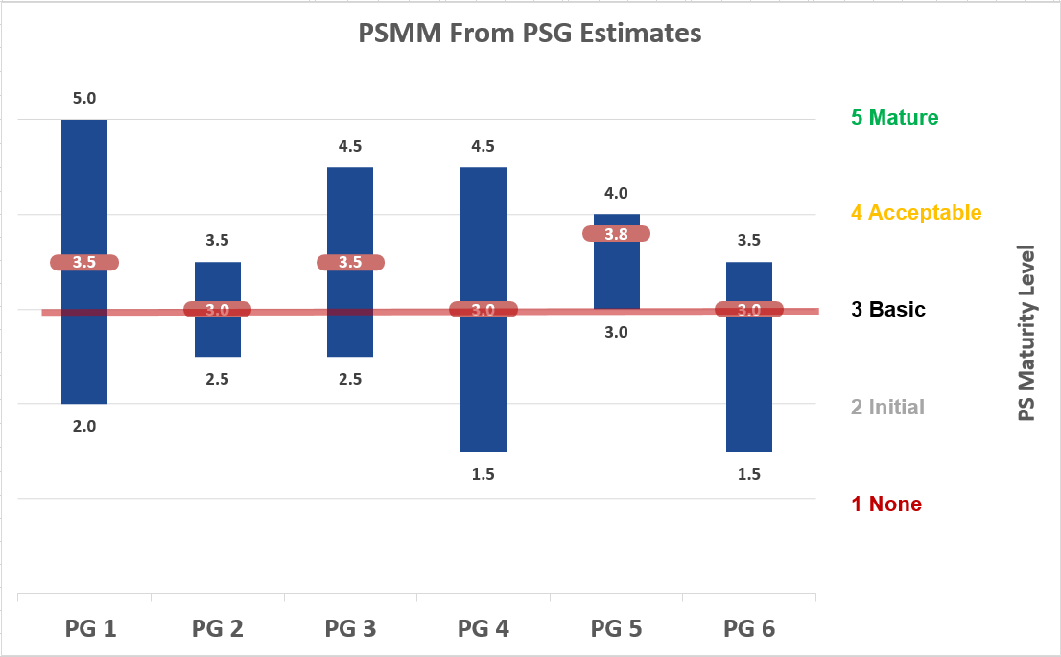
Least Accurate Metric – From PSG Estimates

Slide 33
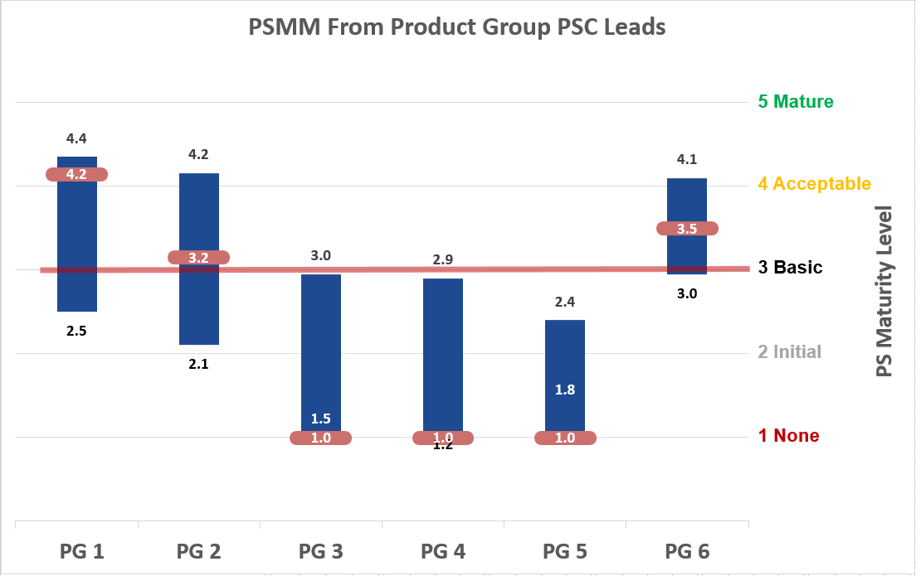
Somewhat Accurate Metric – From PSC Leads

Slide 34
Most Accurate Metric – From Product Data
Notes:
Product Security Maturity Model (PSMM) by LOB
Again, this metric indicates how well the LOBs are implementing the product security program.
Each Software Groups has multiple engineering team located in different development centers.
Some are more mature security-wise than others.
The data above is fictitious, of course. It was created using a stock chart in MS Excel.
We record the groups highest and lowest scores, along with the average.
Newly acquired companies tend to be lower on the scale.
PSCs peer review each other for self policing.
┘

Slide 35
PSMM – Operational
Continued improvement
2+ PSAs
Tier-2 PSCs
Extensive training library
Tool experts
Dedicated PSIRT
Single crisis
ISO 27034 compliance
Tracking DB w/dashboard
Developer-centric
Self-sustaining
Scalable
BU PSAs
Tier-3 PSCs
PSEs
Corp. SME training
Tools budget
Proactive PSIRT
Multiple crises
Agile + waterfall / HW + SW SDL
Tight corp. integration
Policy executive support
Metrics integrated into risk mgt. tools
Level of Maturity
X
SVP commitment
Tier-1 PSCs
Mandatory training
3+ tools integrated
PgM milestones
PSIRT defined
SDL used
Extended team
PSIRT XLS
Awareness
No budget
No reviews
Few tools
No PSIRT
Tribal knowledge
Email tracking
Plan created
BU PSCs
1+ tools
PSIRT is CSIRT
SDL adopted
PSMM Phase
None Initial Basic Acceptable Mature
Notes:
Like all maturity models, you go from low to high maturity based on your activities.
We have them defined in detail for our PSCs to ascertain what level their teams are operating at.
The Operational parameters are about the program as a whole.
┘

Slide 36
PSMM – Technical
Level of Maturity
Security reviews
All releases threat modeled
Defect rates decreasing
Fuzzing scripts written
Accept risks of 3rd party libs
Tight privacy partnership
Major releases threat modeled
All primary tools used
BlackDuck
Standards adopted
Privacy + security
Early reviews
Preventive measures modeling
Defect rates near 0
Best-in-class tools
Continuous security testing
All products pen tested
Open source SLAs
Standards adapted to environment
Tight privacy integration
Major attack vectors addressed
Freeware tools used
Standard awareness
Privacy team
X
Frequent attacks
No reviews
No constraints
PSMM Phase
None Initial Basic Acceptable Mature
Notes:
The Technical parameters are about how well the engineers are practicing secure principles and using their tools.
┘

Slide 37
Key Takeaways
1) PSMM: A simple yet powerful way to measure the security maturity of your product security program, deliverables and outcomes
2) Cost: Minimal budget, typically no additional resources needed, uses existing tools, minimal engineering overhead
3) Metrics: Product security metrics to drive towards 4-Acceptable and 5-Mature PSMM levels; focus on what matters per product line
4) Effort: 20% effort to reach 4-Acceptable, +80% to reach 5-Mature

Slide 38
Q&A
Harold Toomey
Sr. Product Security Architect
Product Security Group
Intel Security
Harold.A.Toomey@Intel.com
W: (972) 963-7754
M: (801) 830-9987

Slide 40
Backup Slides

Slide 41
Agenda
SDLC / SDL
Maturity Models
Design Criteria
20 Parameters
Org. Structure
PSMM Reports
MS Excel / Word
Metrics
Notes:
Harold's CSC October 2-3, 2015 Presentation Abstract
Submitted 20 August 2015
Session Format:
======================
Individual Speaker
Session Type:
======================
Standard Session: 50 minute technical breakout
Session Track:
======================
CISO
Session Title:
======================
Beyond ISO 27034 - Intel's Product Security Maturity Model (PSMM)
Session Abstract:
======================
What happens (or doesn't happen) in product development upstream impacts IT security downstream. How mature are your company's software security practices? ISO 27034 covers the *what* of product security. The Intel Product Security Maturity Model (PSMM) measures *how well* the operational and technical side of product security is being done.
Three Key Takeaways:
======================
1) PSMM: A simple yet powerful way to measure the maturity of your product security program
2) SDL: Best practices in developing truly secure products / software
3) Product security metrics to drive positive change, security and efficiency
Session Detail:
======================
Every software development company needs a solid product security program.
Just because they are compliant with the ISO 27034: Application Security standard doesn't mean they are doing it well. Compliance vs. Security.
Hiring outside vendors and consultants to measure the maturity of their program is costly.
Intel Security's Product Security Group has developed a simple yet powerful maturity model that measures how well the software security program is being run and how well engineering is implementing security.
We use it daily as we build security into each Intel product.
The PSMM measures the following parameters:
Operational
1. Program
2. Resources
3. SDL
4. PSIRT
5. Policy
8. Process
7. Training
8. Reporting & Tracking Tools
Technical
1. Security Requirements Plan [Waterfall] / Definition of Done (DoD) [Agile]
2. Architecture and Design Reviews
3. Threat Modeling
4. Security Testing
5. Static Analysis
6. Dynamic Analysis
7. Fuzz Testing
8. Vulnerability Scans / Penetration Testing
9. Manual Code Reviews
10. Secure Coding Standards
11. Open Source / 3rd Party COTS Libraries
12. Privacy
The end result will be a CISO measuring their program's maturity using a free tool that is measured by their own security architects and product security team.
CISOs can then drive towards a more mature program and reap the rewards of highly secure software and efficient operations.
Various metrics using COTS solutions will be shared.
Session Level:
======================
Beginner to Intermediate
Session Tags:
======================
Software Security
Security Metrics and Reporting
Speakers:
======================
Harold Toomey

Slide 42
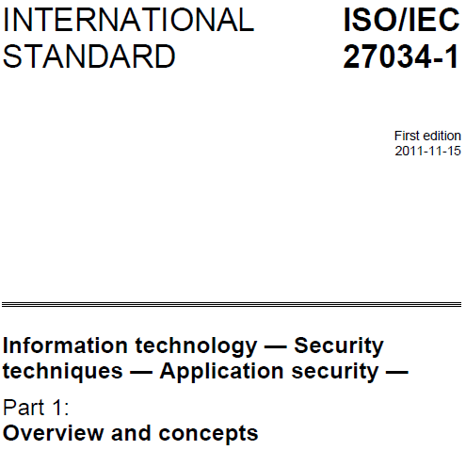
ISO 27034
ISO 27001/2: IT Security
ISO 27034: Application Security
Part 1: Overview & concepts (Nov. 2011)
Part 2: Organization normative framework (Aug. 2015)
Part 3: Application security management process
Part 4: Application security validation
Part 5: Protocols and application security controls data structure
Part 6: Security guidance for specific applications
Indicates what needs to be done
Process focused
Notes:
ISO/IEC 27034 is not:
•Development standard for software applications
•Application project management standard
•Software Development Lifecycle (SDLC) standard
ISO/IEC 27034 does not:
•Provide guidelines for physical and network security
•Provide controls or measurements (metrics)
•Provide secure coding strategies for any programming language

Slide 43
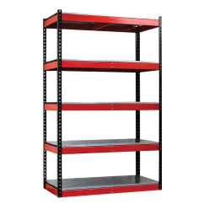
Agile SDLC
Design
Build
Verify
Requirements
RTW
Architecture
Backlog
PSI
Attack & Penetration Testing
Sprints
Hardening, Innovation, Planning
Evolving Architecture
Sprint 1 | … | Sprint n

Slide 44
Agile SDL Sprint
Iterative
Design
Functional Testing
Build
Dynamic Testing
Web
Vuln.
Static Analysis
Fuzzing
Secure Coding
Code Review
Sprint_{n}
Sprint Checkpoint

Slide 45
Agile SDL Activities
Plan of Intent:
Security activity mapping
Answer 7 key security questions
Initial privacy review initiated
Release Planning:
Security plan creation
Threat modeling
Security architecture review
Open source & 3rd party COTS whitelist
Initial privacy review completed
Post Release Sustainment:
PSIRT program
Security metrics
Sprint Planning:
Security plan execution
Iterative threat model updates
All security activities mapped in backlog
Security backlog prioritization
Static, dynamic & fuzzing activities
Security Definition of Done (DoD)
Black Duck Protex, license compliance
Development & Test:
Security plan executed
Security backlog verified
Static, dynamic & fuzzing executed
Sprint Review & Retrospective:
Iterative security plan completed
Security defects at “zero”
Security exceptions tracked
Open source & 3rd party COTS approved
PSI security metrics achieved
Security tools (tunes & optimized)
Release Launch Checkpoint:
Security plan archived
Security activities completed & reported on
Security Definition of Done (DoD) achieved
Threat model fully implemented
All security exceptions documented
Open source & 3rd party COTS exceptions
Final privacy review

Slide 46
Roles & Responsibilities
Role | Responsibilities
Sr. Director Product Security | Owns all product security within BU
Product Security Architect (PSA) | Mentor PSCs for threat modeling, security architecture reviews, security reviews, tools, PSIRT, training
PSC Product Group Lead | Over all Product Group PSCs and products w/out PSCs
Product Security Champion (PSC) | Collocated security engineer / architect POC for a product
Software / Security Architect | (See PSC)
Product Security Evangelist (PSE) | Collocated security QA POC for a product
Support Engineering Operations (SEO) | Tech Support champion for a product
Product Privacy Champion (PPC) | (See PSC)

Slide 47
Detailed MS Word Doc – Technical
5.4 Security Testing
This parameter measures how well software security requirements are being performed and verified by both engineering and QA.
Level 1 None
No security plan. No security plan testing or validation performed.
Level 2 Initial
Security plan created. Security plan testing and validation performed occasionally.
Level 3 Basic
Security plan testing and validation performed completely at least once before release
Functional Testing (what you know) performed to verify intended behavior
Level 4 Acceptable
Security plan testing and validation performed completely several times before release
Negative Space Testing (what hackers know) performed to identify non-intended behavior
Level 5 Mature
Security plan testing and validation performed continuously and completely both before and after release

Slide 48
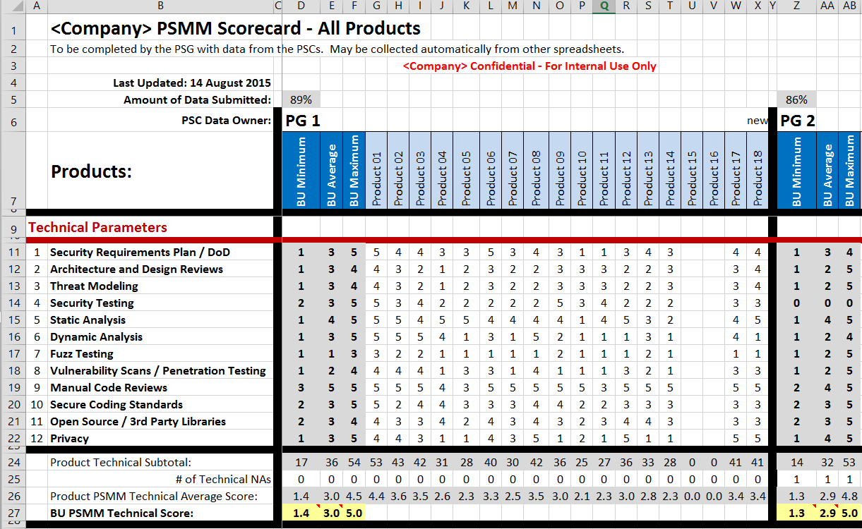
MS Excel All Product Groups Products Scorecard

Slide 49
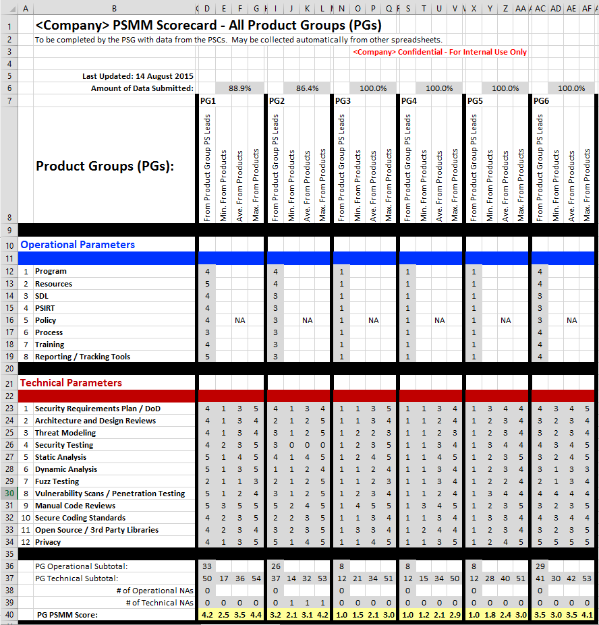
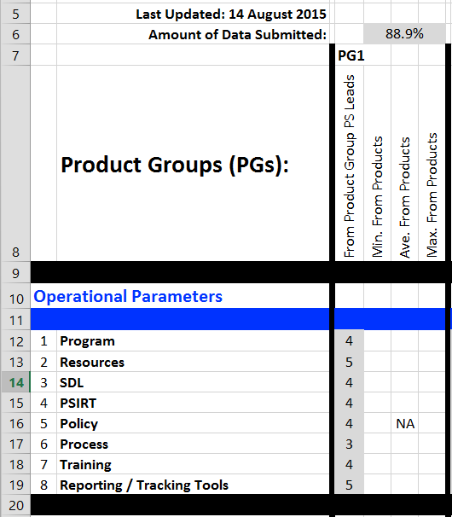
MS Excel All Product Groups

Slide 50
PSMM – % Overhead Costs
NOTE: High overhead % is bad
Overhead Costs $$
100%
Fire stomping mode
Hidden costs due to inefficiencies, disruptions, ad hoc responses
Mostly reactive
Refactoring
Program building
Balance of proactive & reactive
Some automation
~50%
50%
~40%
Mostly proactive
Some reactive
Efficient
Majority proactive
High automation efficiencies
~25%
X
~10%
~5%
0%
PSMM Phase
None Initial Basic Acceptable Mature
Notes:
http://commons.wikimedia.org/wiki/File:1_white,_green_rounded_rectangle.svg
None

