Slide 1
Open Source Technical Debt
29 Feb 2016
Harold Toomey | Sr. Product Security Architect & PSIRT Manager, ISecG

Slide 2
Introduction
Responsibilities
PSIRT Manager
Manage a team of 72 Sr. Security Architects (PSCs)
Manage the PSG program, Agile SDL and policies
Training program
Metrics / Reporting
Experience
4 Years: Software / Application Security
2 Years: IT Operational Security
11 Years: Product Management
10 Years: Software Development (C++)
CVSS Special Interest Group (SIG)
ISSA North Texas Chapter, Past President
CISSP, CISA, CISM, CRISC, CGEIT, …
Harold Toomey
Sr. Product Security Architect
Notes:
Good afternoon.
My name is Harold Toomey.
I work for Intel Security.
I am here with my manager, Dr. James Ransome.
I have worked for McAfee/Intel Security for the past 9 years.
Before that I worked for Symantec for 8 years.
For the past 4 years I have worked in software security.
I manage our PSIRT team as well as other SDL programs.
┘

Slide 3
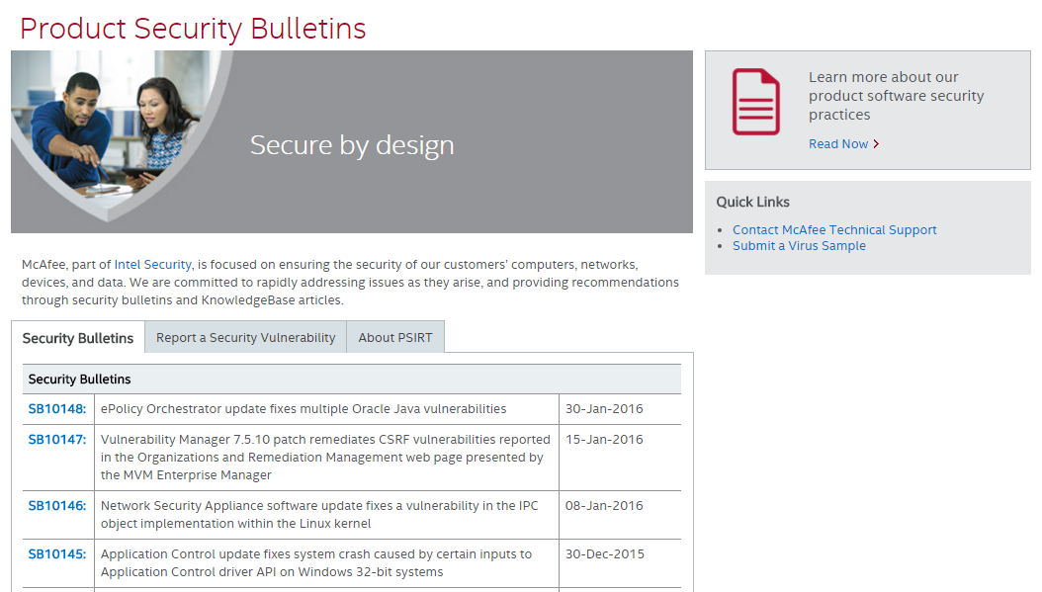
Intel Security PSIRT Website (Google “McAfee PSIRT”)

Slide 4
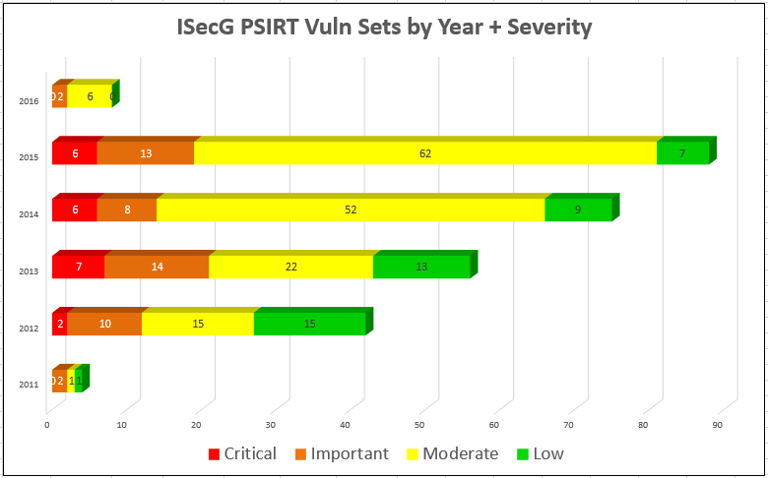
PSIRT – Vulnerabilities by Year
Data is by vulnerability set, not by vulnerable products
# of externally reported vulnerabilities is increasing linearly, doubling every 3 years
Average of 1 critical severity vulnerability every 2 months
58% of the vulnerabilities are from 3rd party libraries
24 Feb 2016
Notes:
ISecG
Metrics show all open PSIRT cases, not just those resulting in published security bulletins
ISecG tracks PSIRT cases more granularly than mother Intel, e.g. 1 vuln. per product vs. 1 vuln. per BU
~2% of vulns. are double counted in both PSIRT databases
58% of the vulnerabilities are from 3rd party and open source libraries
Spike in 2015 due to OpenSSL vulnerabilities [Heartbleed /POODLE] - 137 total
Only 14% are internally found vulns. since most are only tracked in Bugzilla
In 2015 ISecG shipped more products than all other Intel BUs combined
Current portfolio contains 136 product lines
2015 PSIRT incidents declined significantly, likely due to the PSG’s proactive activities including: training, mentoring, security reviews, and tool usage.

Slide 5
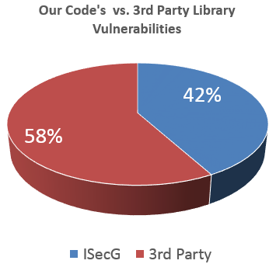
Open Source Security Impact

Slide 6
PSIRT – 3rd Party Code Only
External Code
Externally reported vulnerable products from 3rd party libraries
(includes open source)
Goal Downward trend YoY
136 Supported Products
11 Feb 2016

Slide 7
PSIRT – Our Code Only (No 3rd Party Code)
Internal Code
Externally reported vulnerable products from our code
(excludes 3rd party and open source)
Goal Downward trend YoY
136 Supported Products
11 Feb 2016

Slide 8
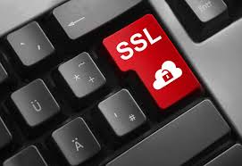
3rd Party Library / Open Source Vulnerabilities
2016
Linux / glibc
2015
OpenSSL
ILO Appliance Firmware
Linux / GNU
NTP
DNS / BIND
2014
OpenSSL
XSS
NTP
2013
Oracle Java / Outside-In
Apache / Tomcat
RSA BSAFE Crypto Library
IPMI Appliance Firmware
2012
BIND
Microsoft

Slide 9
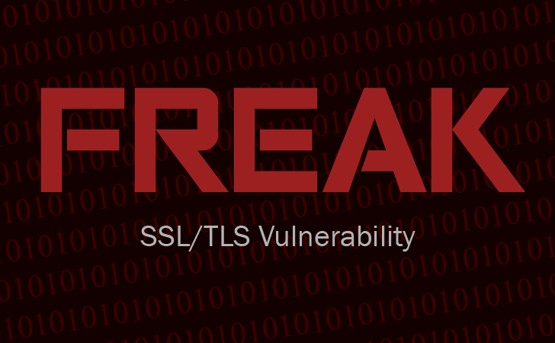
OpenSSL Vulnerabilities
Date | Description | # Vuln. Products | SB
11 May 2012 | CVE-2012-2110 | 1 | KB75482
28 Jan 2013 | CVE-2013-6450 | 1 | SBC
8 Apr 2014 | Heartbleed | 19 | SB10071
2 Jun 2014 | Heartbleed II | 22 | SB10075
9 Jun 2014 | GnuTLS Buffer Overflow | 1 | SB10078
16 Apr 2014 | CVE-2014-3511 | 1 | SB10084
22 Aug 2014 | CVE-2014-3507 | 1 | SB10105
14 Oct 2014 | POODLE | 28 | SB10090
14 Oct 2014 | 3 SSLv3 CVEs | 16 | SB10091
Date | Description | # Vuln. Products | SB
9 Jan 2015 | 8 OpenSSL CVEs | 2 | SB10102
4 Mar 2015 | FREAK | 6 | SB10108
18 Mar 2015 | CVE-2014-3507 | 1 | SB10109
19 Mar 2015 | 14 OpenSSL CVEs | 24 | SB10110
8 Jun 2015 | 7 OpenSSL CVEs | 11 | SB10122
9 Jul 2015 | CVE-2015-1793 | 3 | SB10125
3 Dec 2015 | 4 OpenSSL CVEs | 7 | KB86280
28 Jan 2016 | CVE-2015-3197 | 1 | SBC1601281
Total: 144

Slide 10
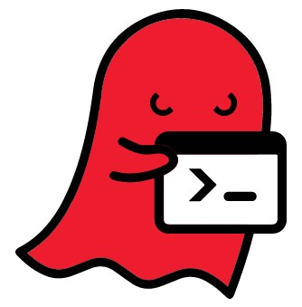
Linux/UNIX Vulnerabilities
Date | Description | # Vuln. Products | SB
24 Sep 2014 | Shellshock / BASH | 23 | SB10085
27 Jan 2015 | GHOST (glibc) | 28 | SB10100
19 Jan 2016 | Linux Kernel Flaw | 3 | KB86557
16 Feb 2016 | GNU C Library (glibc) | 19 | SB10150
Total: 73

Slide 11
DNS / BIND Vulnerabilities
Date | Description | # Vuln. Products | SB
1 Aug 2012 | ISC BIND CVE-2012-1667 | 4 | SB10030 SB10033 SB10034
2 Aug 2012 | ISC BIND CVE-2012-3817 ISC BIND CVE-2012-1033 | 1 | SB10032
27 Sep 2012 | Bind CVE-2012-4244 | 1 | SB10035
23 Jul 2013 | BIND CVE-2013-4854 | 4 | SB10052
12 Feb 2015 | BIND CVE-2015-1349 | 1 | SB10116
8 Jul 2015 | BIND CVE-2015-4620 | 1 | SB10124
28 Jul 2015 | BIND CVE-2015-5477 | 1 | SB10126
3 Sep 2015 | BIND DNS CVE-2015-5722 BIND DNS CVE-2015-5896 | 3 | SB10134
Most BIND vulnerabilities are for the McAfee Firewall Enterprise (MFE)
Total: 16

Slide 12
NTP Vulnerabilities
Date | Description | # Vuln. Products | SB
14 Jan 2014 | Ntpd DoS Attack CVE-2013-5211 | 6 | SBC1401141 SBC1401144
19 Dec 2014 | NTP & FREAK (8 CVEs) | 6 | SB10108
24 Mar 2015 | CVE-2015-1798 CVE-2015-1799 | 2 | SB10114
30 Jun 2015 | CVE-2015-5146 CVE-2014-9298 | 1 | SBC1506301
22 Oct 2015 | NTP – CERT Announcement | 2 | SBC1510222
Most NTP vulnerabilities are for MFE & MWG
Total: 17

Slide 13
RSA BSAFE Vulnerabilities
Date | Description | # Vuln. Products | SB
29 Aug 2012 | MS Critical Update KB 2661254 | 1 | SS792316
19 Sep 2013 | RSA Security Advisory: ESA-2013-068: RSA BSAFE | 3 | SB10067
19 Feb 2014 | RSA Security Advisory: ESA-2014-009: RSA BSAFE SSL-J 4 CVEs | 3 | SBC1402191 SBC1402192
30 Dec 2014 | RSA BSAFE® Micro Edition Suite and SSL-J Triple Handshake Vulnerability | 3 | SBC1412301
17 Apr 2015 | CryptoCME BSAFE Libs | 1 | SBC1507171
12 May 2015 | Crypto-J/SSL-J 6.1.x. Libs | 5 | SBC1505124
Total: 16

Slide 14
Oracle Java Vulnerabilities
Date | Description | # Vuln. Products | SB
9 Apr 2013 | CVE-2013-1493/0809 | 1 | SS871943
10 Sep 2013 | 4 CVEs: CVE-2013-2461 | 1 | KB1309101
5 Mar 2013 | App. exposes sensitive data in Java stack traces | 1 | SB10053
15 Oct 2013 | Oct 15th Oracle Java Bulletin | 1 | SB10058
15 Jan 2014 | Java Update 51 for Jan 2014 | 1 | SBC1401151
15 Apr 2014 | Apr 15th Oracle Java Bulletin | 1 | SB10072
15 Jul 2014 | Jul 15th Oracle Java Bulletin | 1 | SB10083
10 Oct 2014 | Oct 14 Oracle Java Update | 1 | SB10092
20 Jan 2015 | TLS Padding | 1 | SB10104
14 Apr 2015 | Apr 14 Oracle Java Bulletin | 1 | SBC1504142
14 Jul 2015 | July 2015 update for Java 8.0 | 1 | SB10139
14 Oct 2015 | Oct 2015 update for Java 8.0 | 1 | SBC1510141
20 Oct 2015 | Java 8.0 Quarterly Update | 1 | SB10141
15 Jan 2016 | Java 8.0 Quarterly Update | 1 | SB10148
The only product directly affected is ePO / MFS
Total: 14

Slide 15
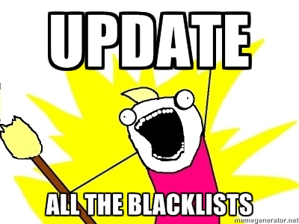
Intel’s Response
Change Example
Oracle Java → Open Source Java → Oracle Java
Whitelist/Blacklist
Send them our way, we can handle it, really!
Grandfather clause
Product Managers
Meeting with PMs since they own feature list
Make clearing the product security issue backlog a priority “feature”

Slide 16
Intel’s Response (cont.)
Sustaining Statements
Low severity vulnerabilities (CVSS score of [0-3.9])
Formal letter send to inquiring customer → KB if 3+ inquiries
Survivability Plan
Required SDL deliverable
Lists all open source and 3rd party components used
List when 3rd party components go EOL
Technology Inventory
Matrix of technologies vs. products

Slide 17
