Slide 1
Intel Security’s Agile Security Development Lifecycle (SDL)
Presentations and Tutorials
Harold A. Toomey, PSG/ISecG
19 October 2016
Notes:
Topic: How Not To Build A Trojan Horse
Description:
A Security Development Lifecycle (SDL) ensures security is included in the design and coding of software as it is being developed. Intel Security’s innovative Agile SDL model and program was created by the ISecG Product Security Group and has been successfully used and matured over the past 5 years. It is functionally equivalent to MySDL and has been approved by Intel for ISecG BU. Several other Intel BUs and departments have recently reached out to ISecG to learn about our Agile SDL so they can accelerate their own agile programs.

Slide 2
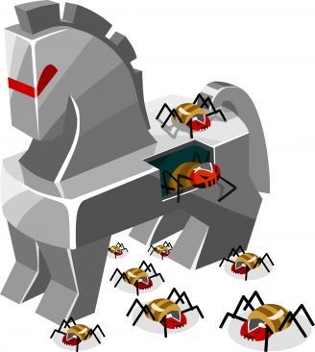
Alternate Title
How Not To Build A Trojan Horse

Slide 3
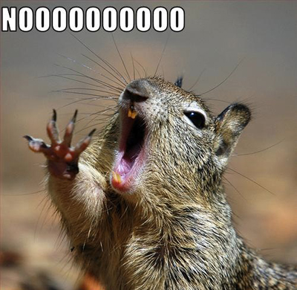
Worst Case Scenario
Your job is to …
Protect the brand
Be your customer’s trusted security advisors
Build secure software

Slide 4
Table of Contents
Worst case scenario
Building secure software
  Product Security Group (PSG)
  Agile Secure Development Lifecycle (SDL)
  Product Security Maturity Model (PSMM)
  Product Security Incident Response Team (PSIRT)
  Challenges
  Experience

Slide 5

Building Secure Software
Executive support
  5958 .DAT
Engineering support
  Development
  IT
  Product security program

Slide 6
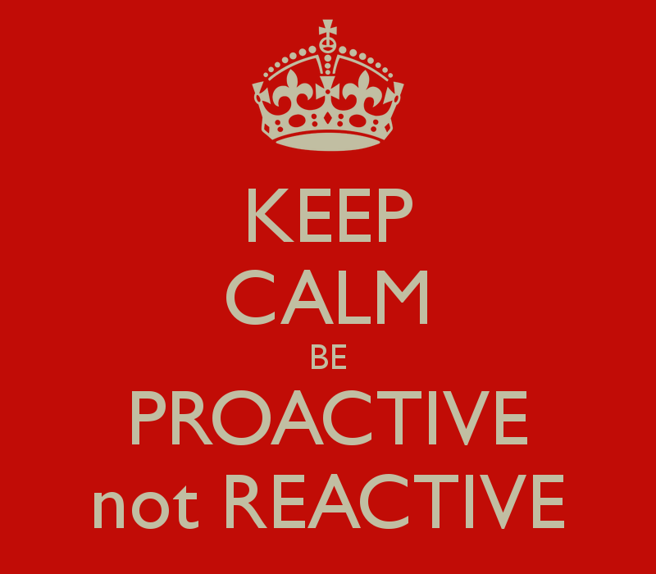
Product Security Program
Product Security Group
Agile SDL – Proactive
PSMM
PSIRT – Reactive

Slide 7

1. Who? – Product Security Group (PSG)
1.1 Product Security Architects (PSAs)
1.2 Product Security Champions (PSCs)
1.3 Others

Slide 8

1.1 Product Security Architects (PSAs)
Mentor
Technical activities
Operational activities

Slide 9

Mentor .
Security training
Bi-weekly technical roundtables
Empower PSC leads

Slide 10
Technical .
Technical
Security Requirements Plan / DoD
Security Architecture Review
Security Design Review
Threat Modeling
Security Testing
Static Analysis
Dynamic Analysis (Web Apps)
Fuzz Testing
Vulnerability Scan
Penetration Testing
Manual Code Review
Secure Coding Standards
Open Source and 3rd Party Libraries
License and Vendor Management
Privacy
Operating Environment
16 Technical SDL activities
Security architecture reviews
Threat modeling
Tools
{

Slide 11
Operational .
Operational
9 Operational SDL Activities
Manage satellite team
Program
SDL
PSIRT
Tools and Services
Resources
Policy and Compliance
Process
Training
Metrics

Slide 12

1.2 Product Security Champions (PSCs)
1 Per Product, Product Group, Solution, and GEO
Qualifications
Responsibilities
Solution
Solution
Product Group
Product Group
Product Group
Product
Product
Product
Product
Product
Product
Product
Product
Product

Slide 13

PSC Qualifications .
Enthusiastic
4+ Years experience
20% Time commitment
VP Engineering approval

Slide 14
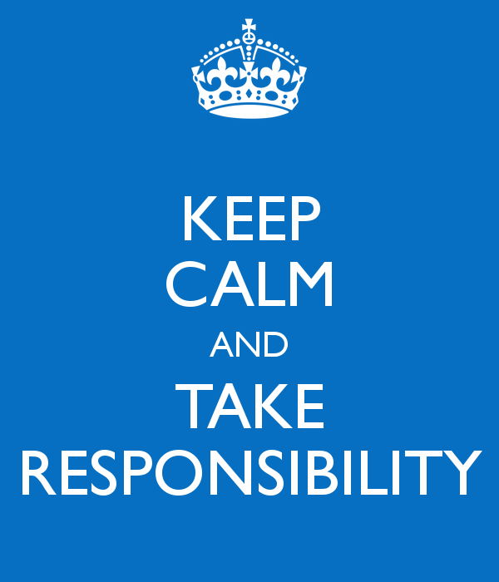
PSC Responsibilities .
Agile SDL activities
Incident response (PSIRT)
Attend meetings and training
Collocated in engineering teams

Slide 15

1.3 Other Team Contributors
Product Security Evangelists (PSEs)
Privacy
Extended team
  Public Relations (PR)
  Technical Support
  IT Security
  Learning
  Legal

Slide 16
2. Agile SDL Activities (What?)
Plan of
Intent
Mandatory
Conditional
Execution
Program
Backlog
Release
Quality
Increment
(PSI)
Finished
Product
Team
Backlog
Stories
Daily
Scrum
Investment Themes,
Epics (Viability,
Feasibility, Desirability)
Release
Planning
Sprint
Planning
Development
& Test
Sprint
Review &
Retrospective
Release to
Customer
1-4 Weeks
Develop on a Cadence, Release on Demand
Plan-Of-Intent
Checkpoint
Release Planning
Checkpoint
Sprint Planning
Checkpoint
Sprint / Release Readiness Checkpoint
Release Launch
Checkpoint

Slide 17
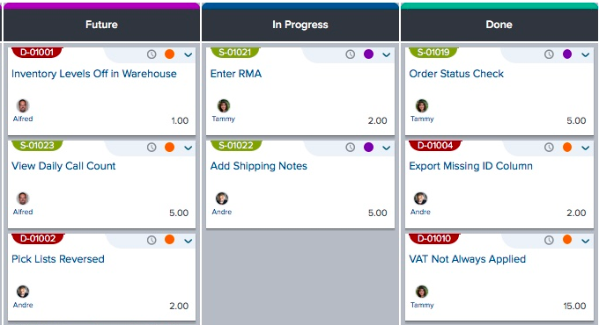

2.1 Mandatory SDL Activities .
1. Static Analysis
2. Manual Code Review
3. Privacy Review
4. Security Definition of Done
  Agile storyboard
5. 7 Key Questions

Slide 18

2.2 Conditional SDL Activities .
1. Release Scope
    Major, Minor, Patch, Hotfix
2. Architecture
    No change, Some change, Redesign, Greenfield
3. Using 3rd Party / Open Source Software
4. Hosting
    By us, By partner (SaaS)
5. Privacy
    Collecting customer data (PII)
6. Interfaces
    Web, Web Services, Non-Web
7. Releasing with an Operating System
7 Key Questions
7

Slide 19
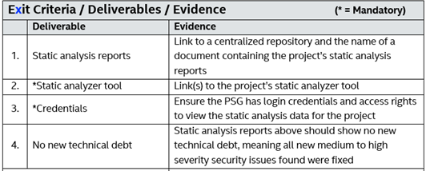
2.3 Execution
How?
  Templates
    Tasks
    Tools
    Resident experts
    Resources
When?
Why?

Slide 20
When? Technical Activities

Slide 21
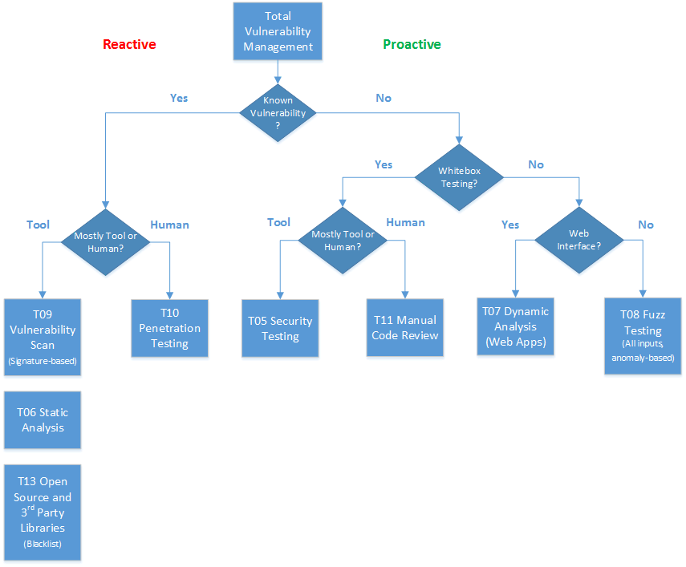
Why? VM Flowchart

Slide 22
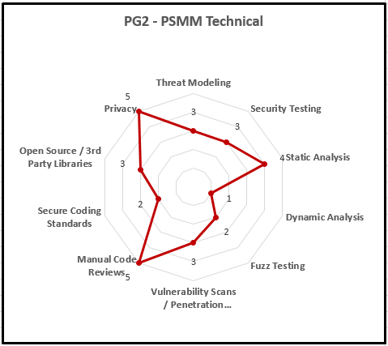

3. Product Security Maturity Model (PSMM) .
None, Minimal, Good, Better, Best
  Maturity levels
    0. None
    1. Basic
    2. Initial
    3. Acceptable
    4. Mature
  Math
Set team goal for each SDL activity
Measure 2x a year and report
$$(9+16)×4=100$$

Slide 23

4. PSIRT (Reactive)
Verify vulnerabilities
Patch within CVSS SLA
Publish security bulletin
Product Security Incident Response Team

Slide 24




4.1 Verify Vulnerabilities .
False alarms (apache/tomcat)
Real vulnerabilities
Cutely named vulnerabilities
  Heartbleed (OpenSSL)

Slide 25
4.2 Patch Within CVSS SLA .
Common Vulnerability Scoring System v3 (CVSS)
Service Level Agreement (SLA)
Low, Medium, High, Critical severity
Severity | CVSS Score | Max. Fix Time | Notification
P1 - Critical | 8.5-10.0 | 1-2 Days | ALERT
P2 - High | 7.0-8.4 | 1 Week | Notice
P3 - Medium | 4.0-6.9 | 1 Month | Notice
P4 - Low | 0.0-3.9 | 1-3 Quarters | Optional
P5 - Info | NA | NA | NA

Slide 26
4.3 Publish Security Bulletin .
SB – Security Bulletin
KB – KnowledgeBase article
SS – Sustaining Statement
NN – Not Needed or Release Notes
CVSS = 0 | 0 < CVSS < 4 Low | 4 ≤ CVSS < 7 Medium | 7 ≤ CVSS ≤ 10 High
NN SS KB (if lots of attention) | KB | SB + TXT Notice | SB + TXT Alert

Slide 27
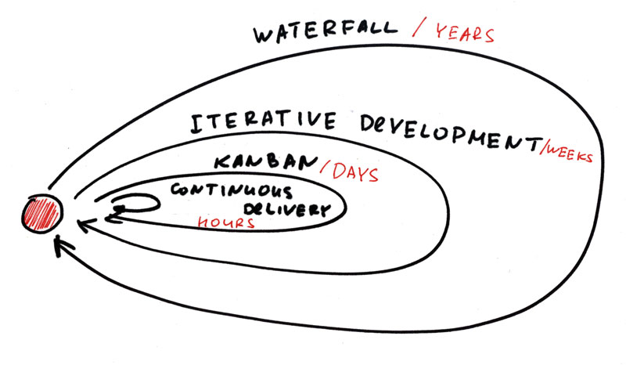
Challenges
Waterfall → Agile → Continuous
Tools
Skill levels
Legacy architectures
Technical debt
Getting to PSMM 4-Mature
PSIRT exponential growth

Slide 28
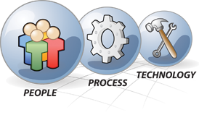
Experience - People
Identify the experts
    No one person can do it all
Trust the Product Security Champions (PSCs)
    They are smart and want to do what is right
    They balance security with their time, expertise, resources and schedule
Collaborate often
    Meet as PSCs weekly (business and technical)
    Use email PDLs
Don’t just train…mentor!
    Have an open door policy and help them to mature and grow

Slide 29
Experience - Process
Keep it flexible
    Don’t micro manage
    Don’t default to “all activities are mandatory”
We don’t need to write a 200 page book on each SDL activity
    Instead point engineers to the best material & BKMs
Some requirements are simply mandatory
    Filing exceptions for incomplete SDL activities or shipping with high severity vulnerabilities
    Blacklist for 3rd party components
    Security and privacy governance (SDL-Gov) audits
The Agile SDL and PSMM go hand-in-hand

Slide 30
Experience - Technology
  Purchase tools as one company
    Volume discounts, flexible license terms
  Human vs. Machine
    Some activities require much more human interaction than others
    Where possible, automate: “Make the computer do the work”
    Automation is required for successful continuous delivery
Bring the tools to the engineers
    Version One / JIRA Software vs. SharePoint
    Provide customized templates and real-world examples
Good tools can minimize exceptions
    It is hard to do fuzz testing without an easy to use tool with good content

Slide 31

Questions?
Harold Toomey
Sr. Product Security Architect & PSIRT Manager
Product Security Group
Intel Security (McAfee)
Harold.A.Toomey@Intel.com
W: (972) 963-7754
M: (801) 830-9987

Slide 32
Session Evaluation
ilnevents.intel.com
on your smartphone or computer

