Slide 1

Herding Cats and Security Tools
Harold Toomey
Product and Application Security
McAfee LLC
10 Nov 2017

Slide 2
Table of Contents
Cat Herding
Product & Application Security
Problem Statement
SDL Activities
Tool Integrations Diagrams
Disclaimer
Usage Scenarios
Considerations

Slide 3

Cat Herding
Notes:
The phrase herding cats comes from the common saying that something involving coordination of many different groups or people is as difficult as herding cats.

Slide 4
Product & Application Security
Product – Software developed by engineering BUs to sell to customers
Application – Software developed by IT Enterprise Applications team to run on company systems, websites, and servers
Primary difference is the target audience
  Customers (Public) - Full SDL
  External-Facing (Partners)
  Internal-Facing (Employees) - Minimal SDL

Slide 5
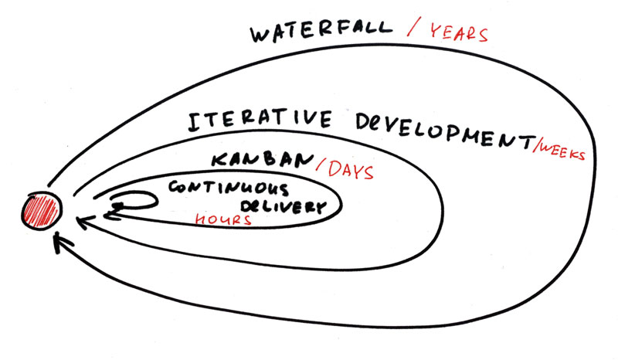
Current Trend
Waterfall → Agile → Continuous (CICD)

Slide 6
Problem Statement
CICD requires automation
Software developers want single place to go (ALM)
ALM
SDLC
SDL
SDL Activity
Entry Criteria
Tasks
Exit Criteria
ALM – Application Lifecycle Management
SDLC – Software Development Lifecycle
SDL – Security Development Lifecycle
Notes:
ALM – Application Lifecycle Management
SDLC – Software Development Lifecycle
SDL – Security Development Lifecycle
ALM vs. Software Development Life Cycle
ALM is a broader perspective than the Software Development Life Cycle (SDLC), which is limited to the phases of software development such as requirements, design, coding, testing, configuration, project management, and change management. ALM continues after development until the application is no longer used, and may span many SDLCs.

Slide 7
SDL – Operational Activities
Program
SDL
PSIRT
People & Resources
Tools & Services
Policy, Compliance, & Certifications
Training
Metrics
Maturity Models

Slide 8
SDL – Technical Activities
Security Definition of Done (DoD)
Security Architecture Review
Security Design Review
Threat Modeling
Security Testing & Validation
Static Analysis (SAST)
  Interactive Analysis (IAST)
Dynamic Analysis (DAST)
Fuzz Testing
Vulnerability Scan
Penetration Testing
Manual Code Review
Secure Coding Standards
Open Source & 3rd Party Libraries
Vendor Management
Privacy
Operating Environment
Notes:
Static Analysis (SAST) - White-box
Interactive Testing (IAST) – Grey-box
Dynamic Analysis (DAST) – Black-box

Slide 9
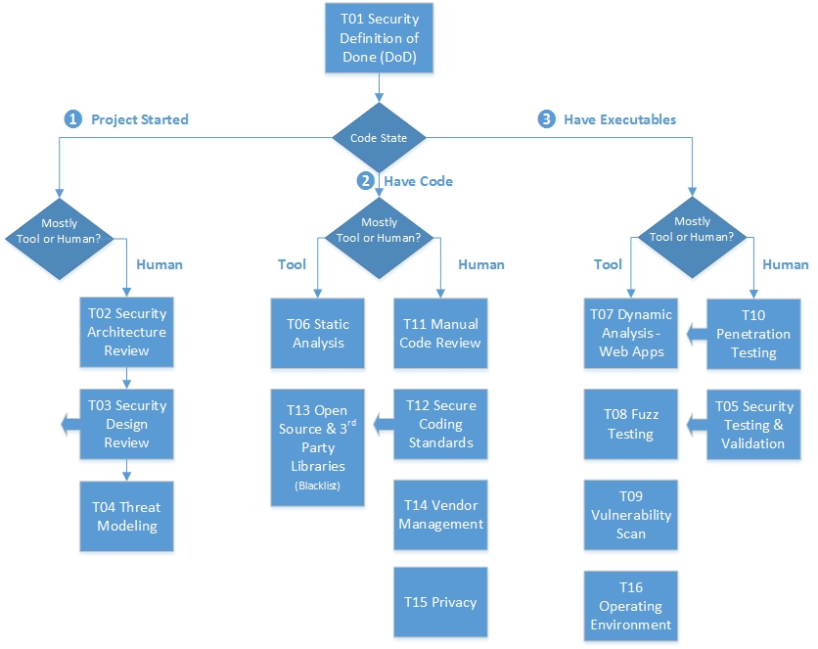
When to do the Technical Activities

Slide 10
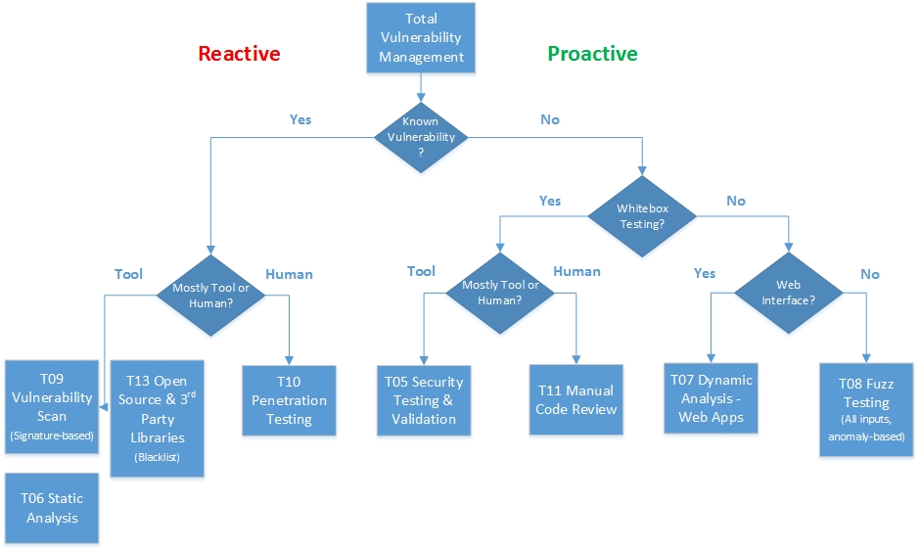
Why the Different Tools

Slide 11
Tools Integration – Generic
Flow Diagram Example

Slide 12
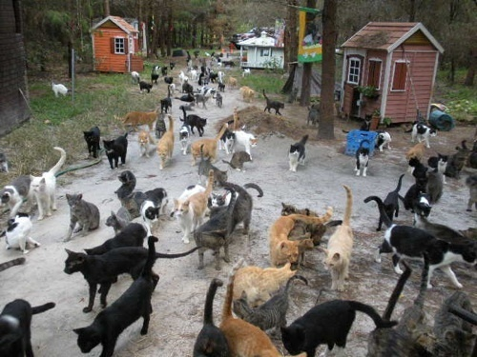
Herding Cats (Tools)

Slide 13
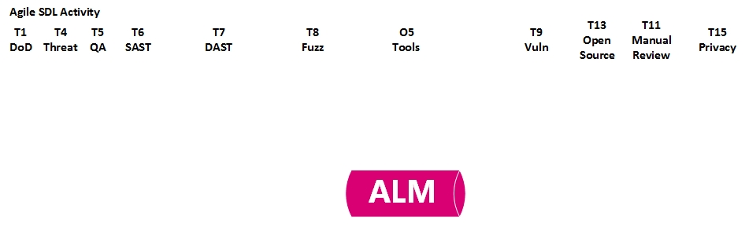

Slide 14
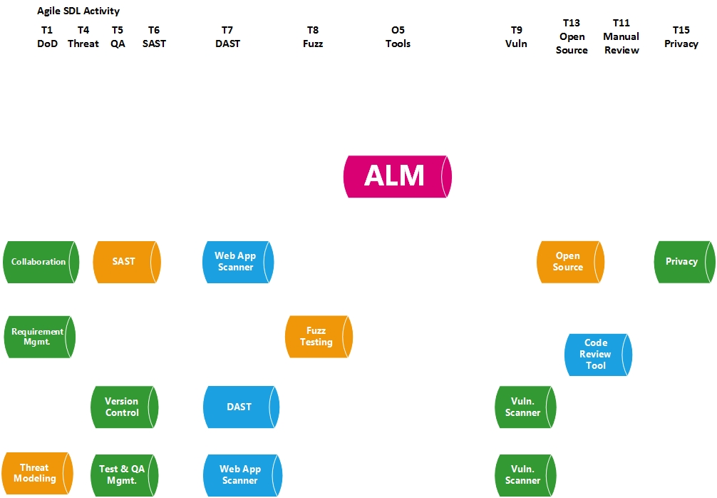

Slide 15
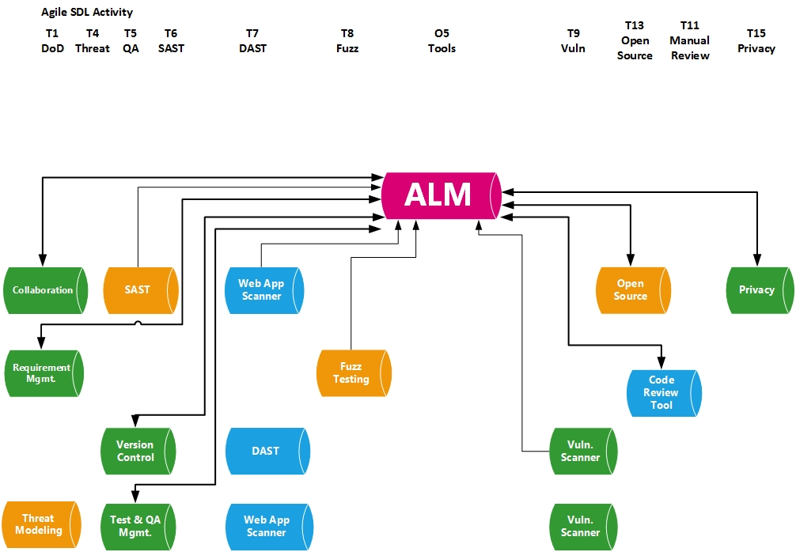

Slide 16
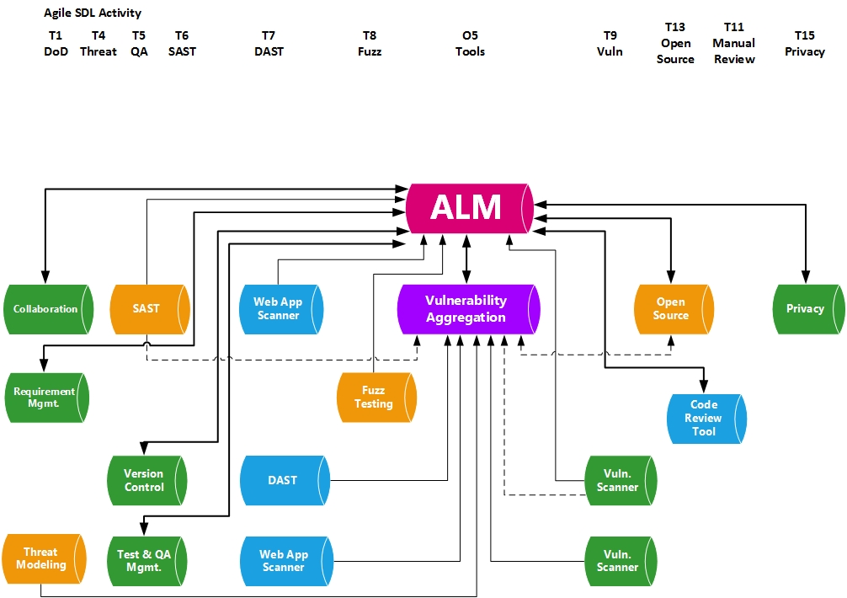

Slide 17
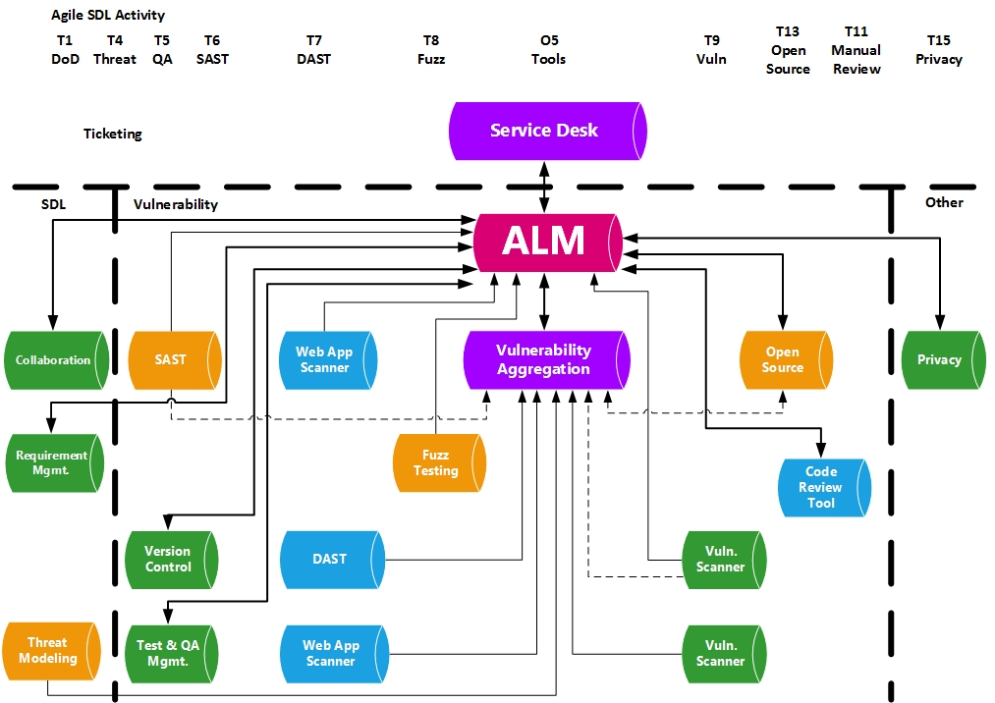
Solution

Slide 18

Disclaimer
Mention of vendor names and tools does not imply endorsement
Vendor list is intentionally incomplete
Based on my limited research
Best integration for me may not be best for you

Slide 19





ALMs

Slide 20
Tools Integration – Real Tools
Flow Diagram Examples

Slide 21
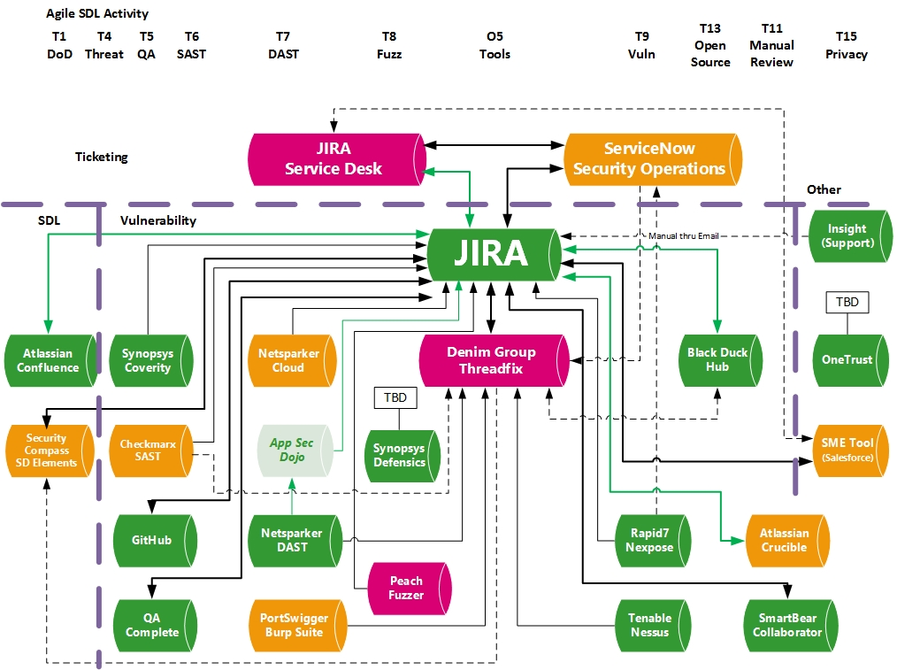
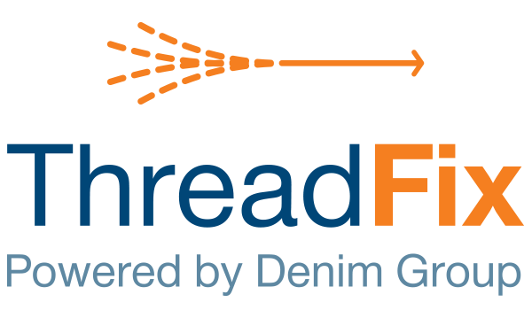

Slide 22
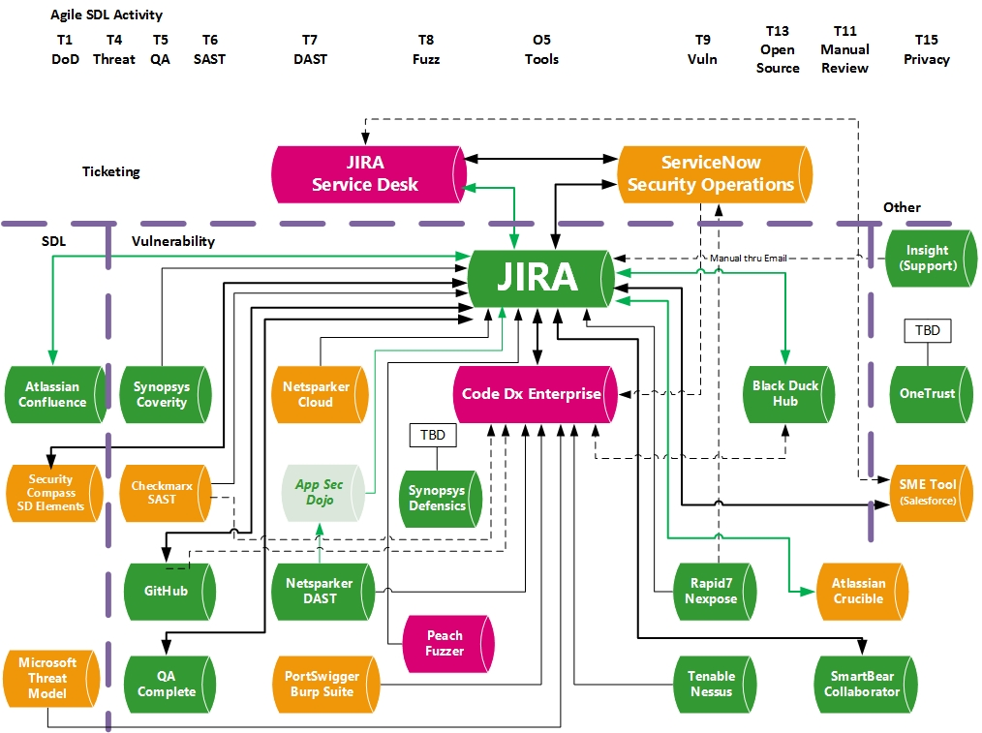


Slide 23





Scenario #1 – SDL Requirements
SW security requirements management
  Custom SDL, FedRAMP (NIST 800-53), GDPR
Use templates in ALM and/or
Use 3rd party tool with seamless bi-directional ALM integration
  SD Elements, HP ALM

Slide 24
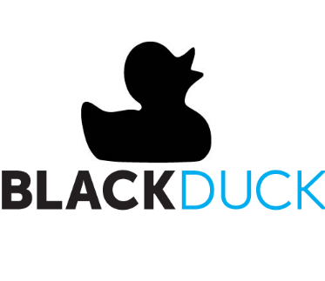

Scenario #2 – Vulnerabilities
Black Duck Hub identifies CVEs in open source
High severity CVEs are sent to JIRA
Engineer sees CVEs in project backlog and fixes
JIRA syncs back to Black Duck Hub and verifies fix

Slide 25

Considerations
Tool integration considerations
  Availability (Y/N)? When?
  Push, pull, both (bidirectional), or none?
  Native or through a 3rd party connector?
  Tight or loose integration?
  Server-side or client plugin?
  Ability to throttle? (high severity only)
  Cost?

Slide 26

Considerations
Business considerations
  Due diligence researched (all options)
  Integration with existing systems?
  Buy, build or use existing?
  When? This Fiscal Year, next FY?
  Who will use?
  Which BUs will purchase? (other benefactors)
  Who will install, host, and maintain?
  Who will configure and customize?

Slide 27
Considerations
Engineer considerations
  Does ALM contain all user stories?
    Insight manual integration (email)
  Ticketing system adds advanced workflow and SLA reminders
    Does it need to be engineer friendly or just tightly integrated with ALM?
  Data overload - throttle settings
    Issue severity: Critical, High, Medium, Low
    Business Impact vs. Risk score vs. CVSS v3 score

Slide 28

Questions?
Harold Toomey
Sr. Software Security Architect
Product & App. Security Group
McAfee LLC
Harold_Toomey@McAfee.com
W: (972) 963-7754
M: (801) 830-9987

Slide 29
Thank you
Collin College
North Texas ISSA (Information Systems Security Association)

